Slide 1


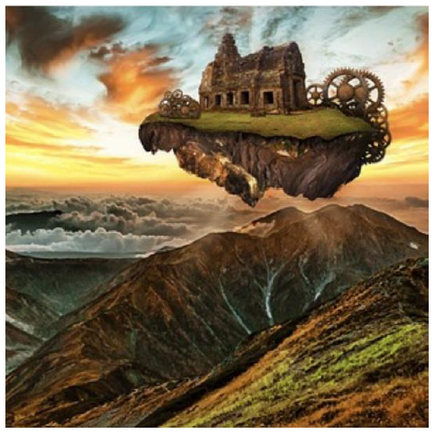



English
DATE
Picture Play
Floating Island

Slide 2

Activity 1
Have a look at the websites below to revise what expanded noun phrases, similes and metaphors.
Expanded noun phrases:
https://www.bbc.co.uk/bitesize/topics/zwwp8mn/articles/z3nfw6f
Similes and metaphors:
https://www.bbc.co.uk/bitesize/topics/zfkk7ty/articles/z9tkxfr

Slide 3
Activity 2
Picture Play
Look at the image to the right.
If you were on the floating island, what could you see? Write a description that tells your reader about:
a) your immediate surroundings including the building and machinery
b) the sky and weather above you
c) the mountains and valleys below.
Think about how you can use your senses in your description.
Try to create atmosphere by using noun phrases, similes and effective verbs.

Slide 4
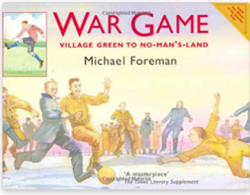
War Game by Michael Foreman
Now, you can listen to Mrs Whittingham finish reading War Game.

