Slide 1



English
Year 2 Swallows Class
Thursday 14th January 2021

Slide 2
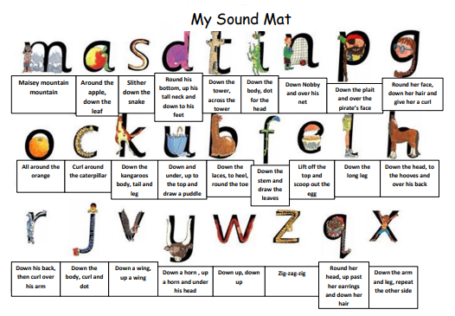

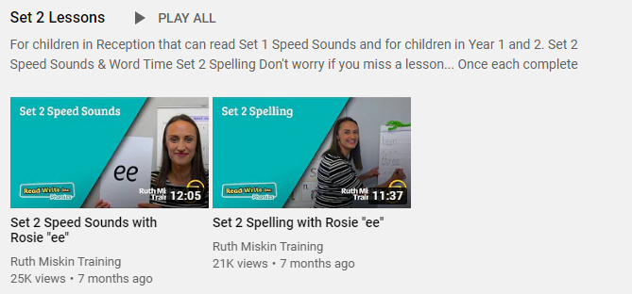
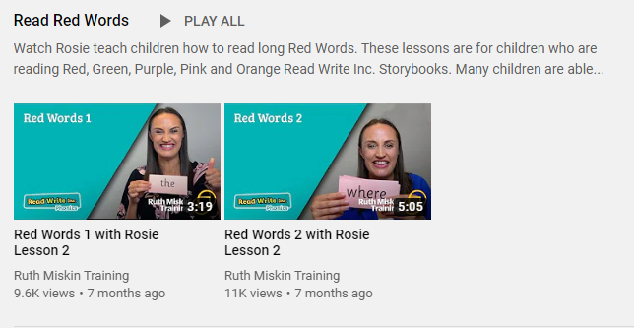
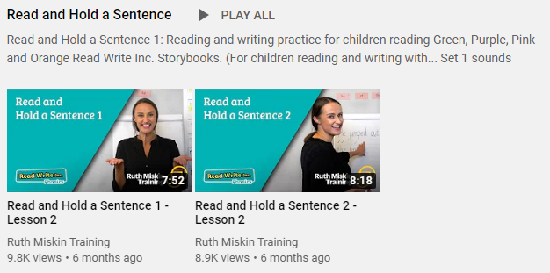
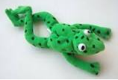
Read Write Inc
Set 2
If you are currently reading green books, please follow the link below to your Read Write Inc lesson today. Each day you will need to click on the video’s shown in the screen shots below. Please remember that although the screen shot says /ee/, the sound will change each day but will be found in the same place. https://www.youtube.com/channel/UCo7fbLgY2oA_cFCIg9GdxtQ
Video 1: Please watch ‘Set 2 Speed sound’ lesson.
Video 2: Please watch ‘Set 2 Spelling’ lesson.
Please complete all 4 video’s each day ☺
Video 3: Please watch ‘Red words 1’ lesson only.
Video 4: Please watch ‘Read and Hold a sentence 1’

Slide 3
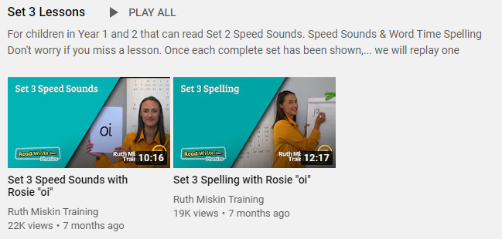
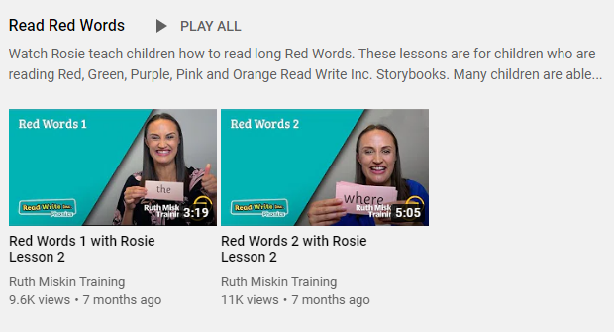
Set 3
If you are currently reading pink, orange, yellow, blue or grey books, please follow the links below to your Speed Sound lesson, red word focus lesson and hold a sentence activity for today. Each day you will need to click on the video’s shown in the screen shots below. Please remember that although the screen shot says /ee/, the sound will change each day but will be found in the same place. https://www.youtube.com/channel/UCo7fbLgY2oA_cFCIg9GdxtQ
Video 1: Please watch ‘Set 3 Speed sound’ lesson.
Video 2: Please watch ‘Set 3 Spelling’ lesson.
Video 3: Please watch ‘Red words 2’ lesson only.
Video 4: Please watch ‘Read and Hold a sentence 2’

Slide 4
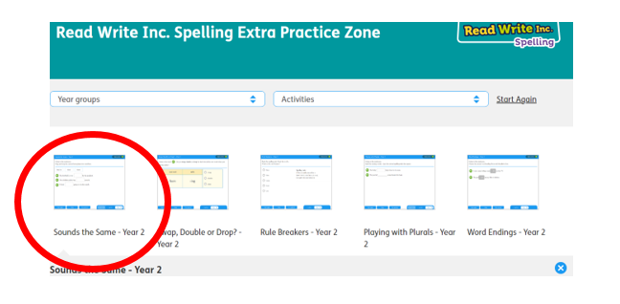
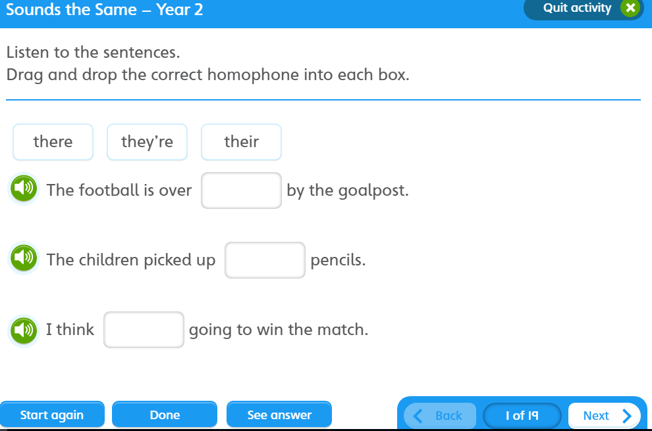

https://www.oxfordowl.co.uk/for-pupils/pupil-home?current_page=home
Username: starlings1 Password: Home
Sounds the Same

Slide 5

Writing
Can I read and understand the text, answering questions to show what I have found out?

Slide 6
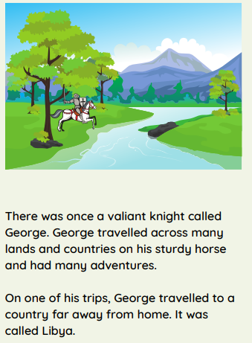

Slide 7
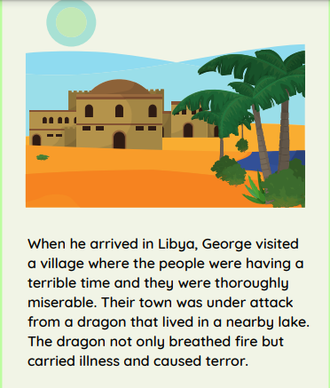

Slide 8
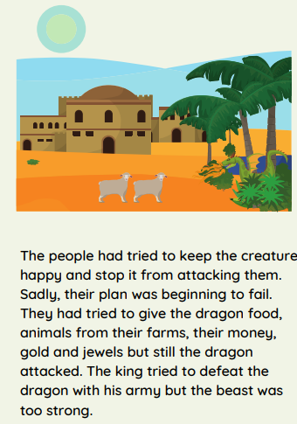

Slide 9
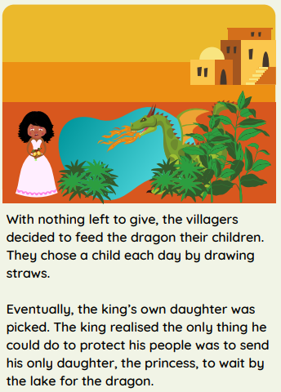

Slide 10
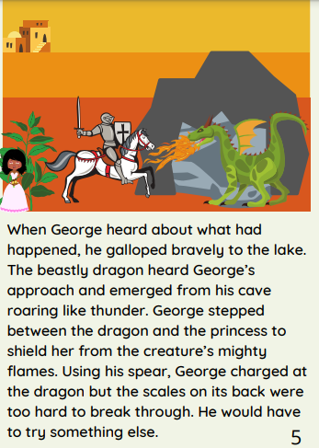

Slide 11
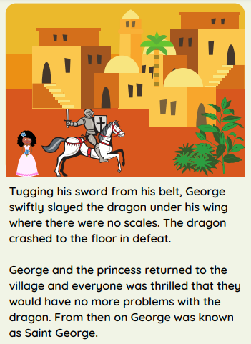

Slide 12
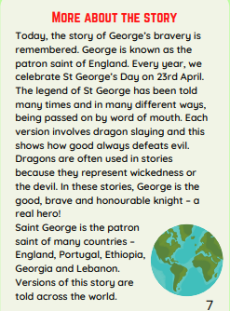

Slide 13
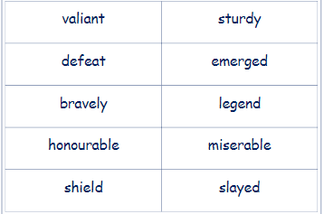
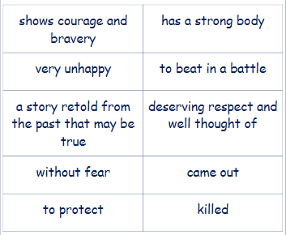
Can you match the word to the definition?

Slide 14
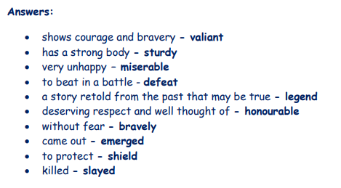

Slide 15
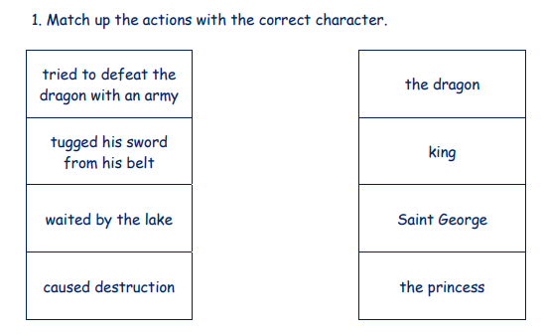
Task

Slide 16
Answers

Slide 17
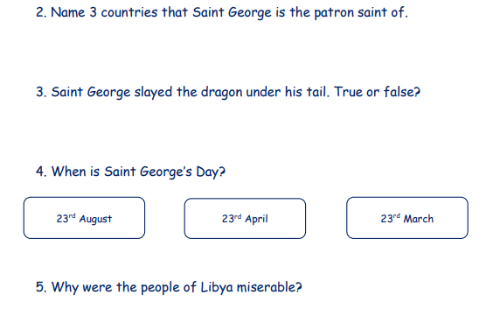
Task
Can you answer the questions below?

Slide 18

The people of Libya were miserable because ______________________________________________________

Slide 19
Answers
England Portugal Ethiopia Georgia or Lebanon
False
It was under his wing.
The people of Libya were miserable because their town was under attack from a dragon.

Slide 20





1 2 3
Well done
ME

Slide 21


Why did Alice and Jago burst into tears?
What did Granny see out of the window?
What did Mutt have as a special treat?
Did you enjoy our story? What was your favourite part?
Author: Michael Morpurgo
Illustrator: Sam Usher
Publisher: Barrington Stoke

Slide 22

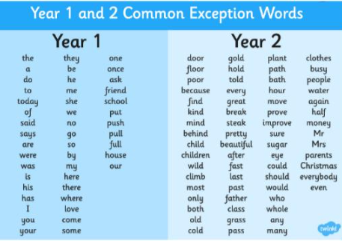
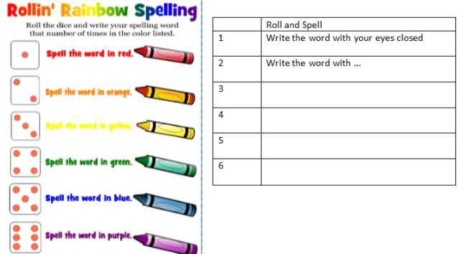
Spellings
Can you read and spell the words below?
class grass pass plant path

