Slide 1








Maths
Year Two Swallows
Thursday 14th January 2021

Slide 2
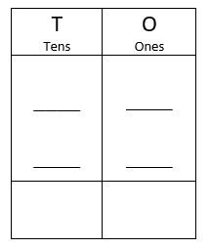
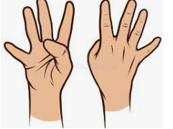
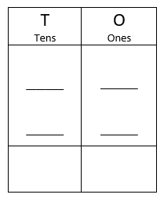
4 A Day
71 + 10 = | 92 –30 =
8 x 10 = | 50 ÷ 10 =

Slide 3
Answers
71 + 10 = 81 | 92 –30 = 62
8 x 10 = 80 | 50 ÷ 10 = 5

Slide 4
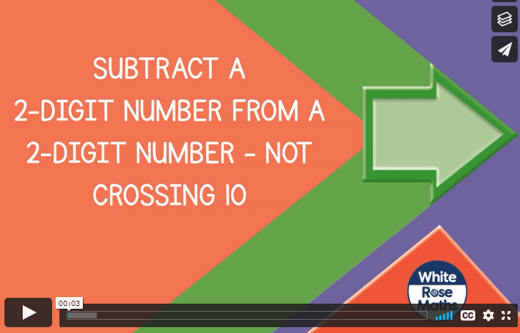
Can I subtract 2-digit numbers?
https://vimeo.com/468561808
Knkkkkkkkkkkkkkk kkVideo

Slide 5
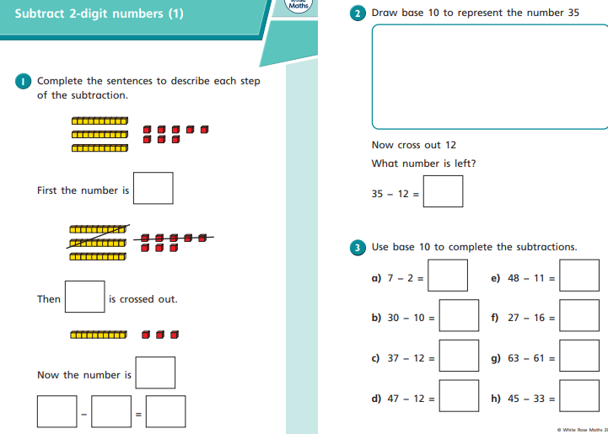
Your Turn

Slide 6
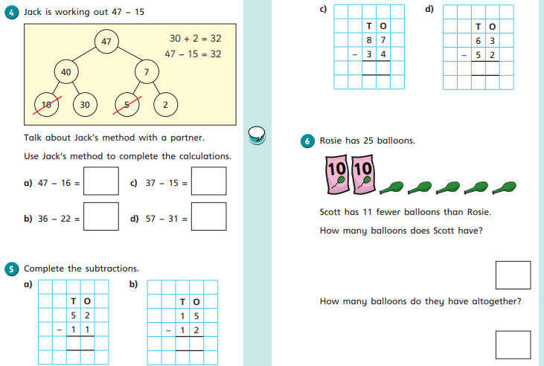
Your Turn

Slide 7
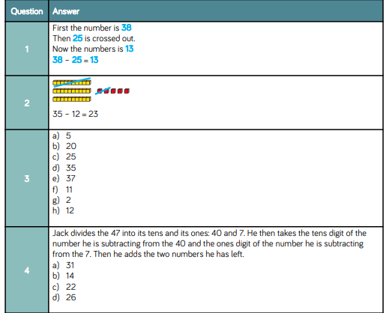
Answers

Slide 8
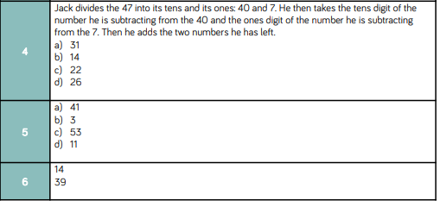
Answers

Slide 9
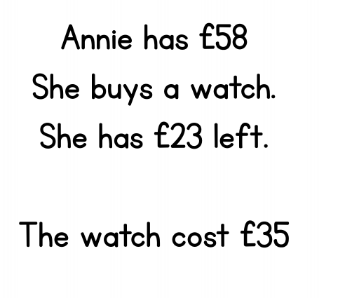
Optional Challenge
True or False?

Slide 10
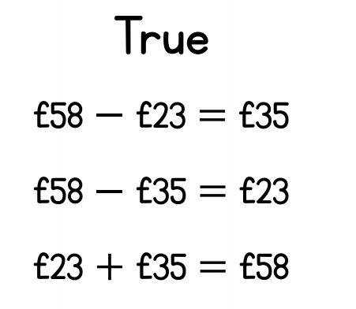
Optional Challenge
True or False?
Can you check your answers by calculating £58 – 35?
So if we had £23 left and we spent £35, we could add them together to check our answers too. Does it equal 58?

Slide 11


