Slide 1




Thursday 14th January 2021
Writing

Slide 2
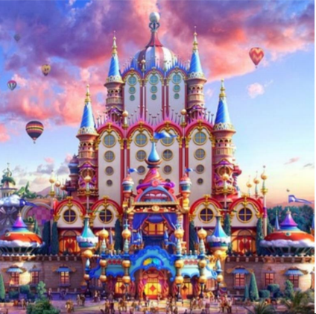

Wow, what a beautiful picture Robins! I’ve even changed the colour of my dashes (usually I go for red) to fit in with the vibrant colours in the picture!
I’d like you to write a description of this place. If you were there (I wish I was!) what could you see? Tell me about this spectacular building. What is it?
What is happening outside?
Think about how you could use your senses in this description. So what could you see, hear, smell and how were you feeling?
We have written lots of different types of descriptions about our senses now, you did it in the Piper AND the Lighthouse Keeper diaries.
Remember to add detail about the weather as this enhances your description. You may mention the sun, wind, clouds…

Slide 3

Description Checklist
1
2
Noun phrases, exciting vocabulary please (the elegant, pointy towers)
Adverbs (tell me how a verb is done, ends with the suffix ly eg happily)
Prepositions of time (tell me when something happened eg shortly after)
Prepositions of place (tell me where something happened eg opposite, beside)
Conjunctions (and, but, or, because, however, so…)
A little mention of the weather
How do you feel when you are there?
What can you see, hear and smell?
What are other people doing/feeling?
Smart, joined handwriting please!

Slide 4
My Turn
I did not know what to look at first because I was opposite the most glamorous building that my eyes had ever seen. Every colour of the rainbow was sparkling in the warm sun as I squinted my eyes to observe the rounded dome more closely. I felt ecstatic and in awe of this breath taking castle. Each pointy tower stood proudly against the pastel coloured sky that was filled with floating hot air balloons. Where were they going I wondered? I particularly liked the wide variety of shapes in the castle, the circular windows and golden spheres were my favourite. Excitement filled the air as shiny trumpets played joyfully and a giddy crowd gathered behind me to wait for the Royal Family to appear .

