Slide 1


English
Date: 13.01.21
Week 2 – Lesson 3
The Lighthouse – Diary Entry

Slide 2

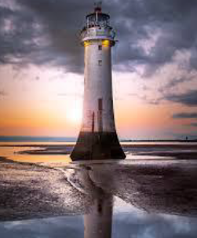
Click on the sound button to hear your first instruction.
Watch this video called: ‘Lighthouse’: https://www.youtube.com/watch?v=6HfBbSUORvo&t=11s

Slide 3
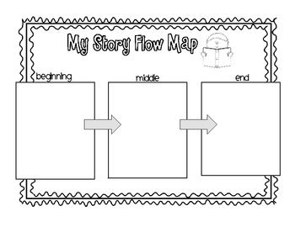
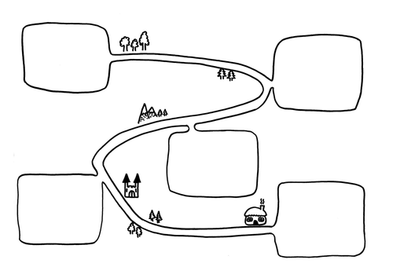

Activity 1
Click on the sound button to hear activity 1 explained to you.
Create a timeline or story map of what happened in the video.
(Like the story map we created for Annie Edson Taylor’s journey along the river)
Remember the events must be written in chronological order.
You might need to watch the video again to help you. I recommend pausing the video throughout and recording each event one at a time.

Slide 4
Activity 2
Click on the sound button to hear activity 2 explained to you.
Imagine you are the lighthouse keeper and write a diary entry explaining what happened on that night. Use your story map to help you.
Think about:
Describing in detail what he saw and what happened
How he was feeling
Why he was worried when the light went out
Move to the next slide to read a WAGOLL (what a good one looks like)

Slide 5
Click on the sound button to hear the WAGOLL read to you.
Dear Diary…
You won’t believe what happened last night! While on duty in the lighthouse, I could hear the busy town below. The chanting and bellowing was getting louder and louder and I couldn’t concentrate on my work. With frustration, I slammed the window shut.
All of a sudden, I heard an unfamiliar noise and then darkness! The light had gone out! Frantically, I followed the creaking and crashing until it led me to the control room.
When I reached the top, my worst nightmare had come true…

Slide 6



