Slide 1


Mathematics
Date: 13.01.21
Week 2 – Lesson 3
Inverse Operations

Slide 2
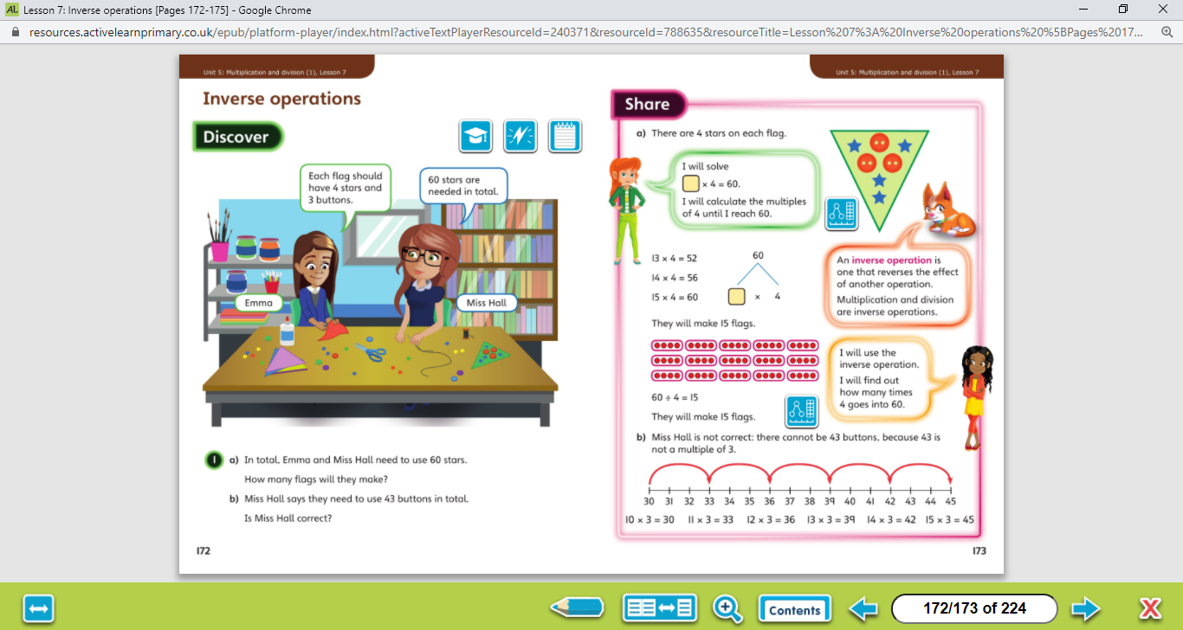

Let’s work together!
Look at the picture clue. What can you see?
Have a look at the questions.
Click on the sound button below to hear the questions read to you. We will also talk through the questions together like we do in school.
We will go through the possible methods and answers on the next slide.

Slide 3
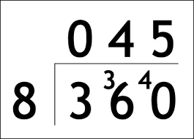
Let’s work together!
Click on the sound button below to hear the answers and possible methods for question A.
Click on the sound button below to hear the answers and possible methods for question B.
Bus stop method reminder:

Slide 4
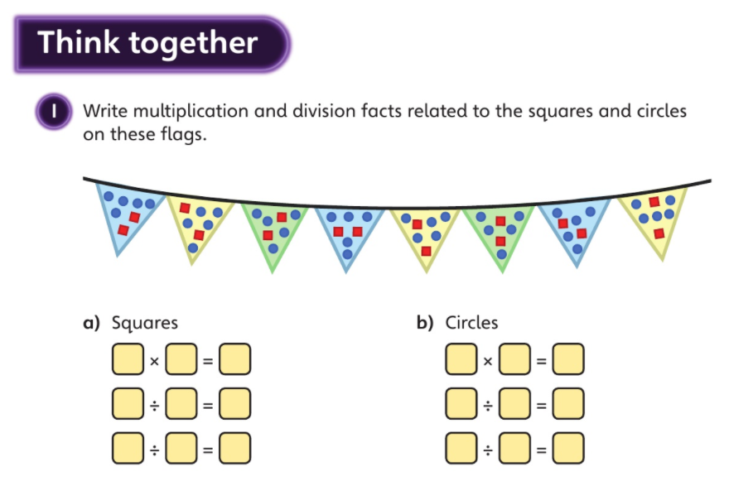
Click on the sound button below to hear the question read to you. We will work together to reach the answer.
Let’s work together!
When dividing, you must always start with the product (answer) of the multiplication.
8
2
16
16
2
8
16
8
2
Click on the sound button below to hear the answers.

Slide 5
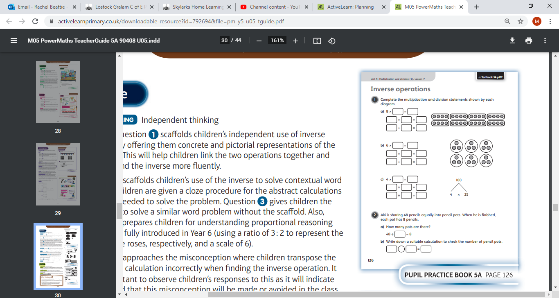
Your Turn…
Have a go at these questions independently. Click on the button below if you would like the questions read to you.
Click to the next slide to hear the answers.

Slide 6
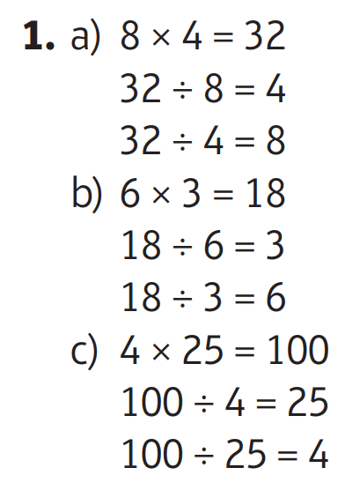
Your Turn…
Click on the sound button below to hear the answers to question 1.

Slide 7
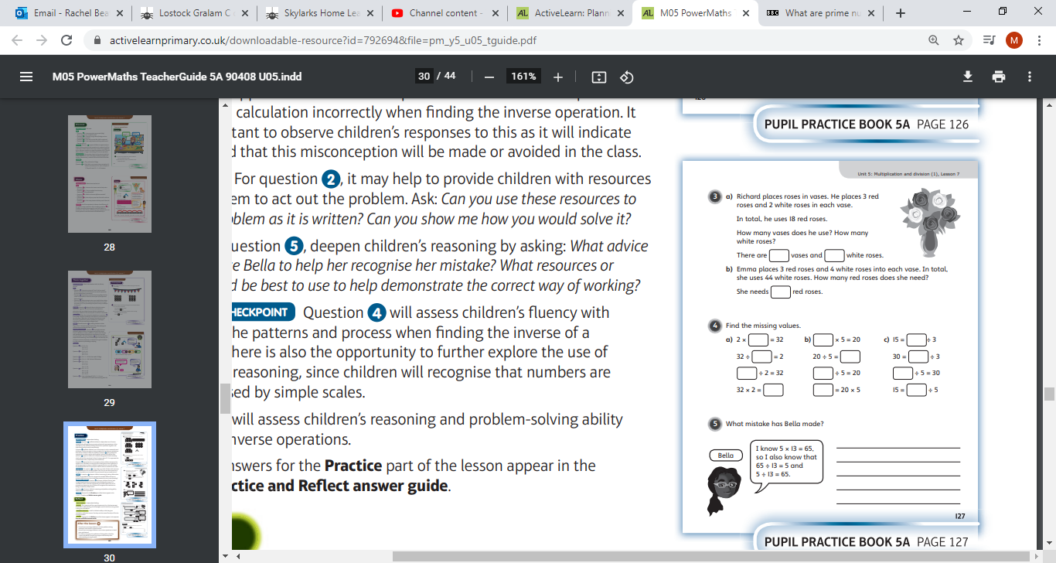
Your Turn…
Have a go at these questions independently. Click on the button below if you would like the questions read to you.
Click on the sound button below to hear the answers.

Slide 8
Your Turn…
Have a go at these questions independently. Click on the button below if you would like the questions read to you.
Click on to the next slide to hear the answers.

Slide 9
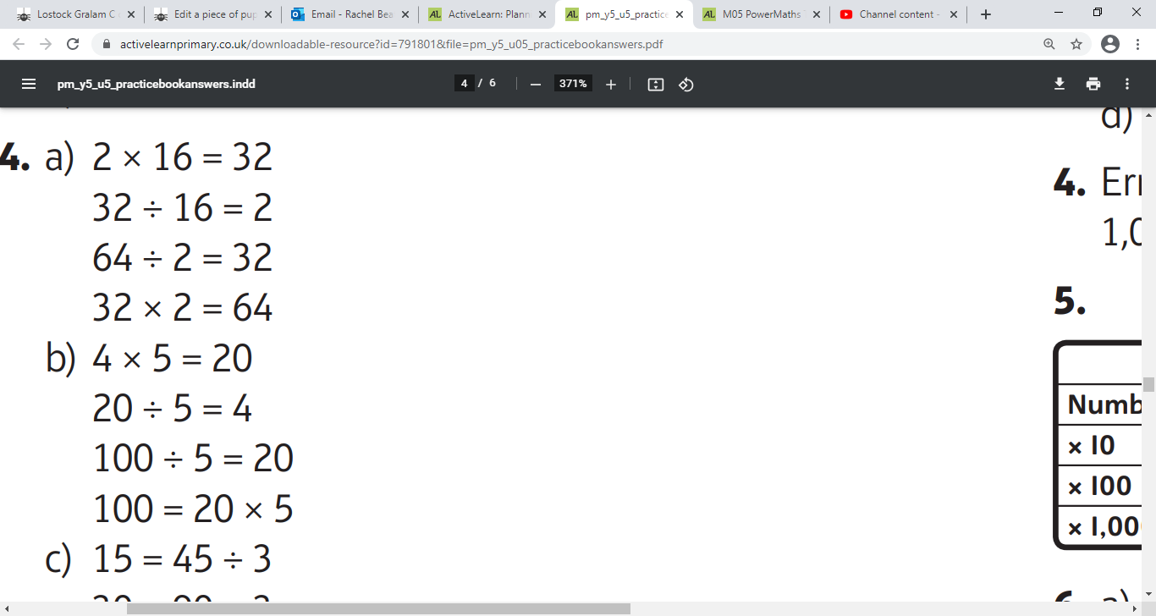
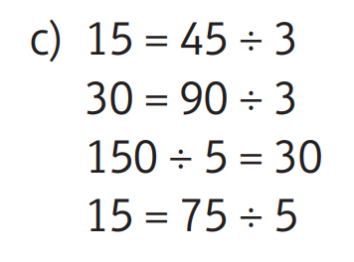
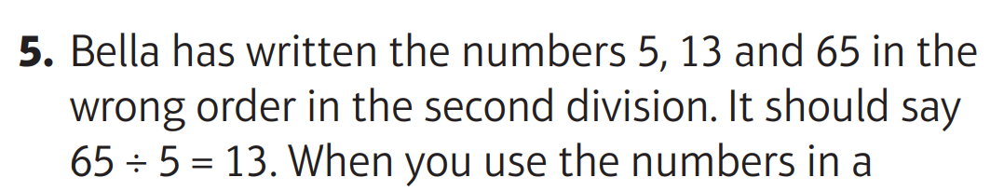
Your Turn…
Click on the sound button to hear the answers for questions 4 and 5.

Slide 10
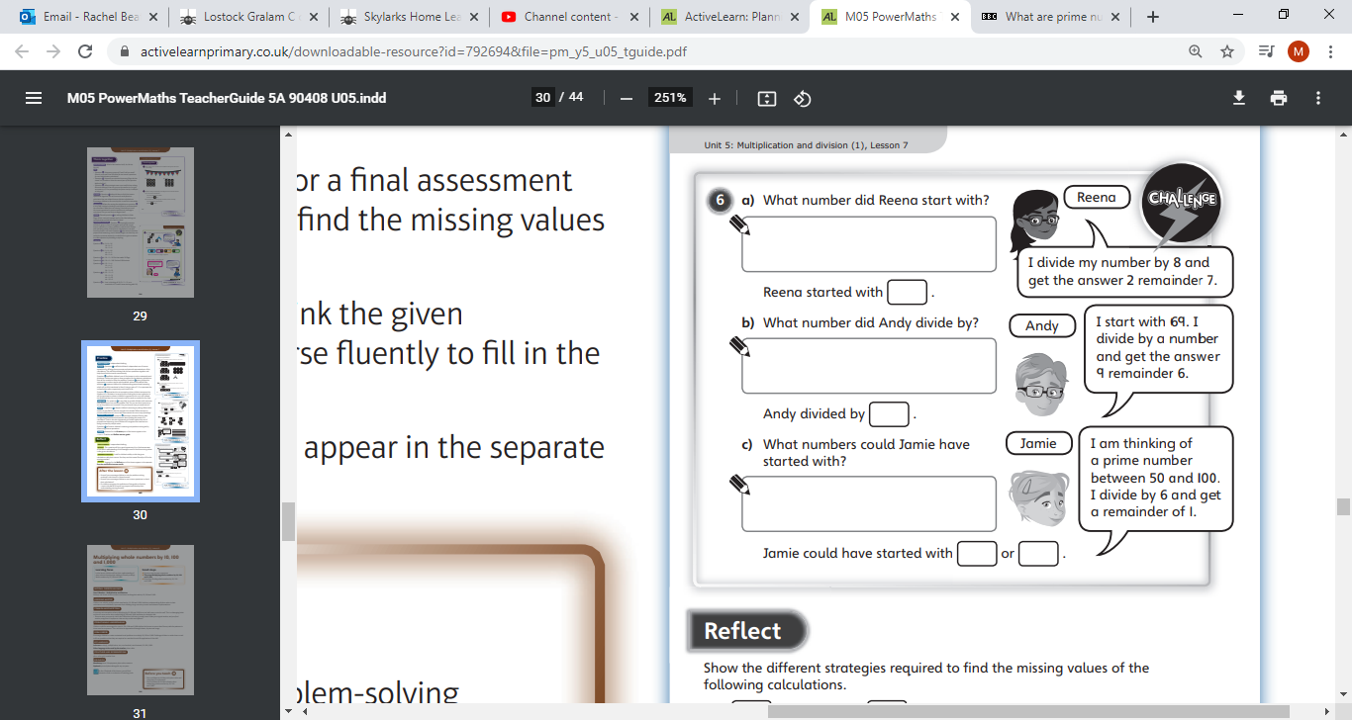
Challenge Time!
Only try this question if you are feeling confident ☺
Your Turn…
Click on the button below if you would like the question read to you.
Click on the button below to hear the answer.

