Slide 1



English
Year 2 Swallows Class
Wednesday 13th January 2021

Slide 2
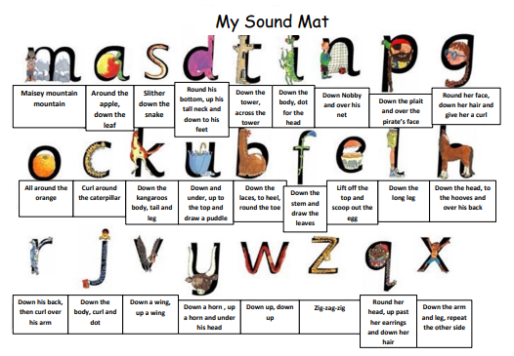

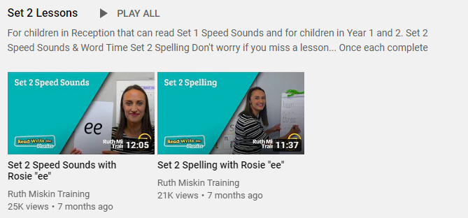
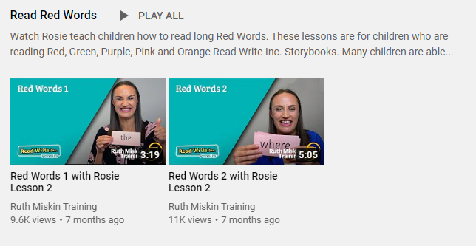
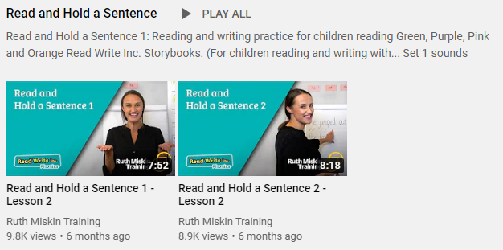
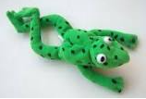
Read Write Inc
Set 2
If you are currently reading green books, please follow the link below to your Read Write Inc lesson today. Each day you will need to click on the video’s shown in the screen shots below. Please remember that although the screen shot says /ee/, the sound will change each day but will be found in the same place. https://www.youtube.com/channel/UCo7fbLgY2oA_cFCIg9GdxtQ
Video 1: Please watch ‘Set 2 Speed sound’ lesson.
Video 2: Please watch ‘Set 2 Spelling’ lesson.
Please complete all 4 video’s each day ☺
Video 3: Please watch ‘Red words 1’ lesson only.
Video 4: Please watch ‘Read and Hold a sentence 1’

Slide 3
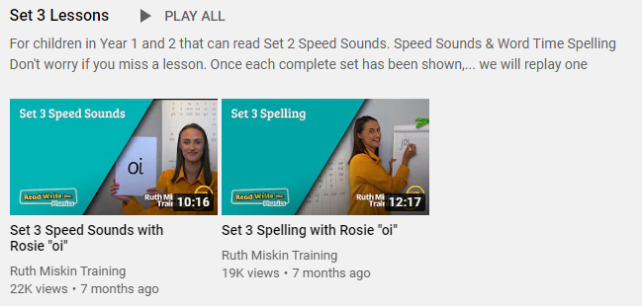
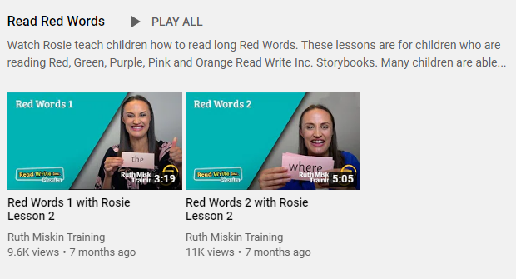
Set 3
If you are currently reading pink, orange, yellow, blue or grey books, please follow the links below to your Speed Sound lesson, red word focus lesson and hold a sentence activity for today. Each day you will need to click on the video’s shown in the screen shots below. Please remember that although the screen shot says /ee/, the sound will change each day but will be found in the same place. https://www.youtube.com/channel/UCo7fbLgY2oA_cFCIg9GdxtQ
Video 1: Please watch ‘Set 3 Speed sound’ lesson.
Video 2: Please watch ‘Set 3 Spelling’ lesson.
Video 3: Please watch ‘Red words 2’ lesson only.
Video 4: Please watch ‘Read and Hold a sentence 2’

Slide 4
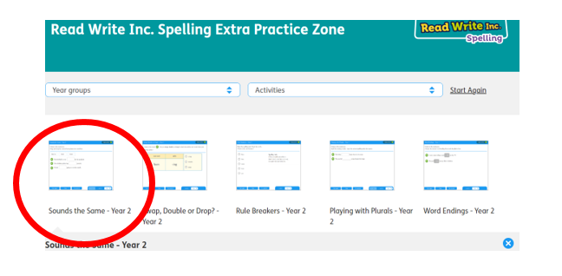
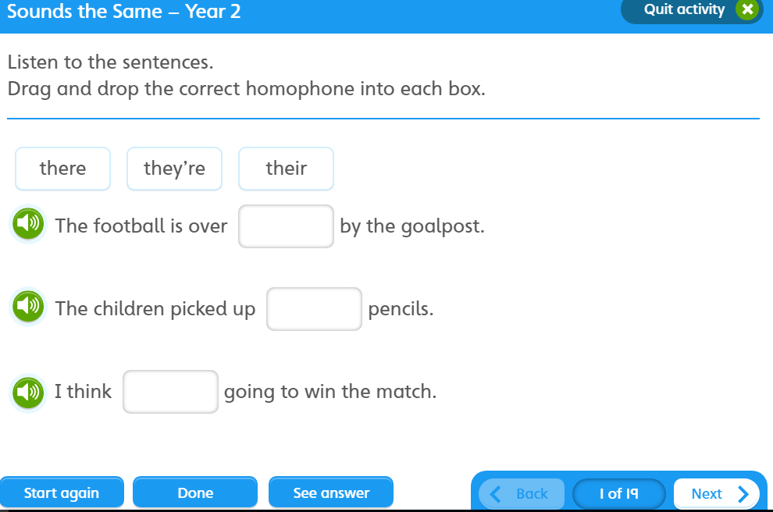

https://www.oxfordowl.co.uk/for-pupils/pupil-home?current_page=home
Username: starlings1 Password: Home
Sounds the Same

Slide 5

Writing
Can I understand the vocabulary used in Saint George and the Dragon?

Slide 6
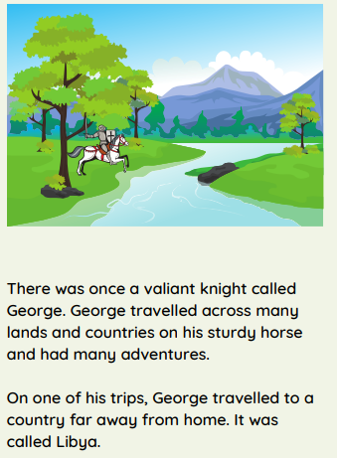

Slide 7
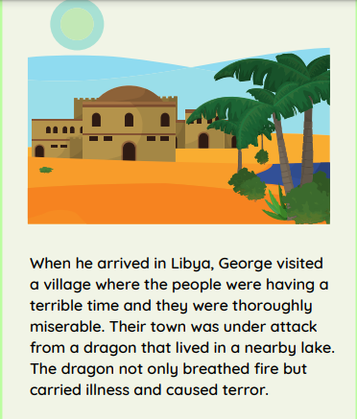

Slide 8
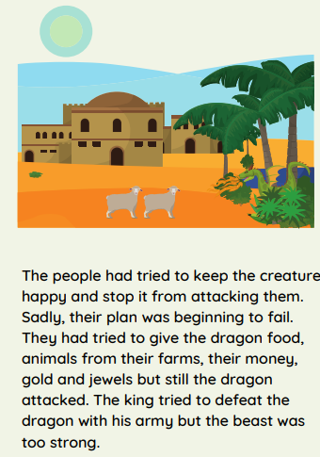

Slide 9
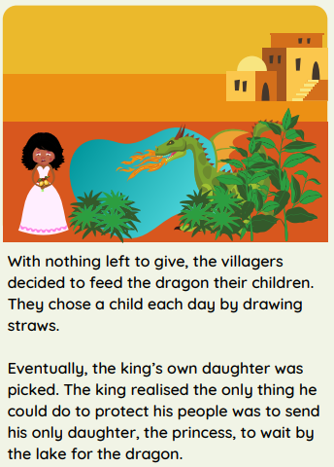

Slide 10
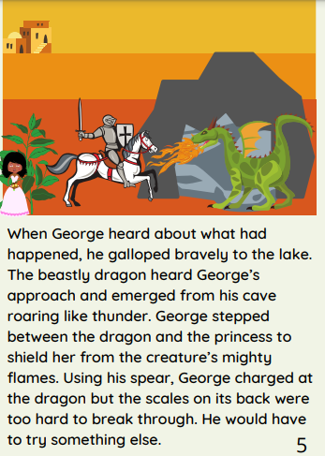

Slide 11
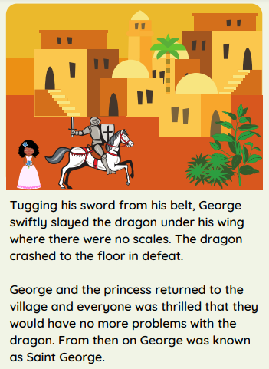

Slide 12
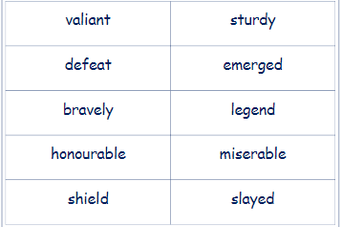
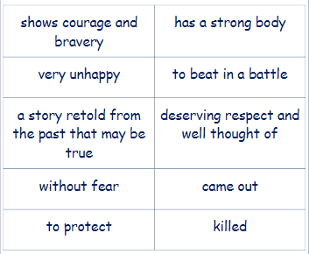
Can you match the word to the definition?

Slide 13
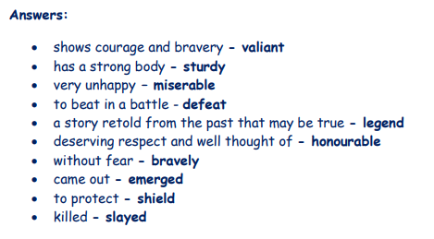

Slide 14
Task
Can you use our new vocabulary in your own sentences?

Slide 15

I bravely picked up the huge hairy spider and threw it out of the window.

Slide 16


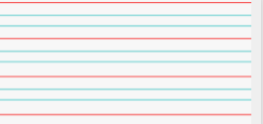
Can you re-read what you have written to check that it makes sense?
Conjunction - and
Adjectives
Joined handwriting

Slide 17


What happened when Mutt put his paw inside the carton?
What did Mutt chase? Why?
Will Alice and Jago be pleased? Why not?
I wonder what will happen next in our story…
Author: Michael Morpurgo
Illustrator: Sam Usher
Publisher: Barrington Stoke

Slide 18

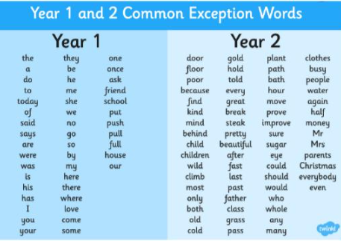
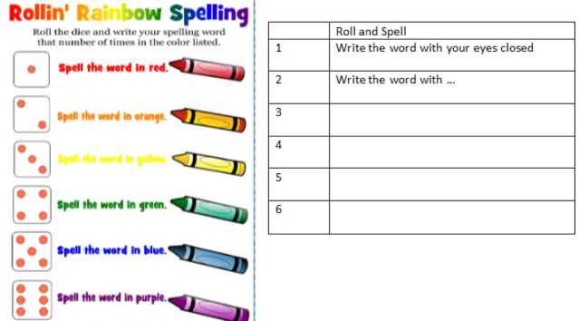
Spellings
Can you read and spell the words below?
class grass pass plant path

Slide 19
