Slide 1




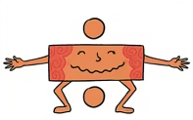


Maths
Year Two Swallows
Wednesday 13th January 2021

Slide 2
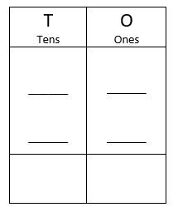
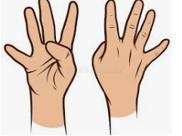
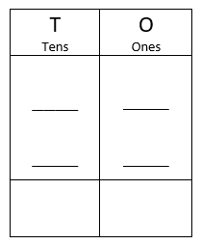
4 A Day
60 + 30 = | 70 –50 =
4 x 10 = | 40 ÷ 10 =

Slide 3
Answers
60 + 30 = 90 | 70 –50 = 20
4 x 10 = 40 | 40 ÷ 10 = 4

Slide 4
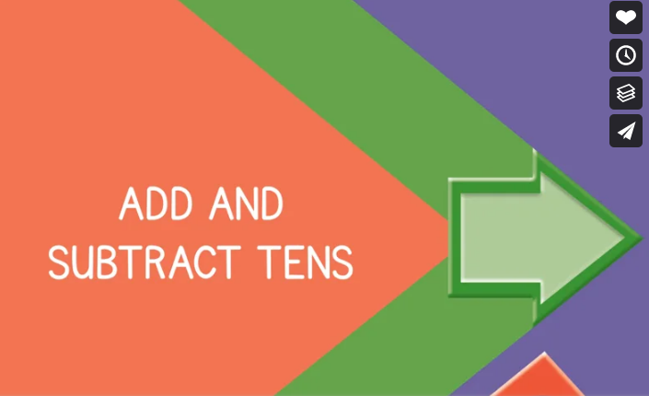
Can I add and subtract tens?
https://vimeo.com/464237963
Knkkkkkkkkkkkkkk kkVideo

Slide 5
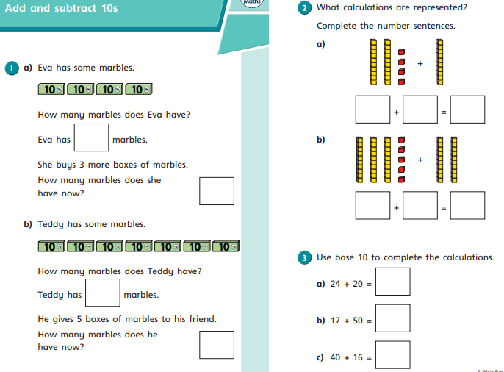
Your Turn

Slide 6
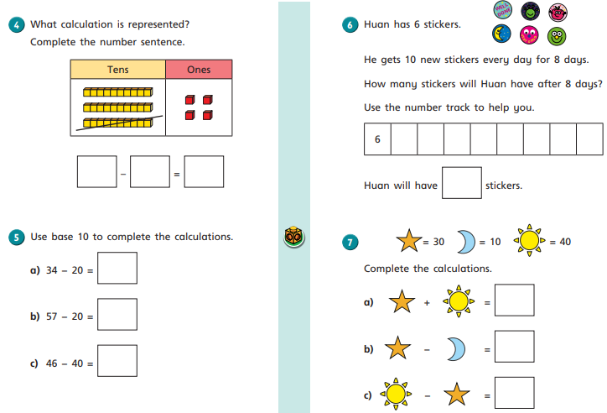
Your Turn

Slide 7
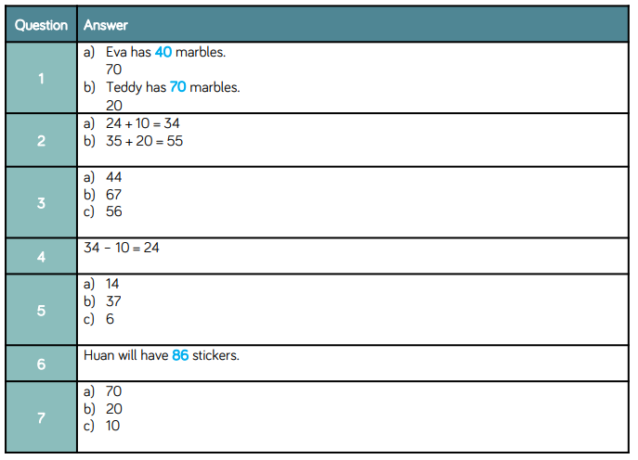
Answers

Slide 8
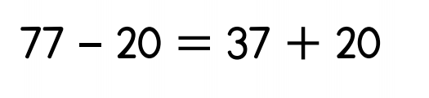
Optional Challenge
True or False?

Slide 9
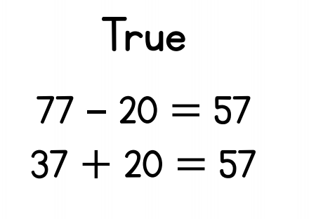
Optional Challenge
True or False?

