Slide 1



Wednesday 13 January 2021
Please follow this link to watch the video lesson for today as we add 3 digit and 2 digit numbers crossing the 100 boundary! Wow, how clever we are!
https://vimeo.com/461794950

Slide 2
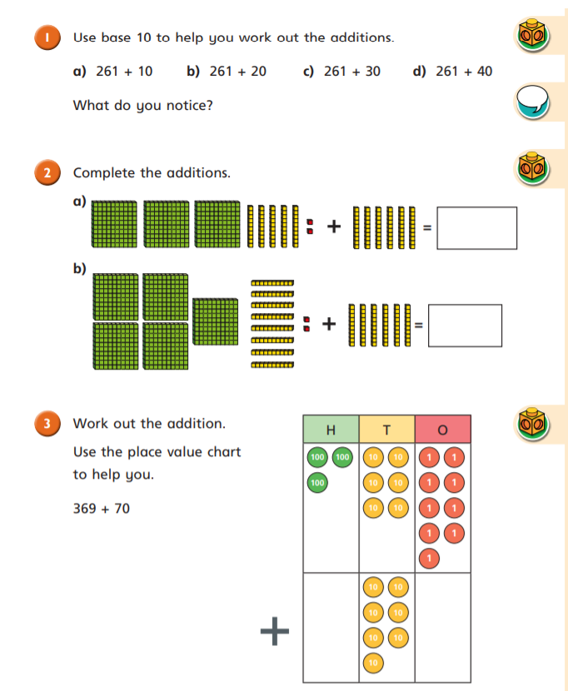
Remember that although you do not have Base 10 equipment at home, you can draw the 100 blocks, ten rods and ones cubes on paper like we do at school to help you.

Slide 3
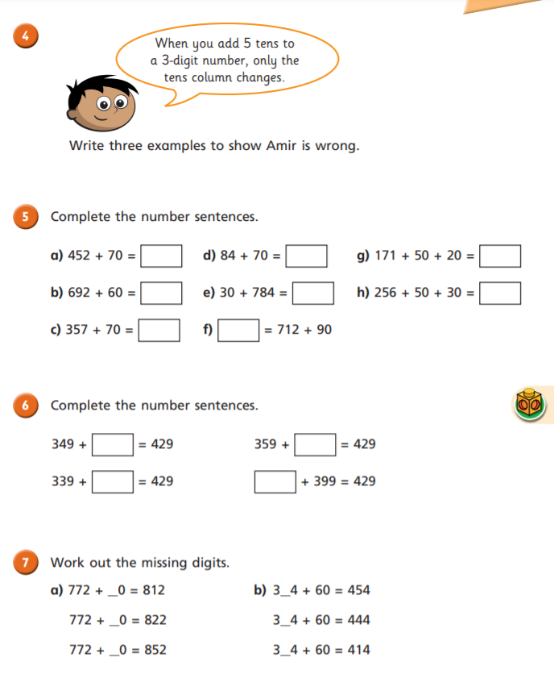

Slide 4
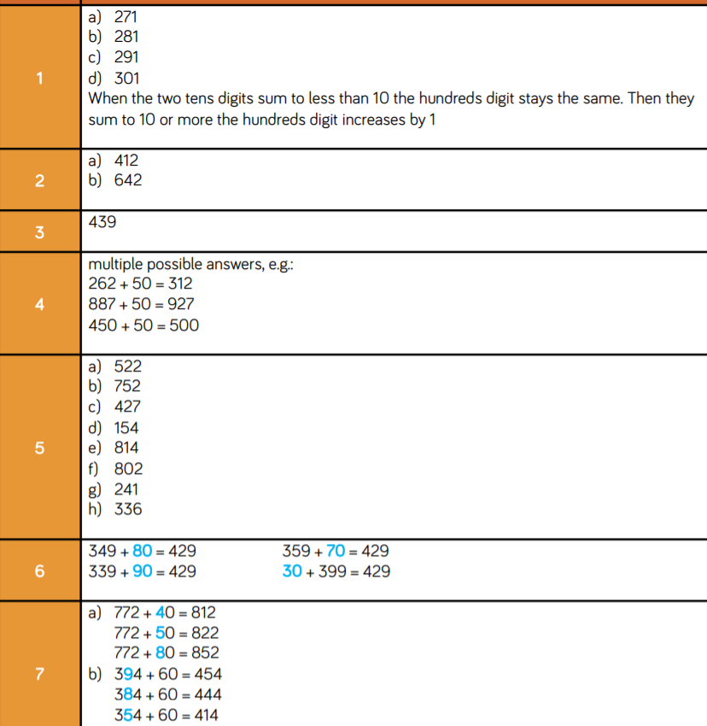

Slide 5
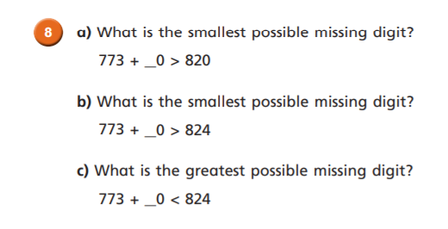
Challenge Time

Slide 6
Challenge Time Answers
a) 5
b) 6
c) 5

