Slide 1




Wednesday 13th January 2021
Writing

Slide 2
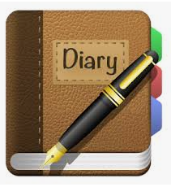
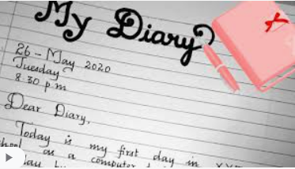
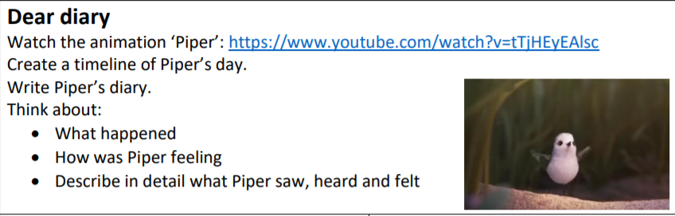

Let’s write a diary today.
A diary from the view point of this cute, little bird, Piper.
Prepositions of time you might like to use:
First, then, next, suddenly, without warning, a few moments later, immediately, shortly after, finally, eventually.

Slide 3
Diary checklist:
First person (I, me, mine, us, we, ours)
Past tense (already happened……ed)
Informal tone (your diary is your friend, you can be “chatty” in your style
Exciting noun phrases, prepositions of place and time, adverbs to tell me how a verb was done.
End you diary entry with a hope/wish for tomorrow.

Slide 4
My turn
Dear Diary (capital letter for Diary)
How frustrating today was! I spent the majority of my day chasing a seed to eat. I thought that my mummy was going to drop it lovingly into my beak but as I sat, snuggled in my nest open mothed, waiting patiently to be fed, she simply walked away! Whilst chasing the tiny seed across the soft, white sand, I noticed a gigantic wave in front of me. I felt terrified but I didn’t have time to escape. Without warning, the wave washed over me, dragging me backwards. It totally swallowed me and spat me back out, dripping wet onto the shore. Immediately, I found the comfort of my cosy nest to dry off.

