Slide 1






English
Wednesday 13th January

Slide 2

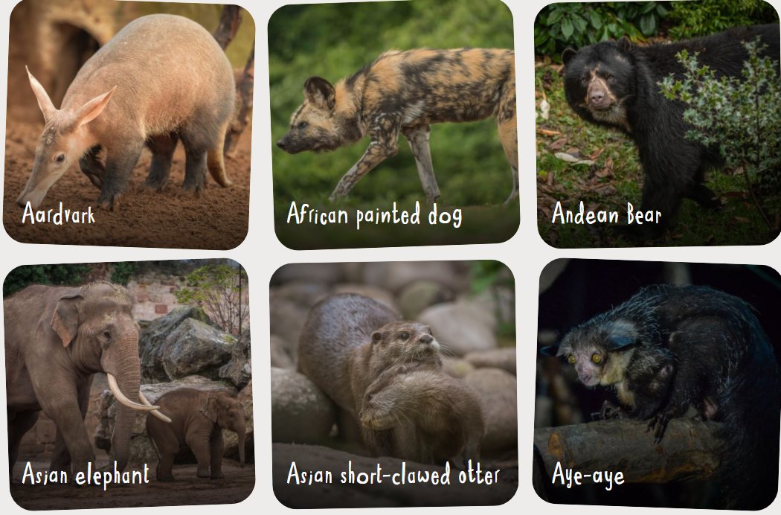
Wednesday 13th January
Can I research facts about an animal?
Useful websites
https://zoo.sandiegozoo.org/
https://www.chesterzoo.org/our-zoo/animals/
Choose an animal to research and find out about this can be nay animal but make sure it is one you don’t already know lots about yet.
Use the website links to help you decide which animal to research.

Slide 3

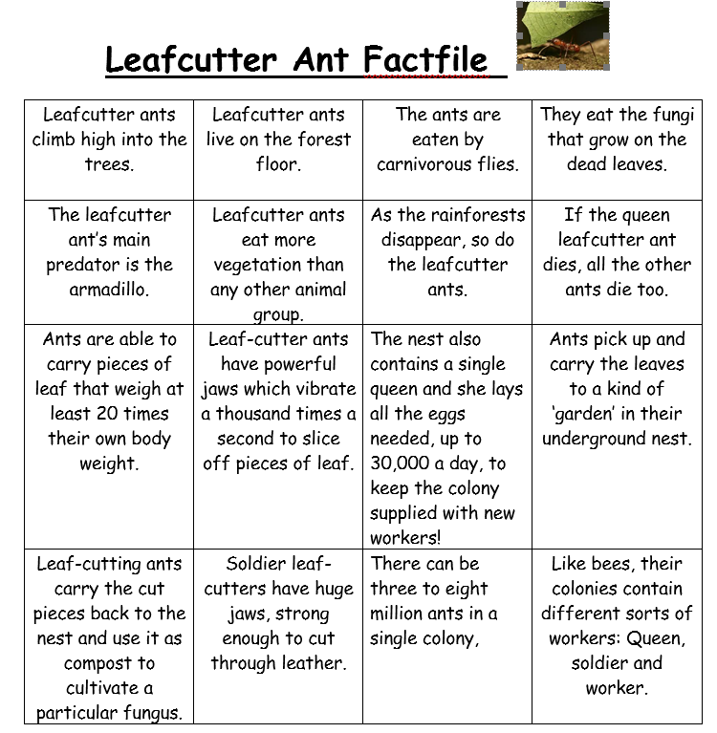
Mrs Evans’ model

Slide 4
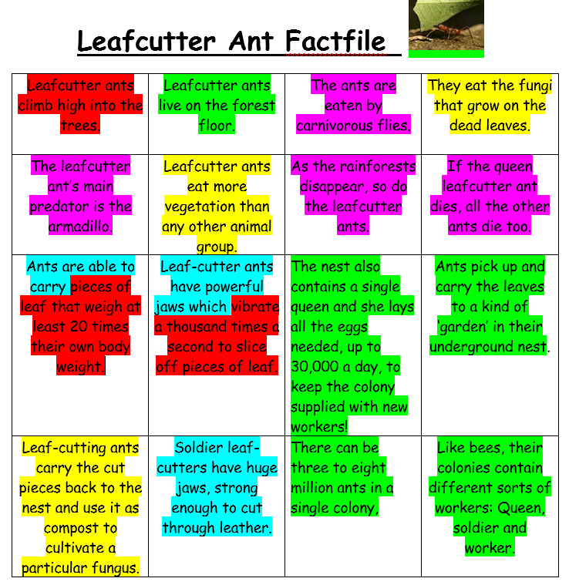
Can I categorise facts?
Key
Behaviour- what they do
Habitat- where they live
Diet- what they eat
Threats- what they are in danger from
Appearance- what they look like

