Slide 1


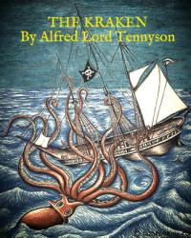


English
DATE
The Kraken
by Alfred Lord Tennyson

Slide 2

Practice reading the poem below. You can click here too to listen to me it reading it you!
The Kraken
Below the thunders of the upper deep,
Far, far beneath in the abysmal sea,
His ancient, dreamless, uninvaded sleep
The Kraken sleepeth: faintest sunlights flee
About his shadowy sides; above him swell
Huge sponges of millennial growth and height;
And far away into the sickly light,
From many a wondrous grot and secret cell
Unnumbered and enormous polypi
Winnow with giant arms the slumbering green.
There hath he lain for ages, and will lie
Battening upon huge sea worms in his sleep,
Until the latter fire shall heat the deep;
Then once by man and angels to be seen,
In roaring he shall rise and on the surface die.
by Alfred Lord Tennyson

Slide 3
Activity
Practise reading aloud your poem or the original. Decide which words need volume and emphasis. Perform to a family member and/or record to send into school so that your teacher can listen. You may wish to publish (handwrite, illustrate and decorate) your final poem. Don’t forget to edit and proof-read!

Slide 4

War Game by Michael Foreman
Now, you can listen to Mrs Whittingham read some more of this beautiful book.

