Slide 1

Starlings English Home Learning
Tuesday 12th January

Slide 2



Today you are learning to take on the role of the characters and act out what they say and do.
That means you will
Show that you understand the different characters in the story
Begin to recognise and understand speech bubbles

Slide 3
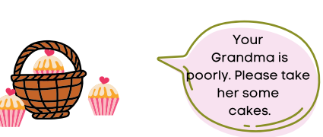
Follow this link to the extended version of the story:
file:///H:/YEAR%20ONE/Home%20Learning/English/Little%20Red%20Riding%20Hood/Little%20Red%20Riding%20Hood%20Y1.pdf
Read the story with your grown up and look out for speech bubbles in the story.
A speech bubble tells us that a character is talking in the story.
Can you tell your grown up which character is speaking for each speech bubble.

Slide 4
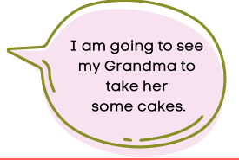

Slide 5
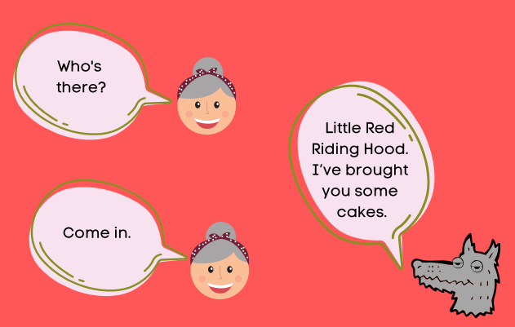

Slide 6
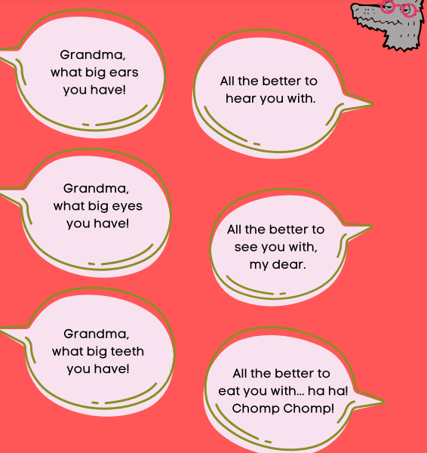
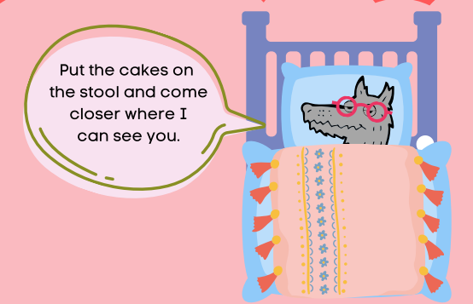
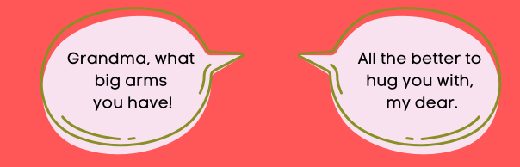

Slide 7

Red group – you need to look out for set 1 videos on the link below:
https://www.youtube.com/channel/UCo7fbLgY2oA_cFCIg9GdxtQ
We would like you to watch 3 videos: set 1 speed sounds, set 1 word time and set 1 spellings please.
Green group you need to look out for set 2 videos on the link below:
https://www.youtube.com/channel/UCo7fbLgY2oA_cFCIg9GdxtQ
We would like you to watch 4 videos: set 2 speed sounds, set 2 spelling, red words 1, and read and hold a sentence 1
Pink, yellow and blue groups you need to look out for set 3 videos on the link below.
https://www.youtube.com/channel/UCo7fbLgY2oA_cFCIg9GdxtQ
We would like you to watch 4 videos: set 3 speed sounds, set 3 spelling, red words 2 and read and hold a sentence 2

Slide 8

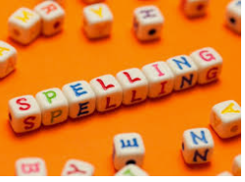



Words of the day!
go no so
Can you write the word go 5 times in your prettiest writing?
Can you write the word no 5 times with your eyes closed?
Can you write the word so 5 times using your other hand?

