Slide 1







Maths
Year Two Swallows
Tuesday 12th January 2021

Slide 2
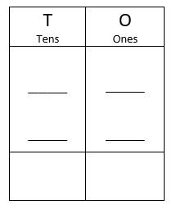
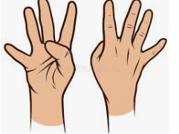
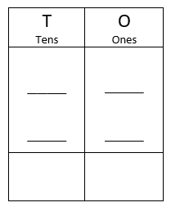
4 A Day
44 + 13 = | 78 – 33 =
10 x 2 = | 100 ÷ 10 =

Slide 3
Answers
44 + 13 = 57 | 78 – 33 = 45
10 x 2 = 20 | 100 ÷ 10 = 10

Slide 4

Can I add and subtract ones?
https://vimeo.com/463031310
Knkkkkkkkkkkkkkk kkVideo

Slide 5
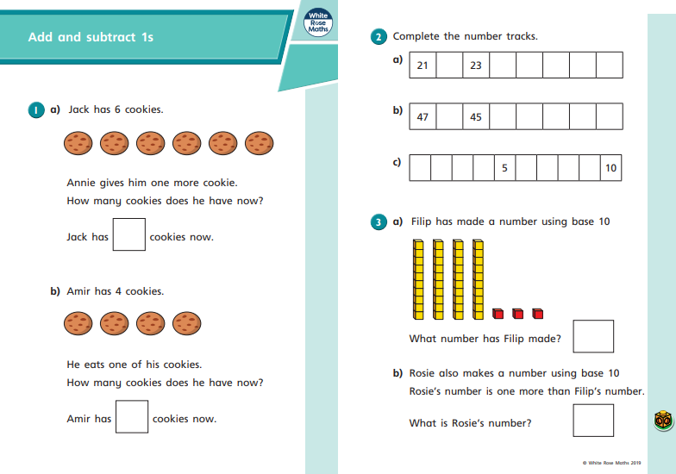
Your Turn

Slide 6
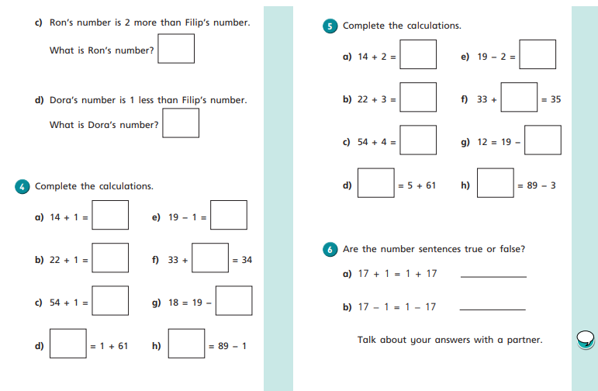
Your Turn

Slide 7
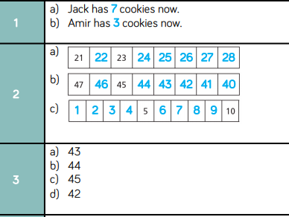
Answers

Slide 8
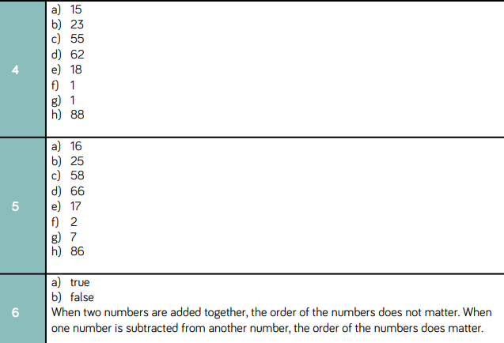
Answers

Slide 9
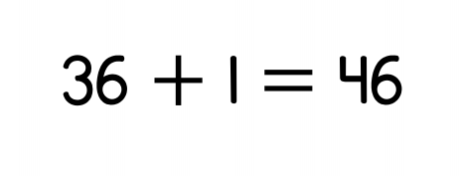
Challenge
True or False?

Slide 10
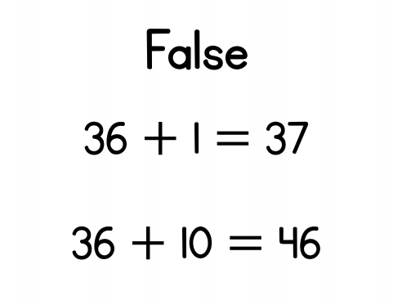
Optional Challenge
True or False?

