Slide 1



English
Year 2 Swallows Class
Tuesday 12th January 2021

Slide 2
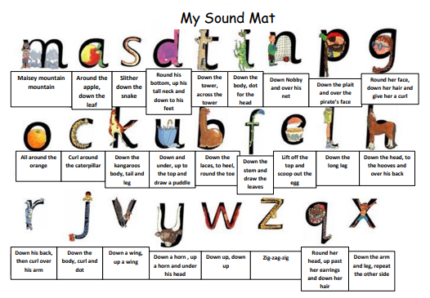

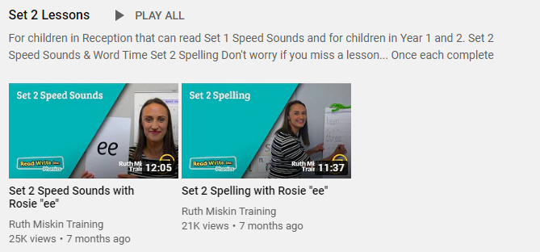
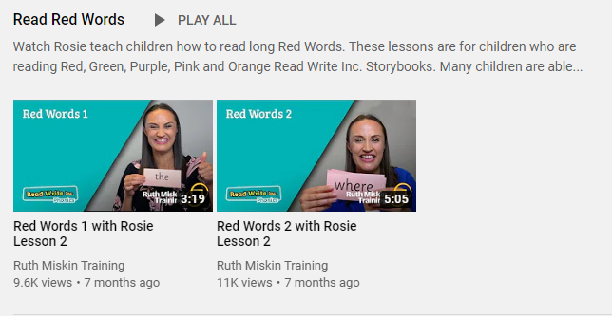
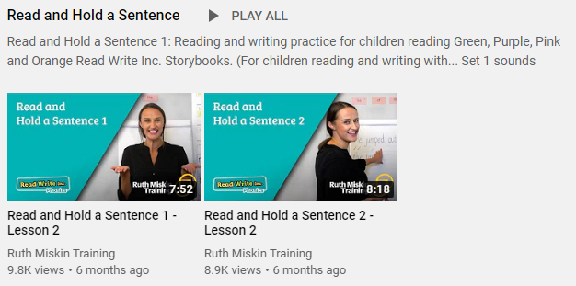
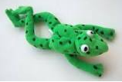
Read Write Inc
Set 2
If you are currently reading green books, please follow the link below to your Read Write Inc lesson today. Each day you will need to click on the video’s shown in the screen shots below. Please remember that although the screen shot says /ee/, the sound will change each day but will be found in the same place. https://www.youtube.com/channel/UCo7fbLgY2oA_cFCIg9GdxtQ
Video 1: Please watch ‘Set 2 Speed sound’ lesson.
Video 2: Please watch ‘Set 2 Spelling’ lesson.
Please complete all 4 video’s each day ☺
Video 3: Please watch ‘Red words 1’ lesson only.
Video 4: Please watch ‘Read and Hold a sentence 1’

Slide 3
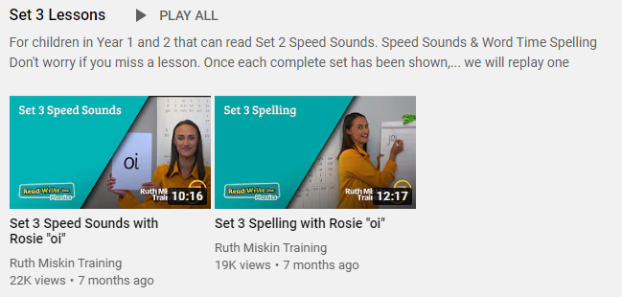
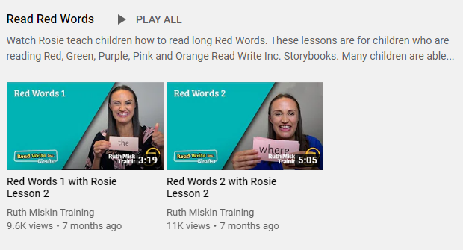
Set 3
If you are currently reading pink, orange, yellow, blue or grey books, please follow the links below to your Speed Sound lesson, red word focus lesson and hold a sentence activity for today. Each day you will need to click on the video’s shown in the screen shots below. Please remember that although the screen shot says /ee/, the sound will change each day but will be found in the same place. https://www.youtube.com/channel/UCo7fbLgY2oA_cFCIg9GdxtQ
Video 1: Please watch ‘Set 3 Speed sound’ lesson.
Video 2: Please watch ‘Set 3 Spelling’ lesson.
Video 3: Please watch ‘Red words 2’ lesson only.
Video 4: Please watch ‘Read and Hold a sentence 2’

Slide 4
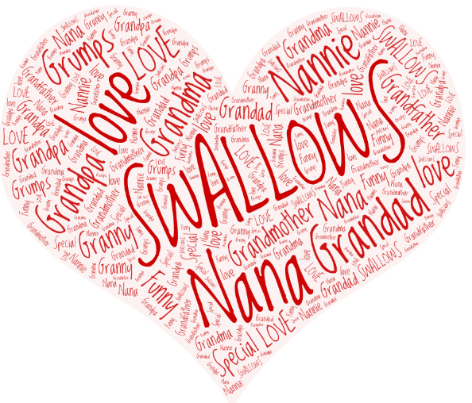
Writing
Can I ask questions? Can I create my own quiz?
Who is special in your family? What makes them special?

Slide 5
Task
Grandparents quiz
Write a quiz to find out a little bit more about grandma, nan or grandad or someone else you know. Ask them questions about what life was like when they were children. Practise writing questions with a capital letter at the start and a question mark at the end. Start your questions with: When, Where, Who, What, Why, Will, Do, Was
You could ask them about:
• homes
• food and meals
• family life
• toys and games
• how they did their shopping
• hobbies

Slide 6

What was life like when they were children?
When
Why
Where
Will
Who
Do
What
Was
How
Which

Slide 7

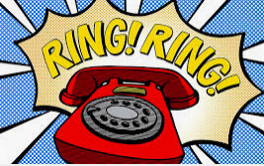
Where did you live when you were little?
What was your favourite food when you were at school?
Did you have school dinners?
What was your favourite toy when you were little?
Who was your best friend when you were at school?
What was your favourite lesson at school?

Slide 8


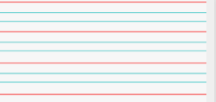
Can you re-read what you have written to check that it makes sense?
Joined handwriting

Slide 9


How many frogs did Alice and Jago find?
Why were the frogs hard to count?
What animal did Alice and Jago say was ‘jumpier’ than a frog?
What was the problem at the end of the chapter?
I wonder what will happen next in our story…
Author: Michael Morpurgo
Illustrator: Sam Usher
Publisher: Barrington Stoke

Slide 10

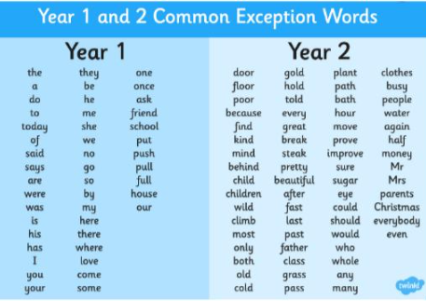
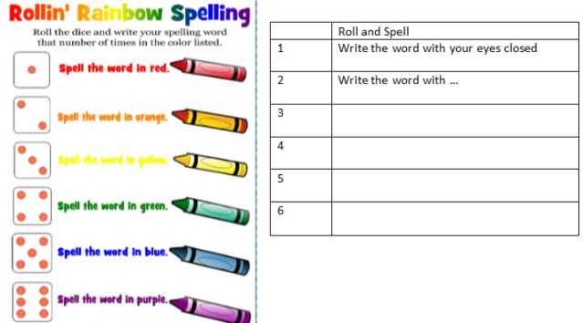
Spellings
Can you read and spell the words below?
class grass pass plant path

Slide 11


