Slide 1




Tuesday 12th January 2021
Writing

Slide 2
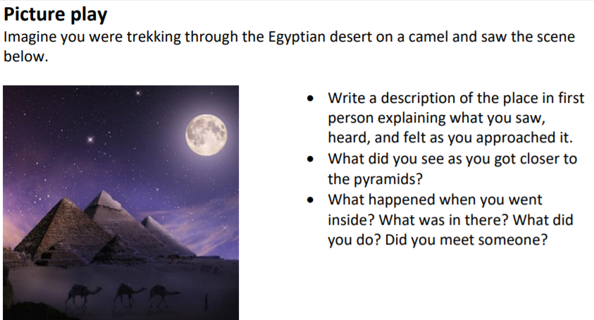

This BBC website has lots of little video clips for you to gain some further information if you are interested?
https://www.bbc.co.uk/bitesize/topics/zg87xnb/resources/1

Slide 3
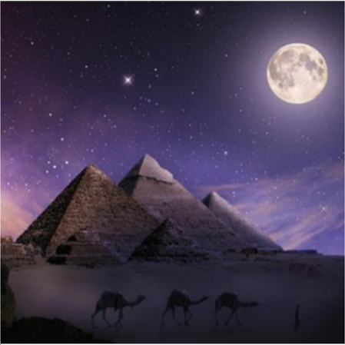
My example
What you saw, heard and how you felt.
As I approached the magnificent pointy pyramids, I saw the dark sky lit up with bright, twinkling stars. The pale moon cast a beautiful path that lit up these spectacular structures. Beautiful shades of purple and blue filled the night sky which made the stars stand out against the darkness. Camels were softly plodding across the sandy desert in a perfect line. They looked majestic. Occasionally, a soft wind blew grains of sand against my face which made my eyes itch. I felt over whelmed at the beauty of this place. The size of the colossal pyramids made me feel insignificant because I was so tiny in comparison.
Blue = adjectives to describe the nouns
Red = adverbs to describe how the noun was done
Green = Conjunctions to extend a sentence or join two parts of a sentence together (and, but, or, because, so, which, so that…)
Purple = preposition (place or time)

Slide 4
What did you see as you got closer to the pyramids?
Eventually, after a long, tiring walk, I had arrived at the pyramids. They were breath taking. I was able to see each individual brick made of sand. The particles were shining prettily in the moonlight. Being this close, made me realise the amount of time and effort that must have gone into building these wondrous structures. They were incredibly strong and powerful buildings.

Slide 5
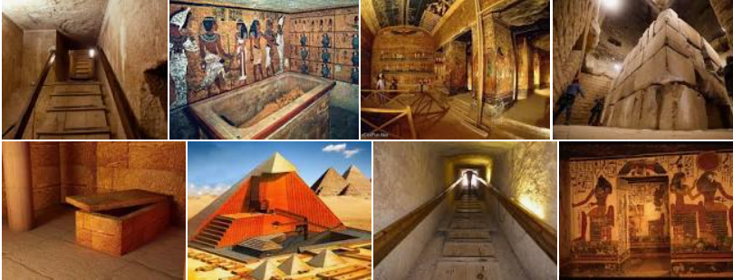
Inside the pyramid:
What happened when you went inside the pyramid?
What was in there?
Did you meet someone?
What did you do?
I want you to think creatively about these ideas. Do you meet a person or a creature? Was it empty inside, full of echoes, filled with treasure?
Please include:
Noun phrases
Conjunctions (because, so, or, but, however, and)
Adverbs (ly words tell me how)
Prepositions of place and time (on top of, above, below, opposite, suddenly, after a few minutes, without warning)

