Slide 1


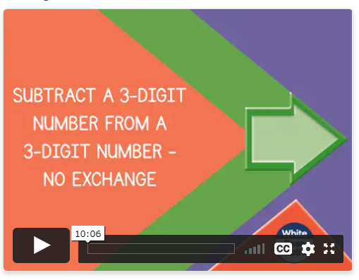
Thursday 14th January
Have another go at times table Conga – how far can you get today? Practise your 6x or 9x tables. https://www.transum.org/software/Game/TablesConga.asp
Can I subtract a 3-digit number from a 3-digit number with no exchange?
https://whiterosemaths.com/homelearning/year-4/week-6-number-addition-subtraction/

Slide 2
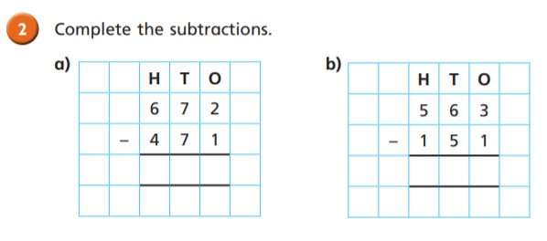
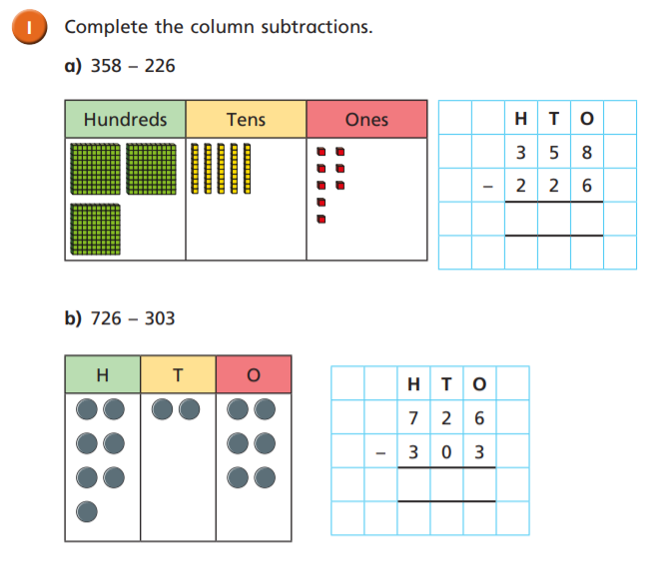
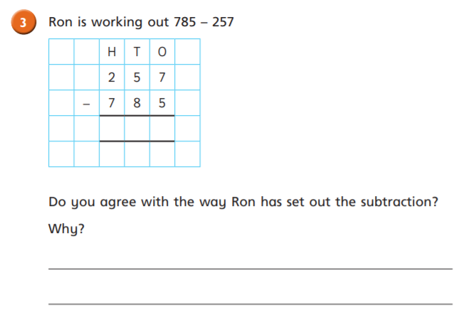

Slide 3
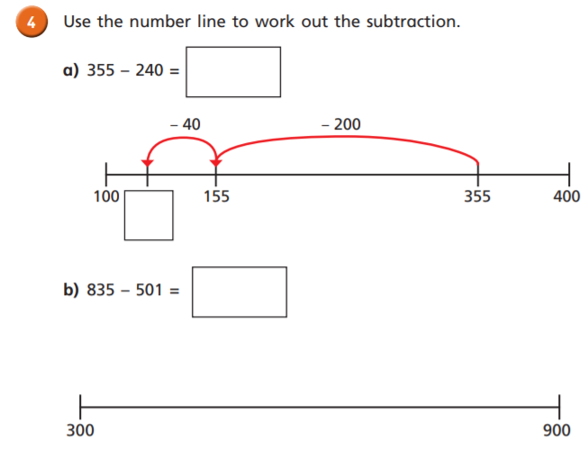
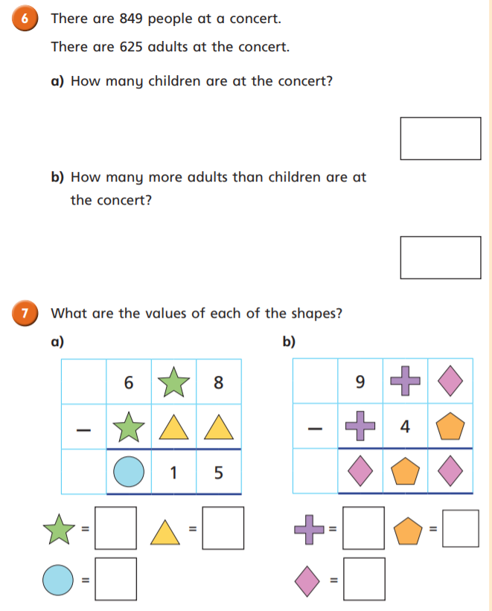


Slide 4
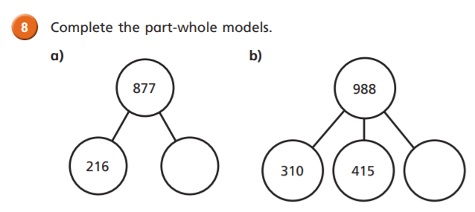
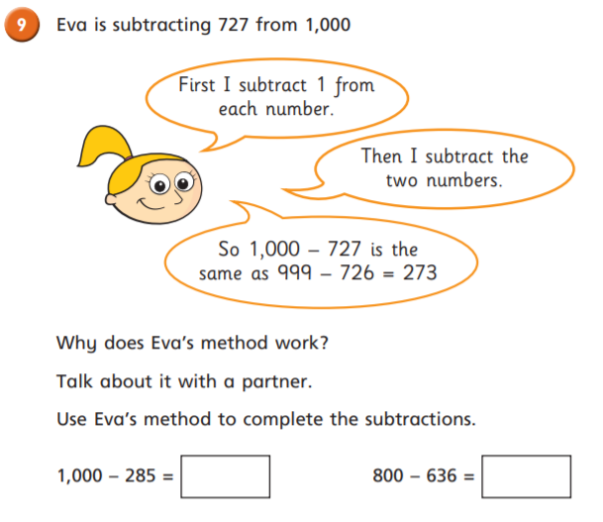
Challenge

Slide 5
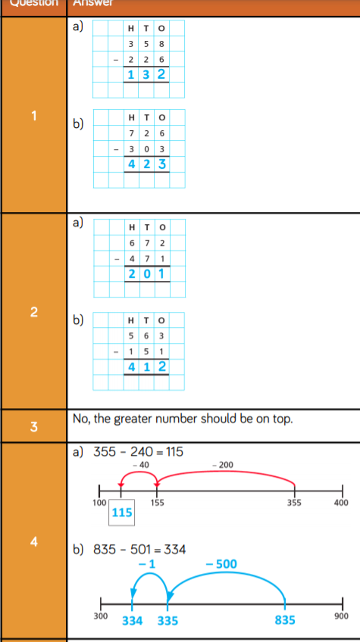

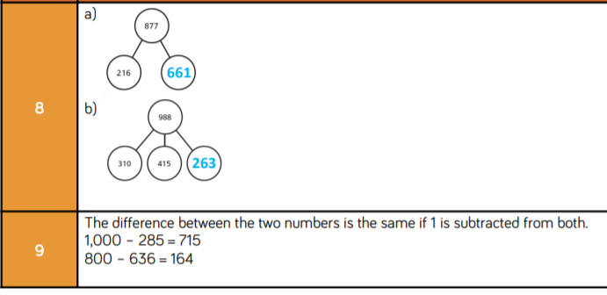

Slide 6
