Slide 1

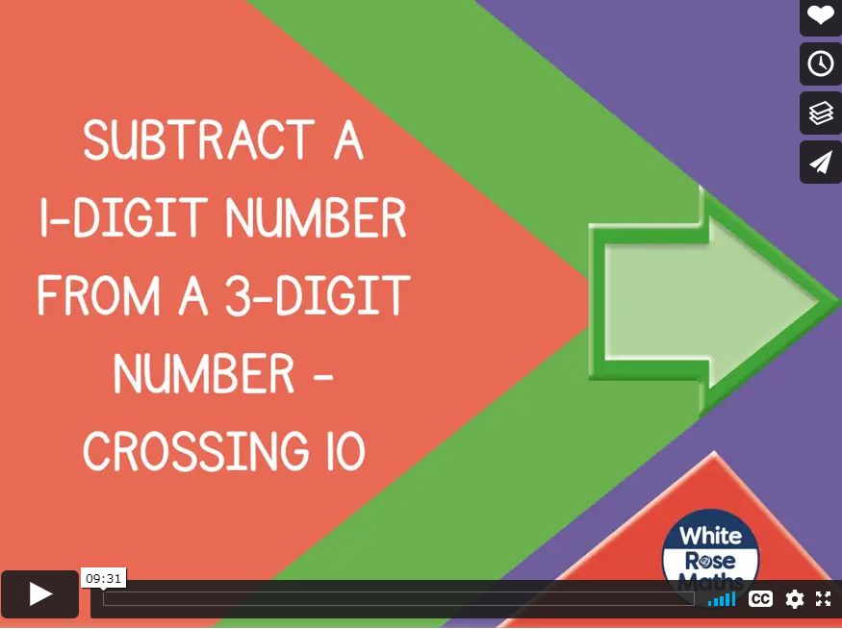

Please click here to watch our lesson today, we are subtracting ones digits from a 3 digit number, crossing the tens boundary.
https://vimeo.com/461351796
Tuesday 12th January 2021
Today is a little different. We will watch the first part of the video and answer questions 1-3 then watch the rest of the video lesson and complete the last questions after that. So today’s lesson is in two parts!

Slide 2
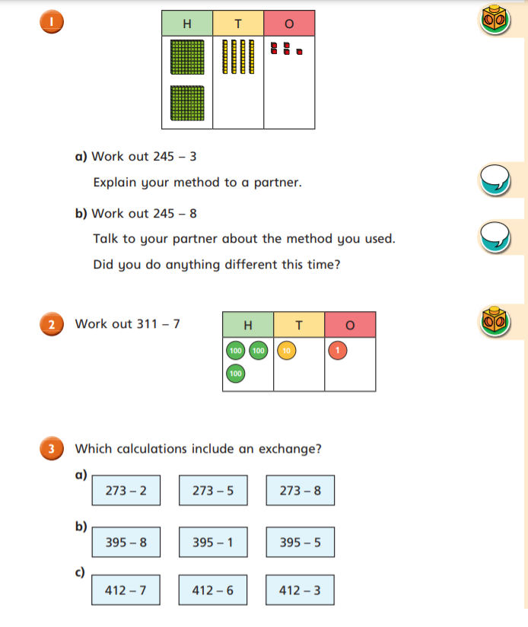
Try these ones now.
Remember you might need to exchange one ten for ten ones if the number you are subtracting is larger than the number of ones in the first number.

Slide 3
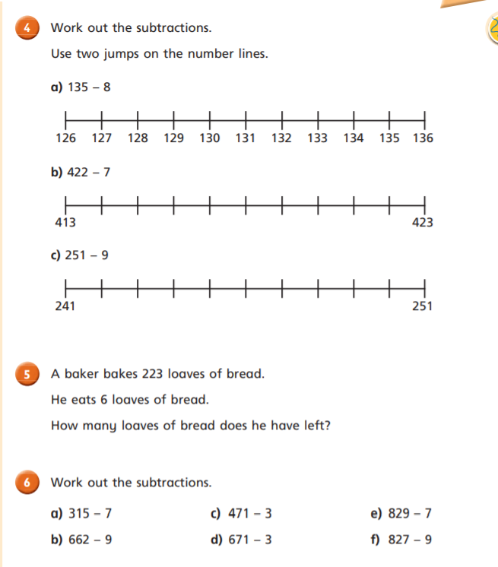
When we are subtracting, always jump back to the multiple of 10 before, then see how many more you need to subtract.
So for question 4a, we are subtracting 8. So if we jump back to 130 from 135, we have subtracted 5, but we need to subtract 8 in total so we need to take away 3 more as take away 5 then take away 3 is equal to taking away 8.

Slide 4
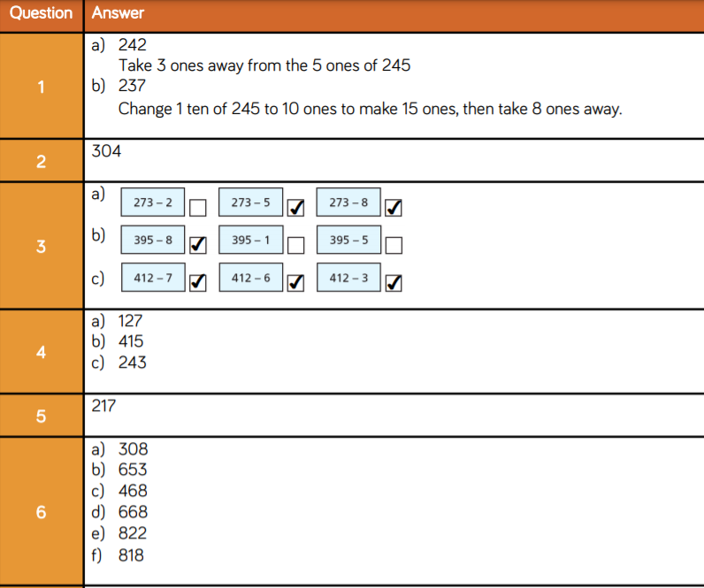

Slide 5
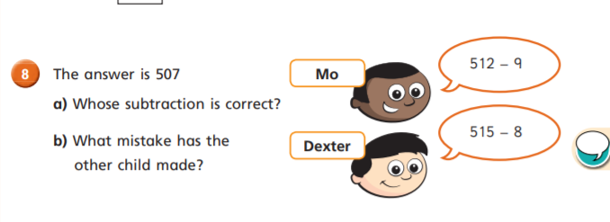
Challenge Time
I like these ones Robins! We have to work out if 512 – 9 = 507 like Mo says OR does 515 – 8 = 507 like Dexter believes? Work out each one to see who is right and what mistake the other child has made. Be a detective!

Slide 6
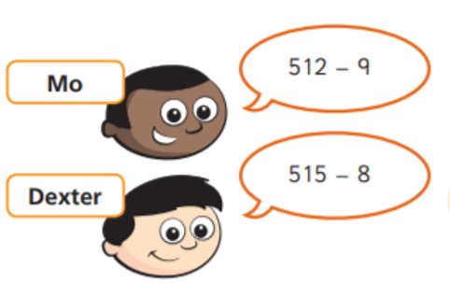
Challenge Time Answers
Dexter is correct because 515 – 8 = 507.
In my head Robins, I started at 515, did a jump of subtract 5 to get me back to 510 which is a lovely multiple of 10 (and you know how much I like those!) then I needed to subtract a further 3 more which took me back to 507.
How did you do?
Mo made a mistake because she subtracted 2 from 9!

