Slide 1


Tuesday 12th January
Literacy

Slide 2
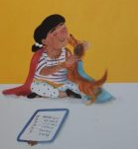
Every superhero
Needs a side-kick!
Who could be
my side-kick?
Notes:
Brave strong and funny

Slide 3
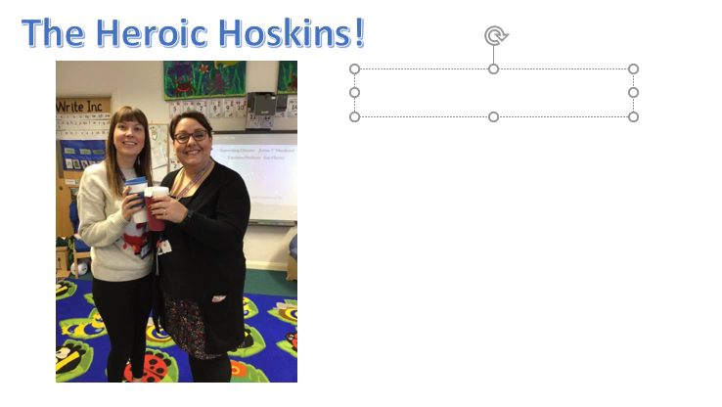

Slide 4
