Slide 1


English
Date: 12.01.21
‘Pleasant Sounds’ by John Clare
Week 2 – Lesson 2
Poetry Writing – Editing, publishing and performing

Slide 2

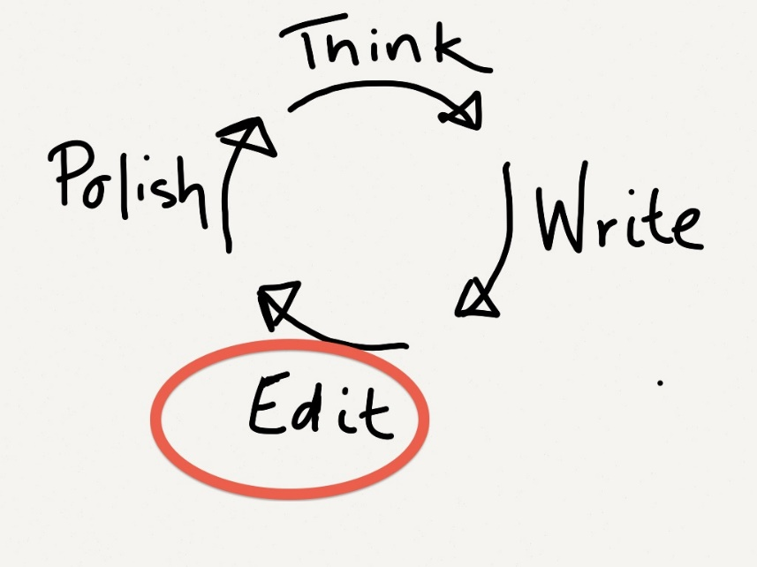
Click on the sound button to hear activity 1 explained to you.
Activity 1 – Editing
Read your poem that you drafted yesterday.
Are you 100% happy with your word choice? Is there anything you would like to change?
If so, don’t be afraid to edit and amend your work like we would in school. It doesn’t have to be neat at this stage.
You could ask an adult at home to check it for any spelling or punctuation errors.

Slide 3
Click on the sound button to hear activity 2 explained to you.
Activity 2 - Publishing
When you are 100% happy with your poem, it is time to publish it!
You could handwrite it neatly, type it on a laptop, illustrate it with pictures or decorate it.

Slide 4
Click on the sound button to hear activity 3 explained to you.
Activity 3 – Performing
When you have written your final version, practise reading it out loud. Decide which words need volume and emphasis.
Perform your poem to a family member or why not record yourself reading your poem aloud and add it to our discussion for me to listen to?
I would love to hear them! ☺

Slide 5
