Slide 1




DAY SIX
Happy Wednesday Starlings!
You have now done a whole week of home learning which is fantastic! Today is our last money day.
Today we are going to learn about the notes we use in the United Kingdom which are very valuable.

Slide 2
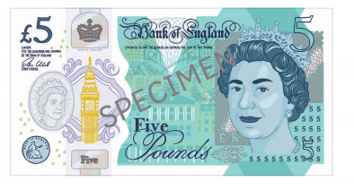
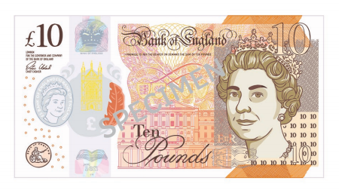
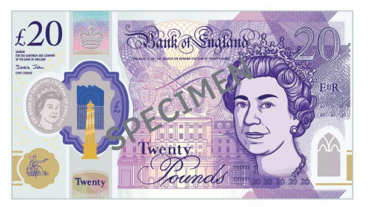
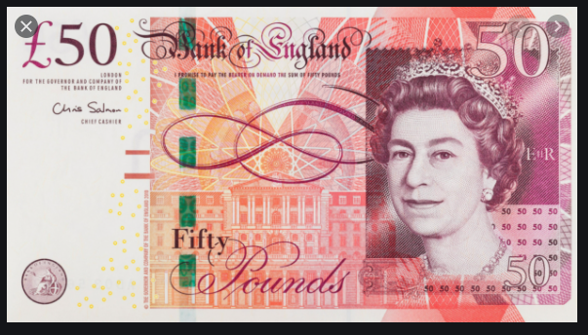
I wonder which one is the most valuable?
These are the notes we use in the United Kingdom. You could ask your grown up to show you if they have any but be careful because they are very valuable. We have a £5, £10, £20 and £50 note. The £50 note is very unusual and even Mrs Judge has never had one!

Slide 3
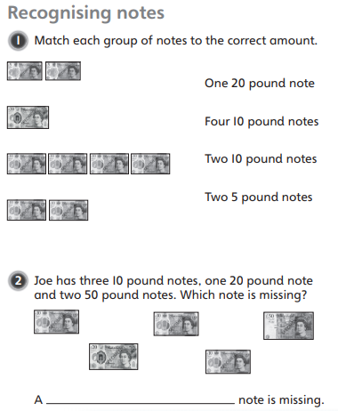
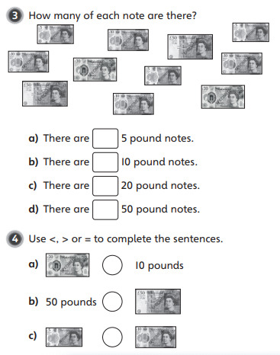

Slide 4
