Slide 1

Starlings English Home Learning
Wednesday 13th January

Slide 2



Today you are learning to write a description of the characters in the story.
That means you will
Describe the character thinking about their size, colour, shape and character.
Begin to join two descriptions together using ‘and’. For example The wolf is big and scary. Grandma is old and kind.

Slide 3
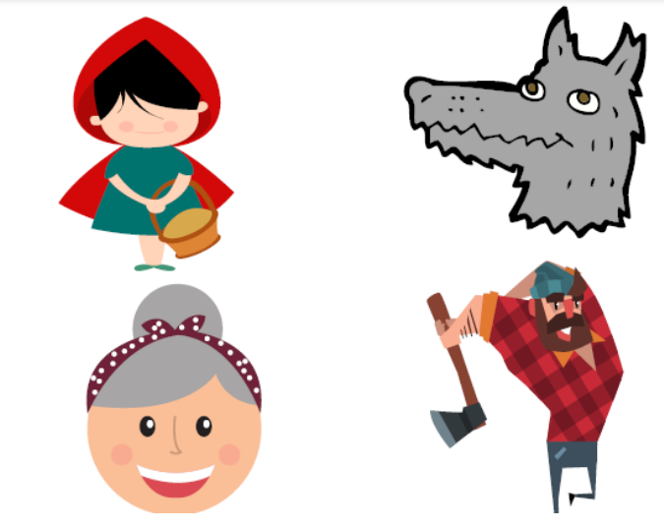

Slide 4
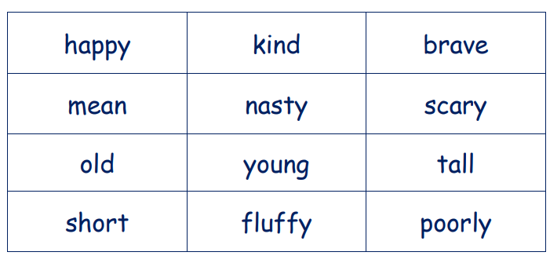

Slide 5
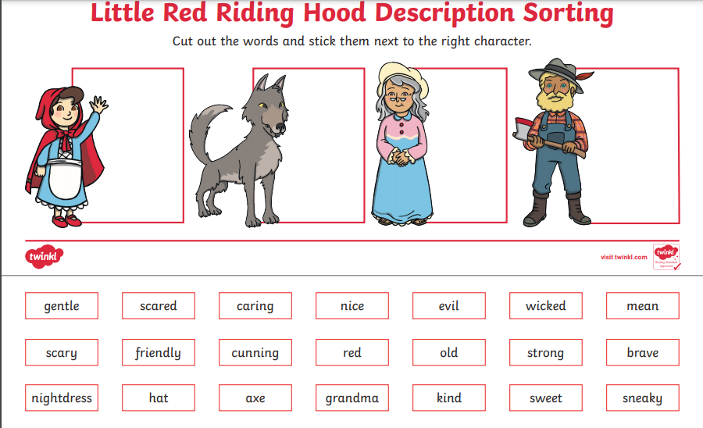

Slide 6
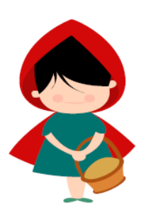
Little Red Riding Hood is young and friendly.

Slide 7

Red group – you need to look out for set 1 videos on the link below:
https://www.youtube.com/channel/UCo7fbLgY2oA_cFCIg9GdxtQ
We would like you to watch 3 videos: set 1 speed sounds, set 1 word time and set 1 spellings please.
Green group you need to look out for set 2 videos on the link below:
https://www.youtube.com/channel/UCo7fbLgY2oA_cFCIg9GdxtQ
We would like you to watch 4 videos: set 2 speed sounds, set 2 spelling, red words 1, and read and hold a sentence 1
Pink, yellow and blue groups you need to look out for set 3 videos on the link below.
https://www.youtube.com/channel/UCo7fbLgY2oA_cFCIg9GdxtQ
We would like you to watch 4 videos: set 3 speed sounds, set 3 spelling, red words 2 and read and hold a sentence 2

Slide 8

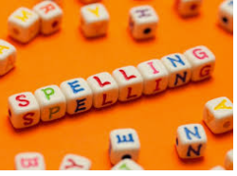



Words of the day!
old told cold
Can you write the word old 5 times stocking your tongue out?
Can you write the word told 5 times as small as you can?
Can you write the word cold 5 times as tall as you can?

