Slide 1

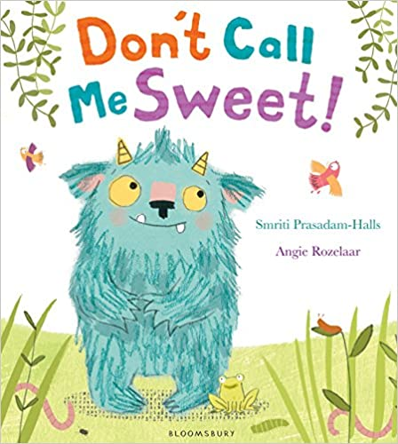

Monsters aren't sweet...are they??
Well this little monster DEFINITELY isn't. He's stinky and slimy and messy and SCARY. He's ANYTHING but sweet....isn't he?

