Slide 1




DAY FIVE
Hello Starlings!
You have been working so hard with your money topic – well done, I’m very proud of you!
Today we are going to practise what we learnt yesterday (comparing the total value of sets of coins)
See if you can complete the tasks on the next two pages and there and some further challenges on the last page if you want to try them.

Slide 2
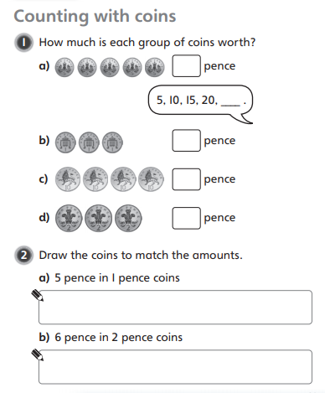
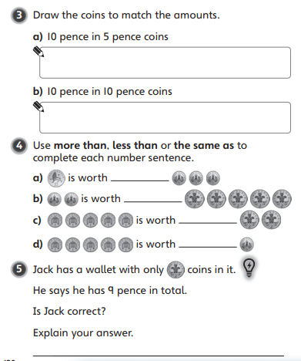

Slide 3
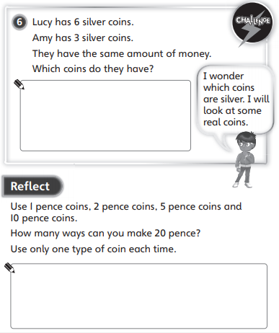

Slide 4
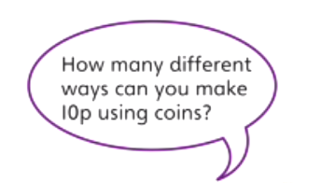

Just 1ps
Just 2ps
Just 5ps
Then a mix of coins
How about how many different ways you can make £1 only using silver coins?

