Slide 1
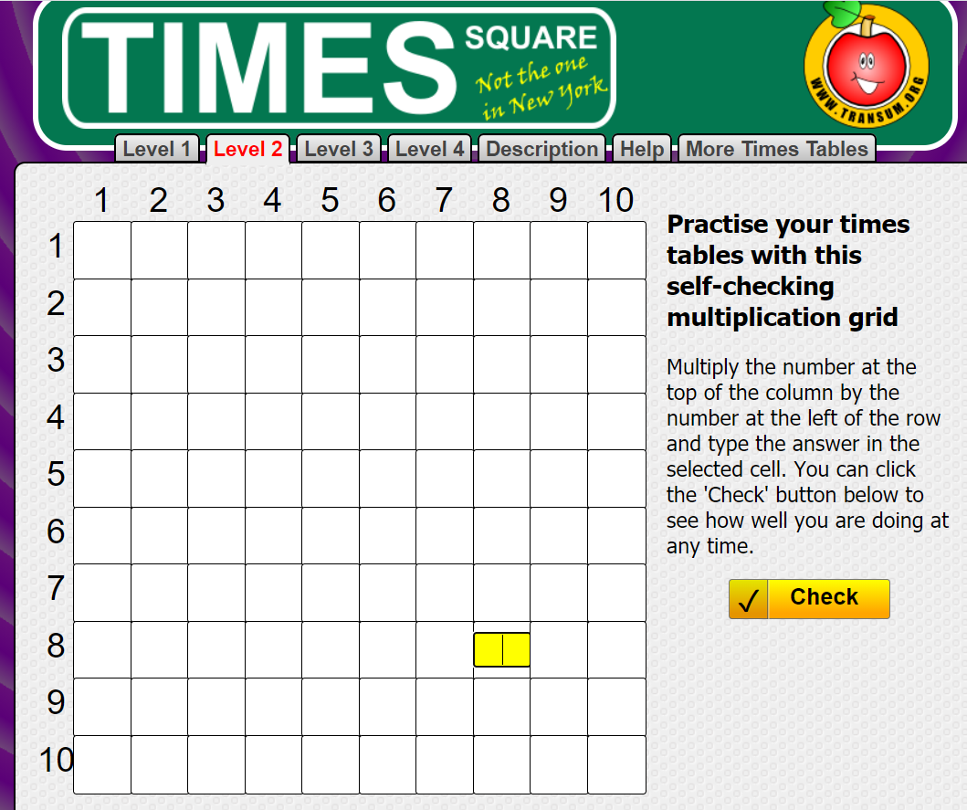

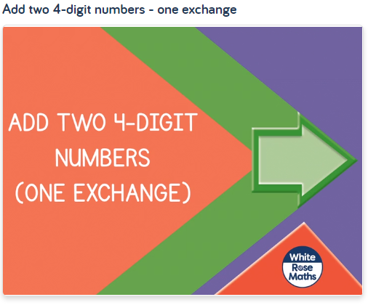
Tuesday 12th January
Have another go at the grid challenge today. Either choose level 2 again and try to beat your time from last week, or see how you do with the level 3 challenge. https://www.transum.org/Tables/Square.asp
Can I add two 4-digit numbers with one exchange?
https://whiterosemaths.com/homelearning/year-4/week-5/

Slide 2
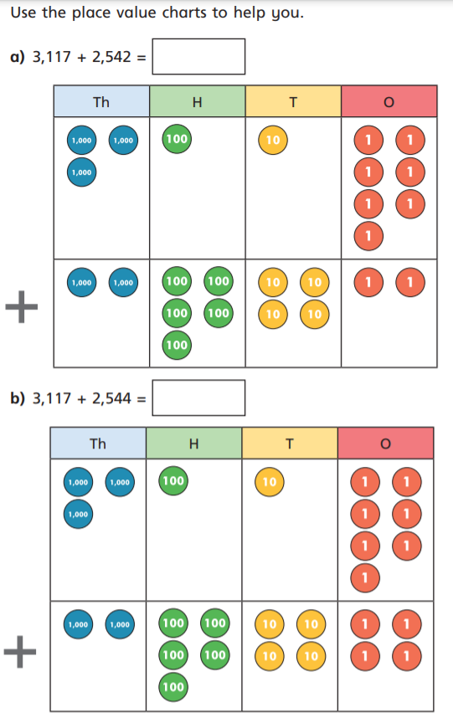
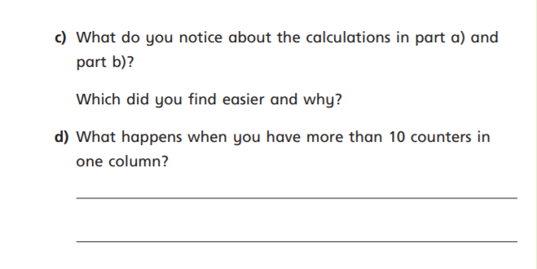
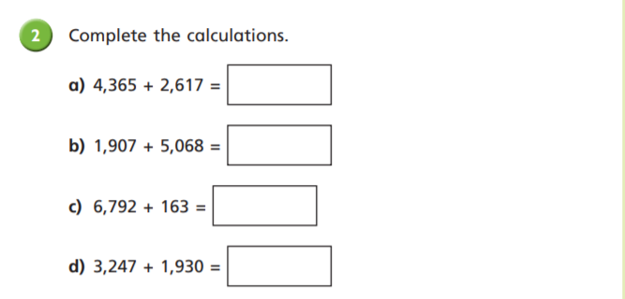

Slide 3
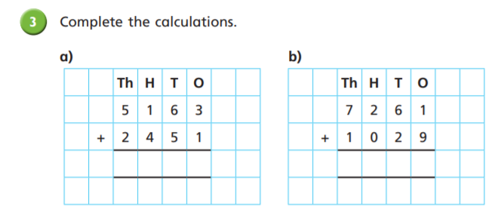
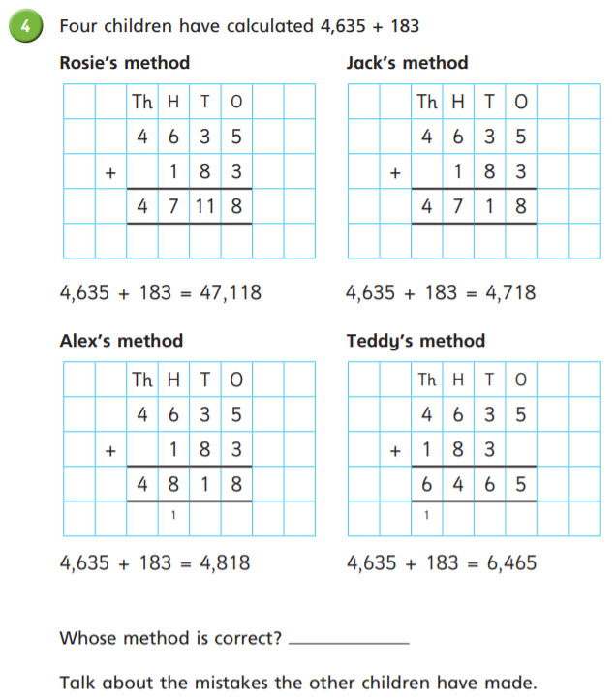
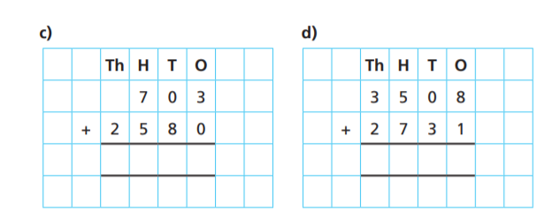

Slide 4
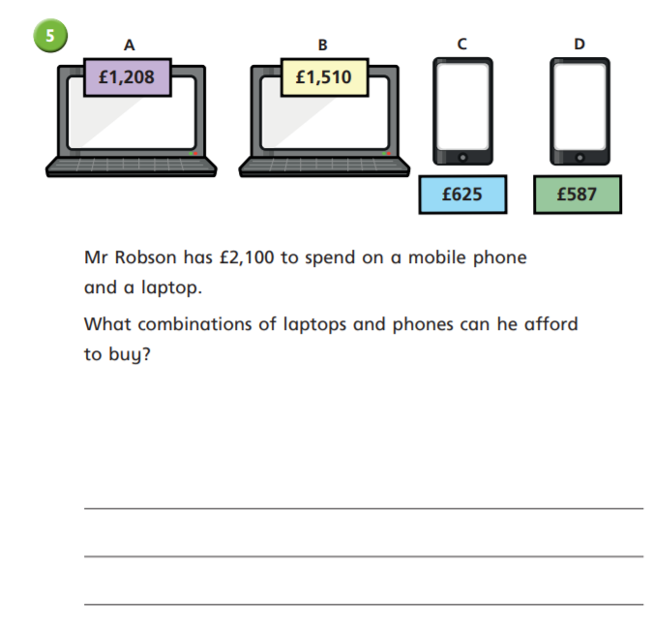
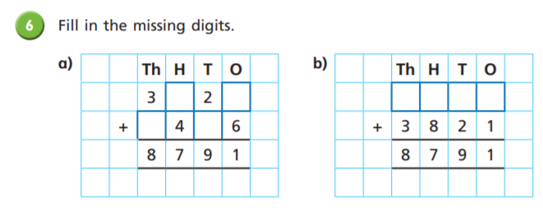
Challenge

Slide 5
