Slide 1

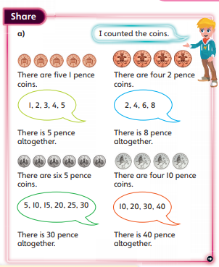


DAY FOUR
Good Morning Starlings!
Today we are going to count in sets of 2s, 5s and 10s to work out the value of a set of identical coins.
Look at the picture above and listen to Mrs Judge’s voice and this will explain what you are doing.

Slide 2
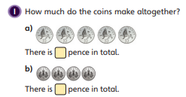
Now get some 2p coins and try counting in twos to find the total (remember that we are counting in twos because 2p is two one pennies)
First can you have some fun and count up in 2s then 5s and lastly 10s?
Can you answer these questions?
I have three 2p coins. What is the total value of the coins?
If I had five 2p coins what would the value be?
Tell me how many 2p coins would I have if my value was 8p?
Repeat with 5p and 10p coins and test your grown up and ask them some questions like the ones above. Look at the picture to give
you some ideas:

Slide 3
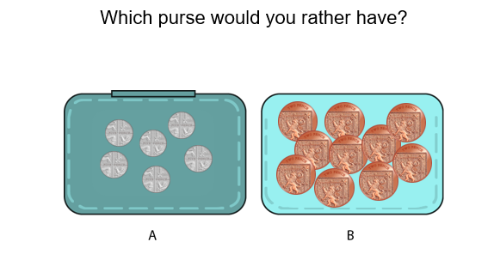
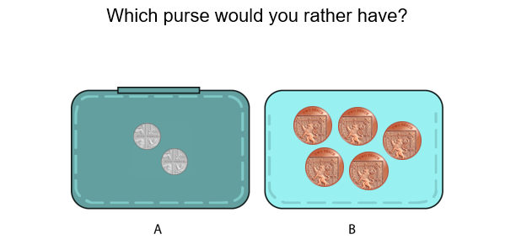
After all that hard work you can play a purse came. Look at the purses below and decide which purse you’d like. Why?
1
2
If you like, can you draw some of your own purses or fill some purses using different coins but with the same amounts in them?
Can you prove by using different coins that just because there are more coins this doesn't mean the value is higher? Answer these questions with your sets of coins to help you: How many coins are there? What is their total value?

Slide 4

