Slide 1



English
Year 2 Swallows Class
Monday 11th January 2021

Slide 2
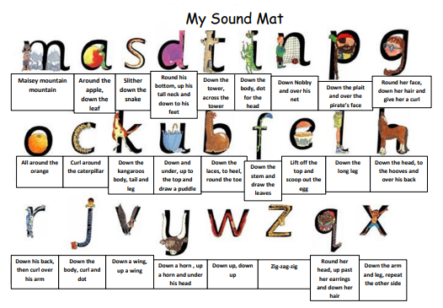

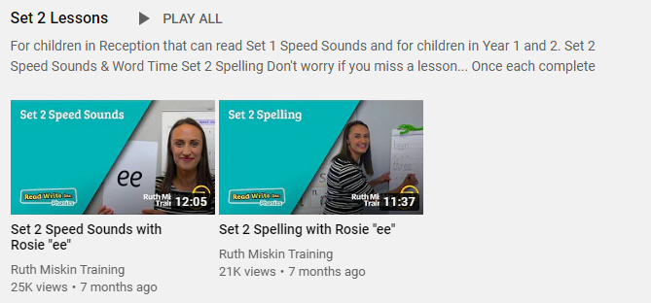
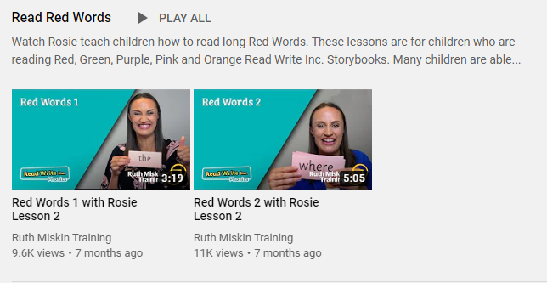
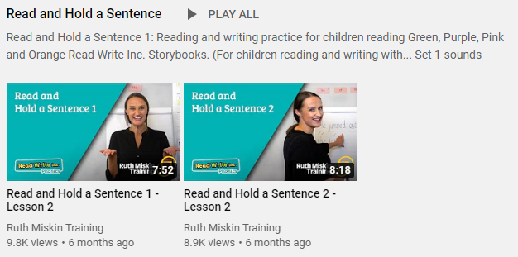
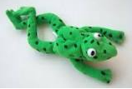
Read Write Inc
Set 2
If you are currently reading green books, please follow the link below to your Read Write Inc lesson today. Each day you will need to click on the video’s shown in the screen shots below. Please remember that although the screen shot says /ee/, the sound will change each day but will be found in the same place. https://www.youtube.com/channel/UCo7fbLgY2oA_cFCIg9GdxtQ
Video 1: Please watch ‘Set 2 Speed sound’ lesson.
Video 2: Please watch ‘Set 2 Spelling’ lesson.
Please complete all 4 video’s each day ☺
Video 3: Please watch ‘Red words 1’ lesson only.
Video 4: Please watch ‘Read and Hold a sentence 1’

Slide 3
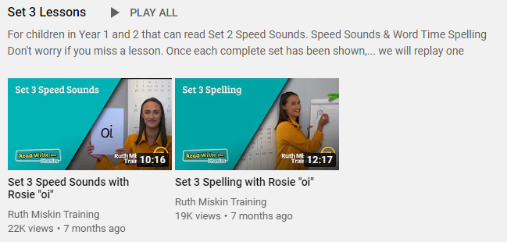
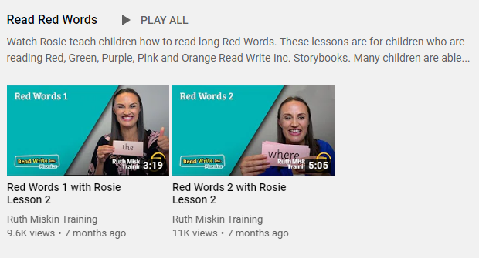
Set 3
If you are currently reading pink, orange, yellow, blue or grey books, please follow the links below to your Speed Sound lesson, red word focus lesson and hold a sentence activity for today. Each day you will need to click on the video’s shown in the screen shots below. Please remember that although the screen shot says /ee/, the sound will change each day but will be found in the same place. https://www.youtube.com/channel/UCo7fbLgY2oA_cFCIg9GdxtQ
Video 1: Please watch ‘Set 3 Speed sound’ lesson.
Video 2: Please watch ‘Set 3 Spelling’ lesson.
Video 3: Please watch ‘Red words 2’ lesson only.
Video 4: Please watch ‘Read and Hold a sentence 2’

Slide 4
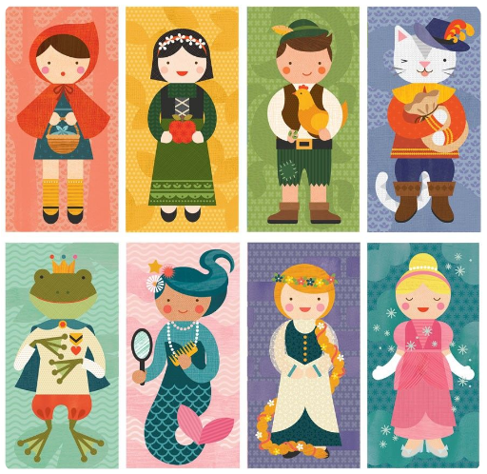
Writing
Can I write a diary?
What is your favourite fairy tale?
Who are these familiar looking characters?

Slide 5
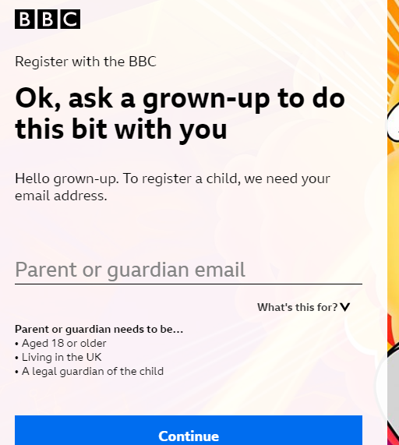
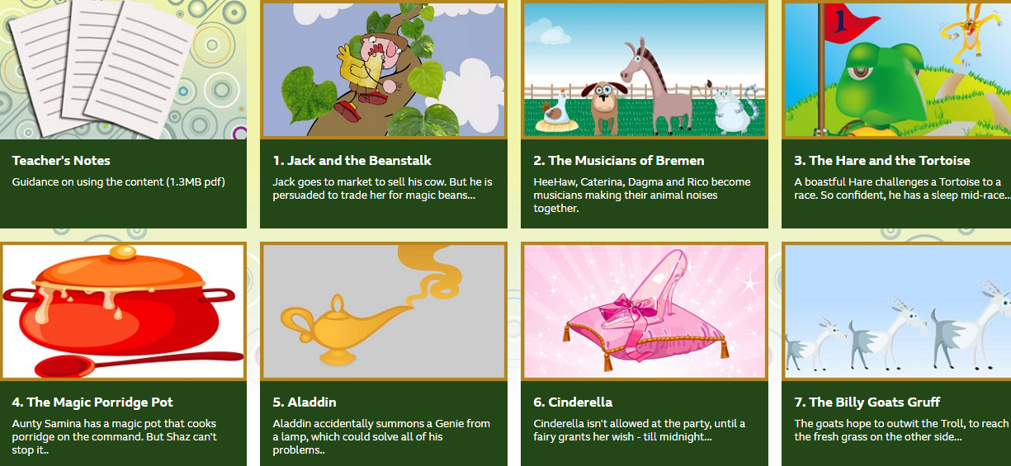
Audio Books
https://www.bbc.co.uk/programmes/b03g64rh
Here is a link to some lovely drama lessons based on traditional tales. A teacher reads each story and encourages you to think about what the characters say and feel in each story. You will need to sign up but it is free and easy. Even Miss Gillam could do it.
Alternative links:
Little Red Riding Hood: https://www.youtube.com/watch?v=LDMWJCrDVMI
The Gingerbread Man: https://www.youtube.com/watch?v=YoQyyB5xvLk
Cinderella: https://www.youtube.com/watch?v=BXDsucz23OA
The Billy Goats Gruff: https://www.youtube.com/watch?v=3QzT1sq6kCY
There are many other stories available on the ‘Gigglebox’ YouTube Channel.

Slide 6
Task
Choose one character and think about all the things they do in a day. Write a diary of their day describing all their jobs and activities. Make sure you write about how you would feel.

Slide 7

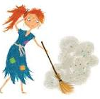
Dear Diary,
I have been so busy today. I have cleaned the floor and swept out the fire place. It made me all dirty and messy. My sisters kept shouting at me and I felt very sad. When I had finished my first jobs I went for a little sleep. It is so tiring having to work all day while my horrible, selfish sisters go to parties. I feel so alone.

Slide 8
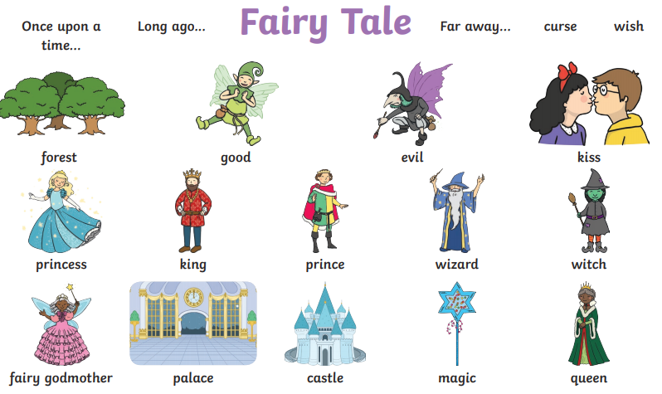
Word Bank
cottage
Dear Diary
forest
today
sisters
basket
wolf
beanstalk

Slide 9

Mastery Keys
Plan or say out loud what is going to be written about
• Use punctuation correctly – full stops, capital letters
• Write expanded noun phrases to describe and specify
• Use subordination (because) and coordination (and)

Slide 10




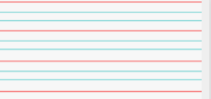
Can you re-read what you have written to check that it makes sense?
adjectives
Joined handwriting

Slide 11


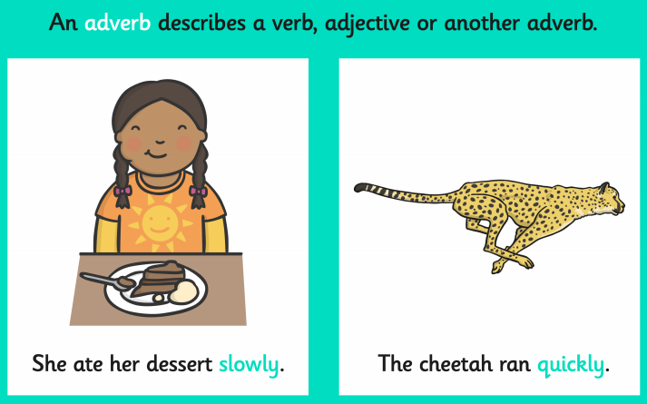
I wonder what will happen in our story today?
The chief toad asked for all of the toads to be put back where they belong. Where did they want to be put?
What adverb described how the children emptied the toads out of the container?
Author: Michael Morpurgo
Illustrator: Sam Usher
Publisher: Barrington Stoke

Slide 12

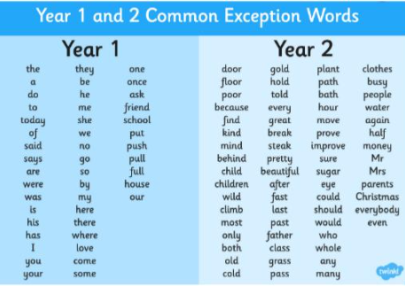
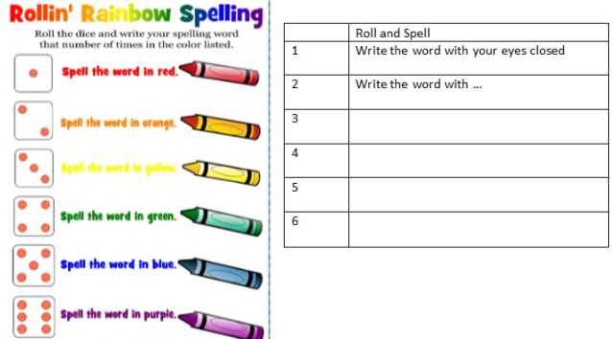
Spellings
Can you read and spell the words below?
class grass pass plant path

