Slide 1




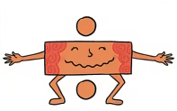


Maths
Year Two Swallows
Monday 11th January 2021

Slide 2
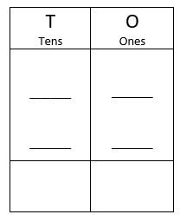
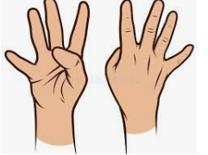
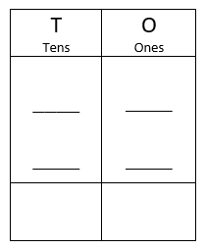
4 A Day
36 + 12 = | 54 – 21 =
4 x 2 = | 90 ÷ 10 =

Slide 3
Answers
36 + 12 = 48 | 54 – 21 = 33
4 x 2 = 8 | 90 ÷ 10 = 9

Slide 4
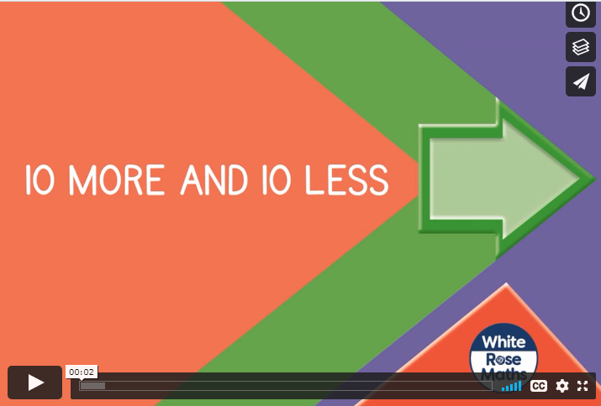
https://vimeo.com/464192071
Knkkkkkkkkkkkkkk kkVideo

Slide 5
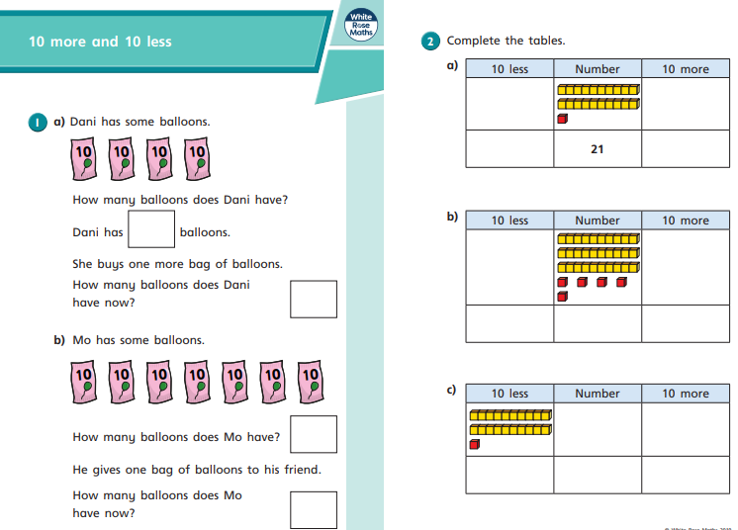
Your Turn

Slide 6
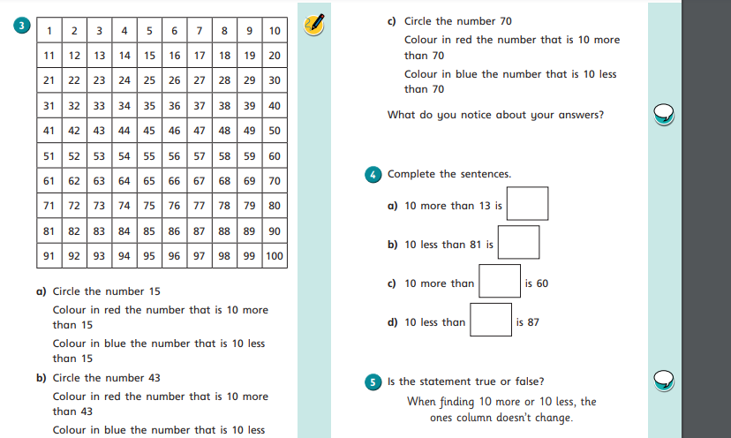
Your Turn

Slide 7
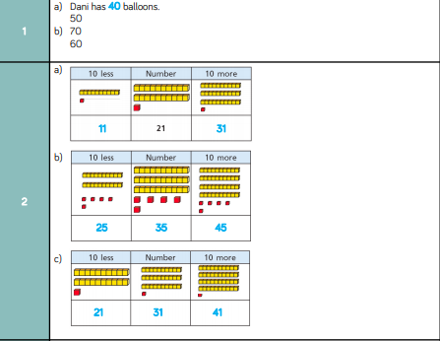
Answers

Slide 8
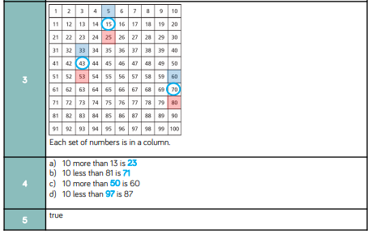
Answers

Slide 9

Challenge
True or False?

Slide 10
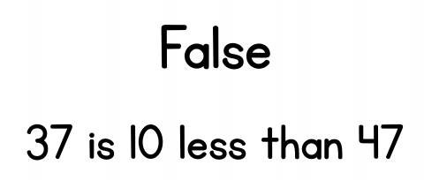
Optional Challenge
True or False?

