Slide 1


Starlings English Home Learning
Monday 11th January

Slide 2


Today you are learning to write sentences to retell the story of Little Red Riding Hood.
That means you will
Practise (orally rehearse) what you will write in your sentence and say this aloud to help you to remember.
Write sentences with capital letters, finger spaces and full stops in the correct places.
Read and check your sentence once you are done.

Slide 3
Some information for parents:
Children need to know how to form sentences and then how to punctuate them.
In their simplest form, a sentence would have a noun (for example ‘the wolf’) and a verb (eg ‘gobbled’).
In class we encourage the children to say their sentence aloud a number of times before writing. Sometimes we use different voices to make this more interesting, for example a robot voice, a low voice, a whispering voice.
Encourage your child to check that every sentence they write has a capital letter at the start and for a character’s name, and has a full stop at the end. A good way of checking is to use a different colour for each capital letter and full stop so that they can see these clearly in their writing.
Counting your sentences also helps to check. If you have 4 sentences you should have 4 full stops for example.

Slide 4
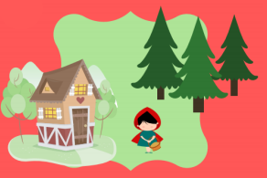

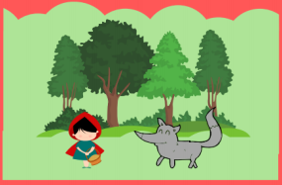
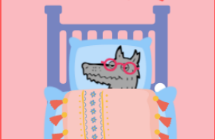
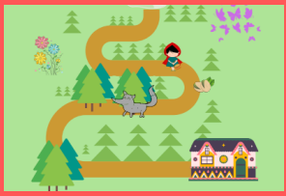

Slide 5
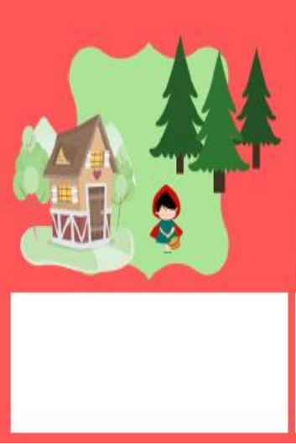

Slide 6
There was a girl called Little Red Riding Hood who lived on a farm in the woods.

Slide 7
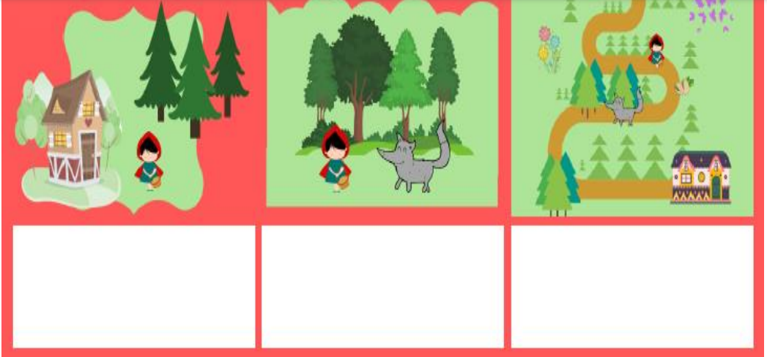
There was a girl called Little Red Riding Hood who lived on a farm in the woods.

Slide 8
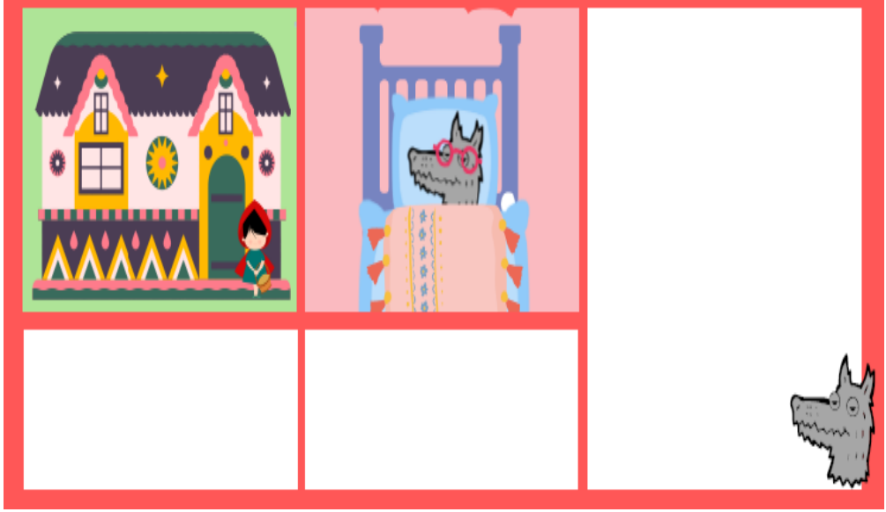

Slide 9

Red group – you need to look out for set 1 videos on the link below:
https://www.youtube.com/channel/UCo7fbLgY2oA_cFCIg9GdxtQ
We would like you to watch 3 videos: set 1 speed sounds, set 1 word time and set 1 spellings please.
Green group you need to look out for set 2 videos on the link below:
https://www.youtube.com/channel/UCo7fbLgY2oA_cFCIg9GdxtQ
We would like you to watch 4 videos: set 2 speed sounds, set 2 spelling, red words 1, and read and hold a sentence 1
Pink, yellow and blue groups you need to look out for set 3 videos on the link below.
https://www.youtube.com/channel/UCo7fbLgY2oA_cFCIg9GdxtQ
We would like you to watch 4 videos: set 3 speed sounds, set 3 spelling, red words 2 and read and hold a sentence 2

Slide 10

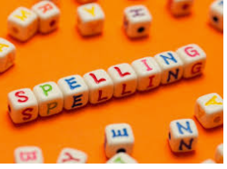



Words of the day!
what was want
Can you write the word what 5 times stocking your tongue out?
Can you write the word was 5 times as small as you can?
Can you write the word want 5 times as tall as you can?

