Slide 1





Monday 11th January 2021
Writing

Slide 2

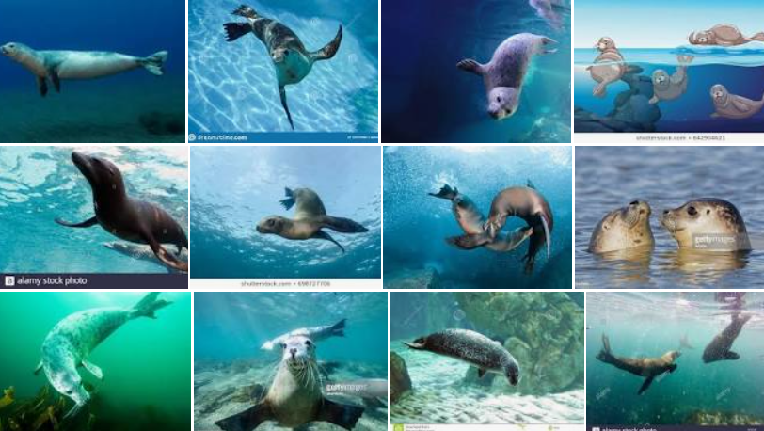
Time to make an information poster Robins about
SEALS!
This may help you. https://www.youtube.com/watch?v=uiSN_fORzyg

Slide 3




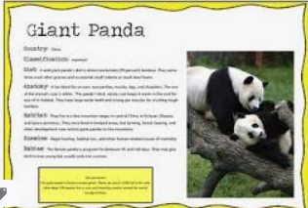
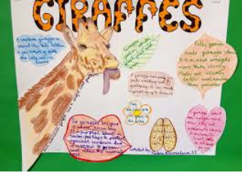
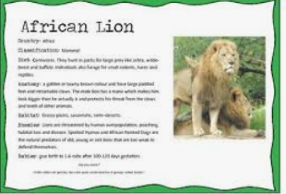

Slide 4
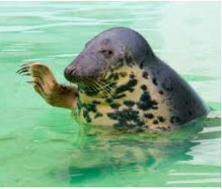
Points to include:
Tell me all about seals. We already know quite a lot about how they move and what they like to do from our writing lessons based on Seal Surfer.
Think carefully about the sections on your poster. What information do you need to include?
Refer back to the sections from our non chronological report from Friday to help you.
(Appearance, Special Features, Habitat, Diet)
How are you going to set your poster out?
How are you going to make your writing interesting to read?
This is a poster, not a huge piece of writing, so just include the most important information eg skilled swimmers, deep divers…
Have fun with this making it look attractive to the reader. A poster’s job is to grab the reader’s attention.

