Slide 1
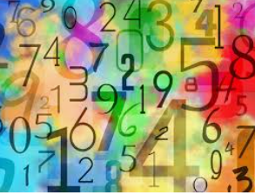
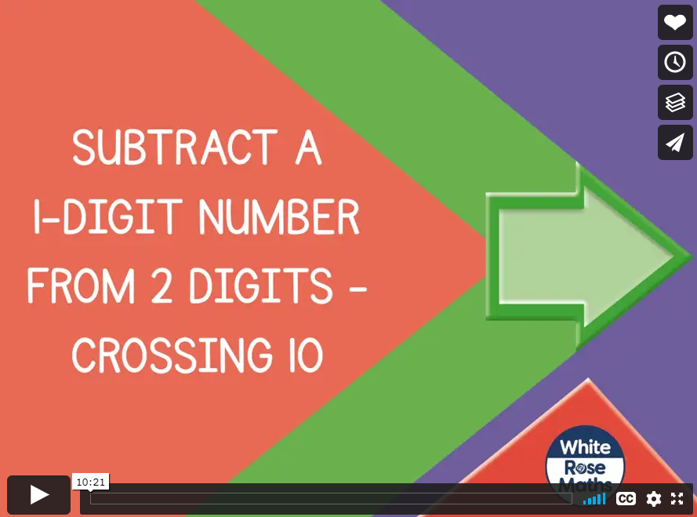

Monday 11th January 2021
Today, let’s recap how to subtract a single digit number from a two digit number crossing the tens boundary.
If the number that we are subtracting, is bigger than the number of ones in the first number, we have to exchange a ten for ten ones.
1
2
https://vimeo.com/461351304
Click here to watch the video lesson

Slide 2

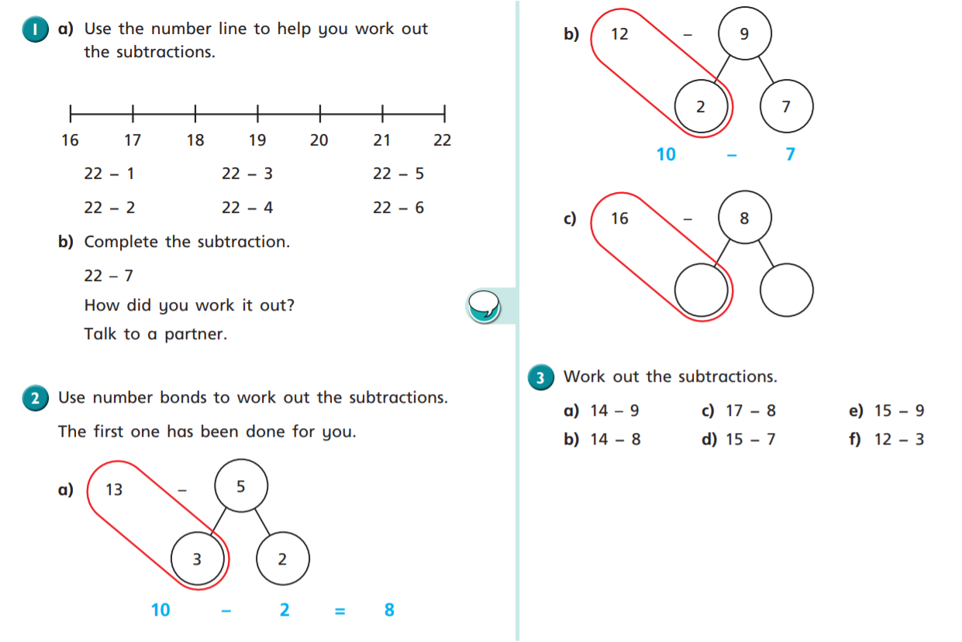

Slide 3
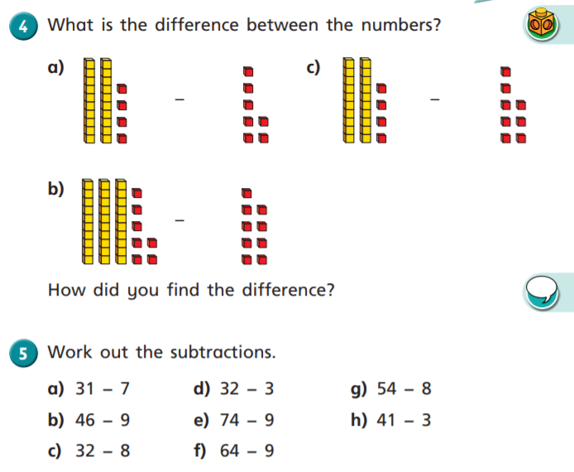

Slide 4
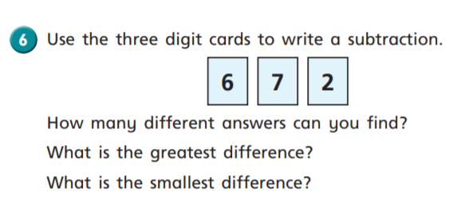
Challenge Time

Slide 5
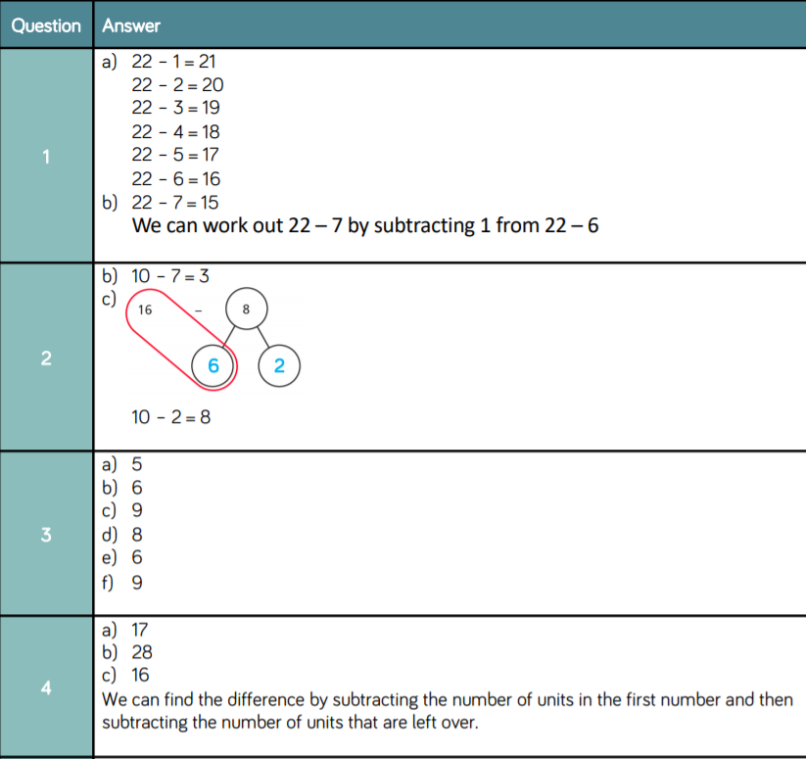
Here are the answers for you to check your work.

Slide 6
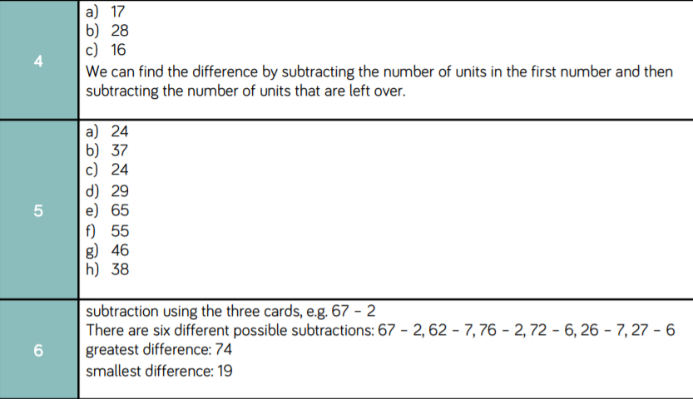
Here are the answers for you to check your work.

