Slide 1


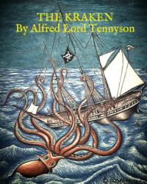


English
DATE
The Kraken
by Alfred Lord Tennyson

Slide 2

Practice reading the poem below. You can click here too to listen to me it reading it you!
The Kraken
Below the thunders of the upper deep,
Far, far beneath in the abysmal sea,
His ancient, dreamless, uninvaded sleep
The Kraken sleepeth: faintest sunlights flee
About his shadowy sides; above him swell
Huge sponges of millennial growth and height;
And far away into the sickly light,
From many a wondrous grot and secret cell
Unnumbered and enormous polypi
Winnow with giant arms the slumbering green.
There hath he lain for ages, and will lie
Battening upon huge sea worms in his sleep,
Until the latter fire shall heat the deep;
Then once by man and angels to be seen,
In roaring he shall rise and on the surface die.
by Alfred Lord Tennyson

Slide 3
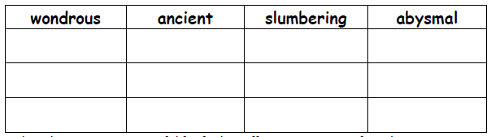
Activity 1
Find synonyms (words that have similar meanings) for the following and write in the table below:
Online thesauri are very useful for finding effective synonyms if you have access to an iPad or PC.
This online thesaurus is great: https://www.thesaurus.com/

Slide 4
Activity 2
Look at how the poet uses lots of prepositional phrases in the poem.
Try to spot and highlight them all e.g. beneath in the abysmal sea, on the surface.
Here is a link to BBC Bitesize which explains what a preposition is:
https://www.bbc.co.uk/bitesize/topics/zwwp8mn/articles/zw38srd
A prepositional phrase is the same except instead of it only being one word it is a group of words.
Definitions
A preposition is a word that tells you where or when something is in relation to something else.
A prepositional phrase is a group of words that tells you where or when something is in relation to something else.

Slide 5
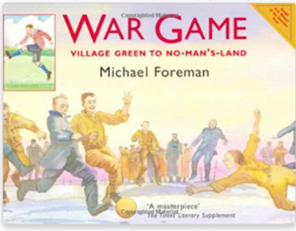
War Game by Michael Foreman
Mrs Whittingham is going to begin reading this beautiful book to you this week.

