Slide 1


Owls class home learning
Monday 11th January
Handwriting practise

Slide 2
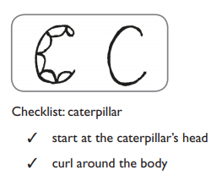

Slide 3
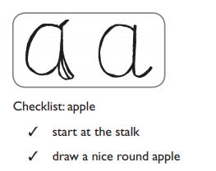

Slide 4
