Slide 1


Owls RE Home Learning
Monday 11th January

Slide 2
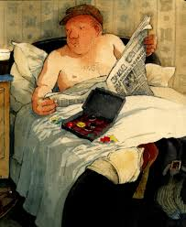

Slide 3

Jesus
King
Kingdom of God

Slide 4


Slide 5
A king is
Strict
Busy
Important

Slide 6
