Slide 1

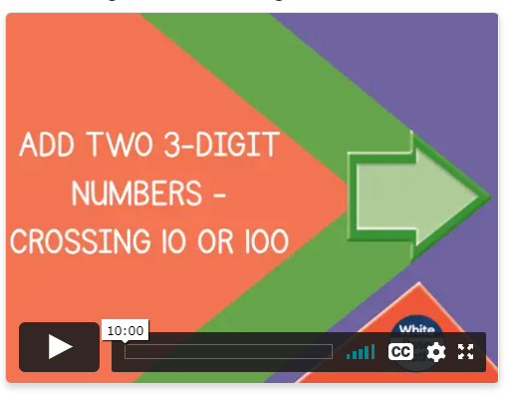
Monday 11th January
Challenge yourself with TTRock stars today. How many coins can you collect?
Can I add 2 3-digit numbers crossing the 10 or 100 boundary?
https://whiterosemaths.com/homelearning/year-4/week-5/

Slide 2
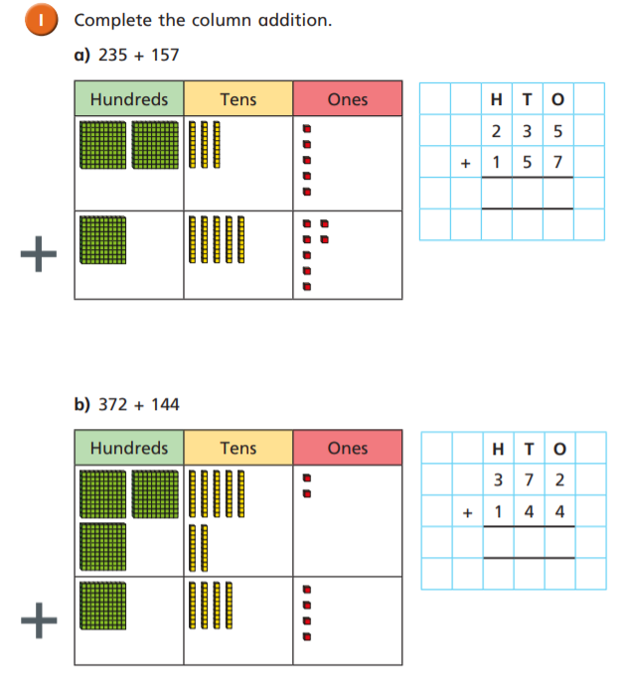
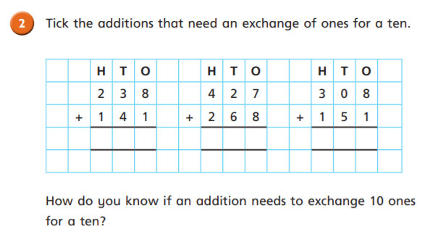

Slide 3
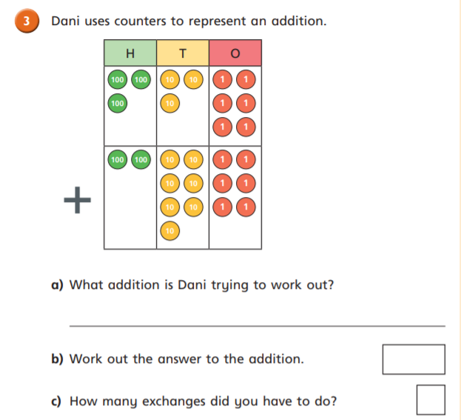
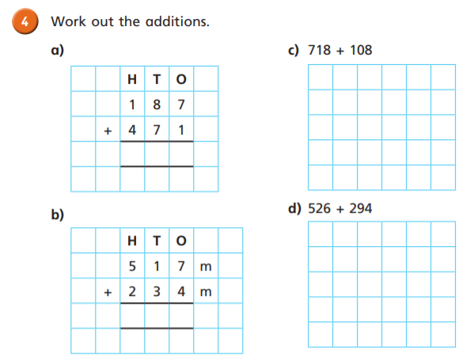

Slide 4
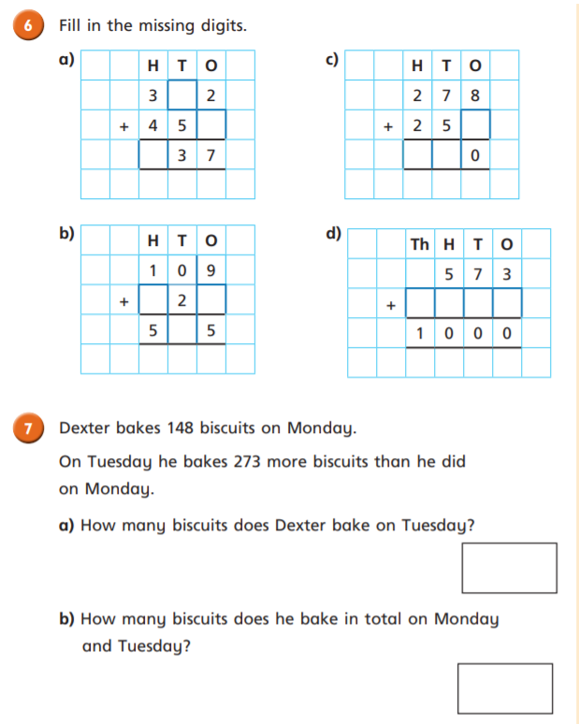
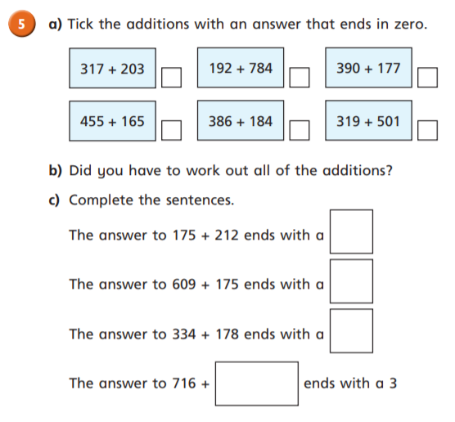
Challenge

Slide 5
