Slide 1

Islam

Slide 2
Idea of community
What does the word community mean?
Which communities are you a part of?
What do you do/wear to show that you are part of this community?
We are all part of Lostock School community. How do we show this?
TASK: Draw a picture of yourself in your school uniform.

Slide 3
People who are followers of the religion Islam are called Muslims.
They believe there is one God, called Allah who created everything and is all powerful.
Where do Muslims go to worship?

Slide 4
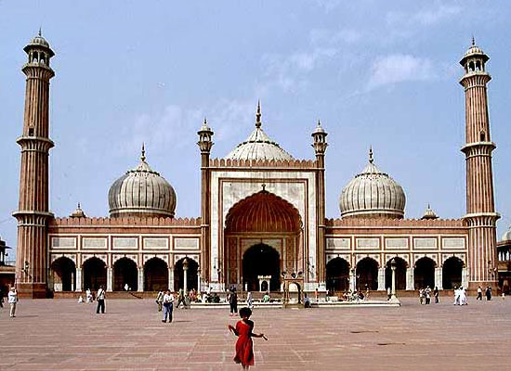
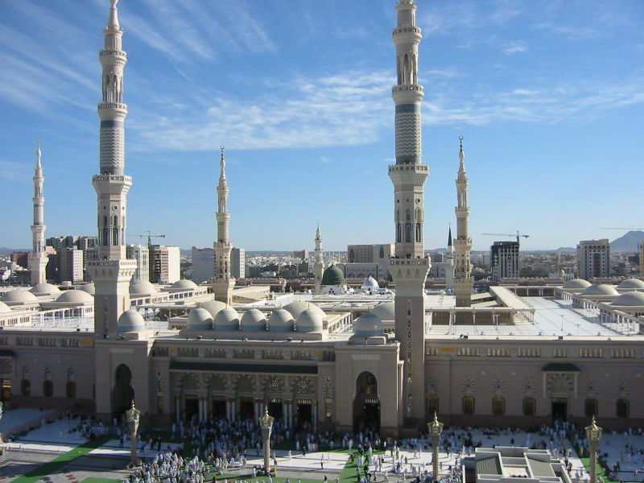
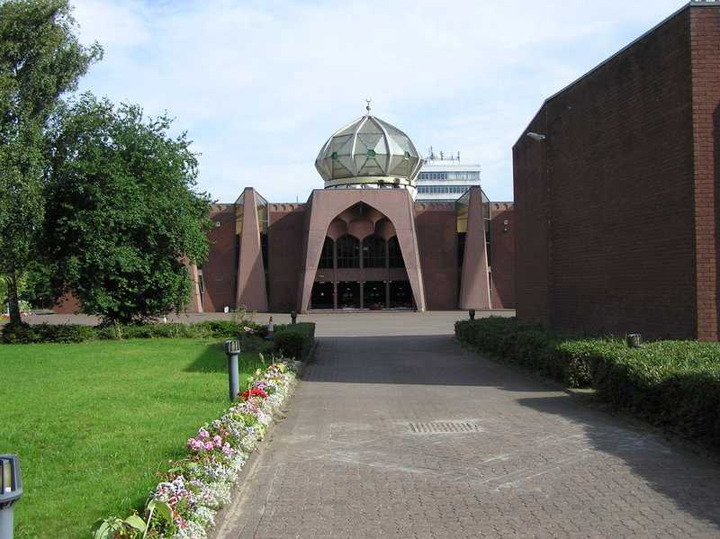
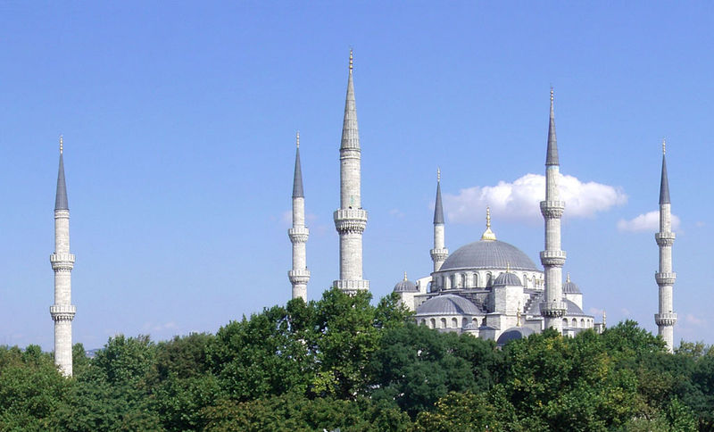

Slide 5
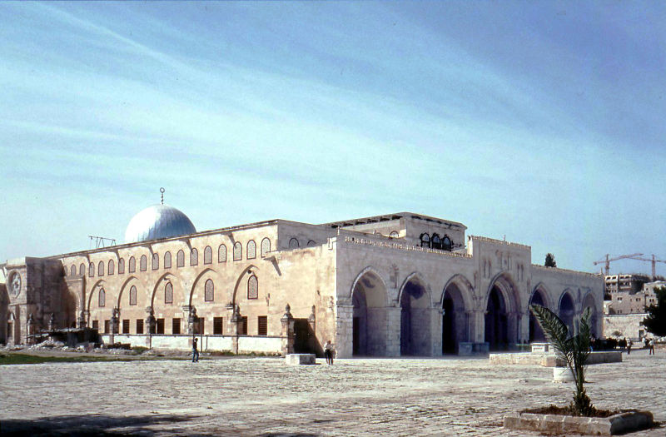
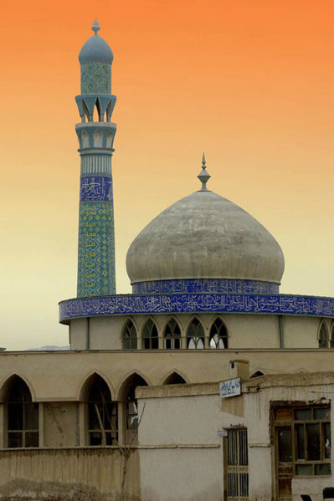
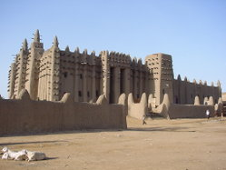

Slide 6
What happens in a Mosque?

Slide 7
Mosque
Watch this video clip and note down what goes on in a mosque. Also what aspects of the mosque show community?
https://www.bbc.co.uk/teach/class-clips-video/the-mosque/zmctvk7

Slide 8
Community in a Mosque
Read through the statements about what happens in a mosque on the next slide
Choose 5 that you think best show the idea of community and write them down

Slide 9
Mosques are a place to worship Allah & proclaim their faith.
Mosques help people make friends.
Mosques call people to prayer 5 times a day.
Mosques are used for weddings, funeral and community events.
All people pray communally together in a mosque. (Salah)
Mosques encourage Muslims in their faith.
One mosque is part of a bigger community made up by many mosques.
Mosques are schools of learning.
Mosques show people have a sense of belonging and identity with Islam.

Slide 10
Next week
We will look at how prayer brings Muslims together.

