Slide 1


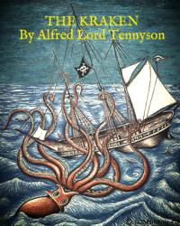


English
DATE
The Kraken
by Alfred Lord Tennyson

Slide 2

Practice reading the poem below. You can click here too to listen to me it reading it you!
The Kraken
Below the thunders of the upper deep,
Far, far beneath in the abysmal sea,
His ancient, dreamless, uninvaded sleep
The Kraken sleepeth: faintest sunlights flee
About his shadowy sides; above him swell
Huge sponges of millennial growth and height;
And far away into the sickly light,
From many a wondrous grot and secret cell
Unnumbered and enormous polypi
Winnow with giant arms the slumbering green.
There hath he lain for ages, and will lie
Battening upon huge sea worms in his sleep,
Until the latter fire shall heat the deep;
Then once by man and angels to be seen,
In roaring he shall rise and on the surface die.
by Alfred Lord Tennyson

Slide 3
Activity 1
Mark your work from yesterday! Listen to me below talking through the answers to the questions.
Where does the Kraken sleep? the abysmal sea
How does he sleep if it is ‘uninvaded’? not interrupted
Can you find examples of archaic (older) language? e.g. sleepeth, hath, lain
How can you tell this sea monster has laid below the sea for a long time? Which words are used?
There hath he lain for ages, and will lie
5. What happens to the Kraken on the surface of the water? he dies
6. Name 5 adjectives used in the poem. abysmal, ancient, dreamless, uninvaded, shadowy, huge etc.
7. Which are your favourite descriptions from the poem? Why do you like them?
Share your opinions of the descriptions from the poem.

Slide 4
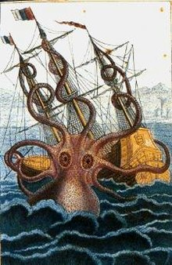
Activity 2
A kraken is a mythical sea monster. They come from Scandinavian/Norse myths. Krakens are rumoured to live off the coast of Norway.
Draw what you think this sea monster looks like – use some of the words from the poem.
Draw its setting deep below the ocean – what would it look like?
Label your pictures with some words from the text.
Again please share some photos of your pictures on our class discussion!
Activity 3
Words cost 10p. You can spend 50p. Which words would you buy? Write a sentence to describe the sea monster using your words.
Include this sentence on your drawing if you’d like and then share photos of your pictures and writing with us all on our class discussion! ☺

Slide 5
The Click of the Garden Gate by May Hill
As you listen to this war poem read by Mrs Whittingham think about how the parents felt during the war waiting for their son or daughter to return home.

