Slide 1
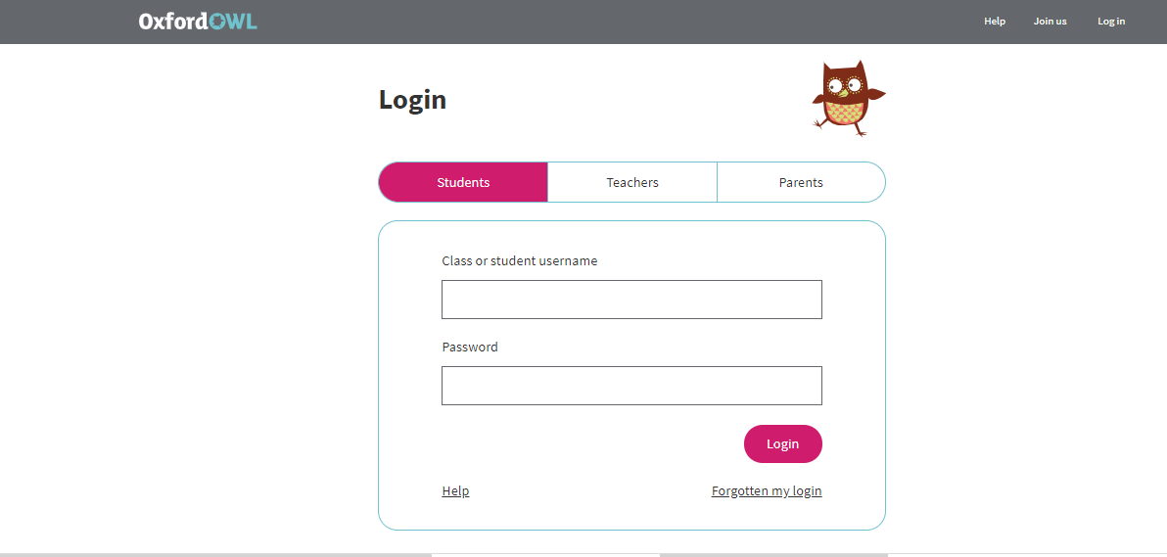
Click on the login tab and you will be directed to this page.
You need to have students login section selected
Username: starlings1
Password: Home

Slide 2

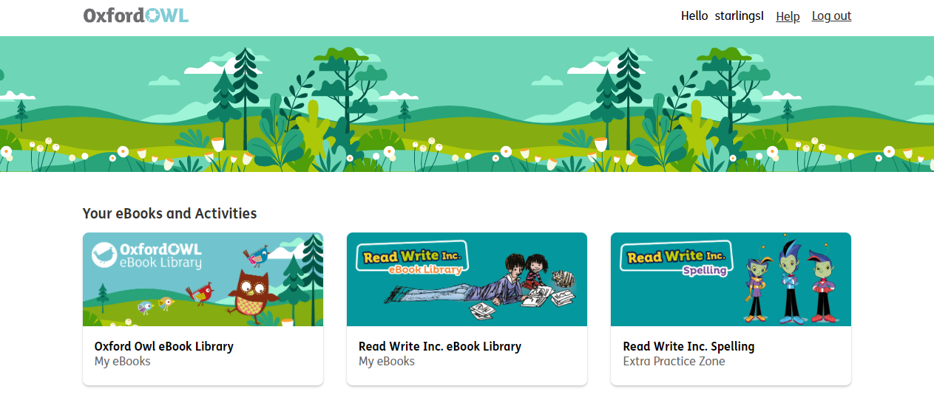

Slide 3
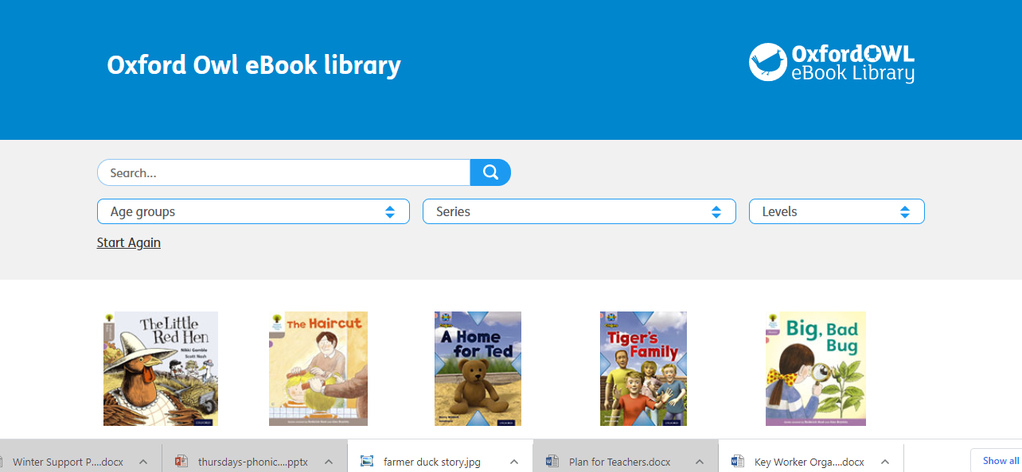
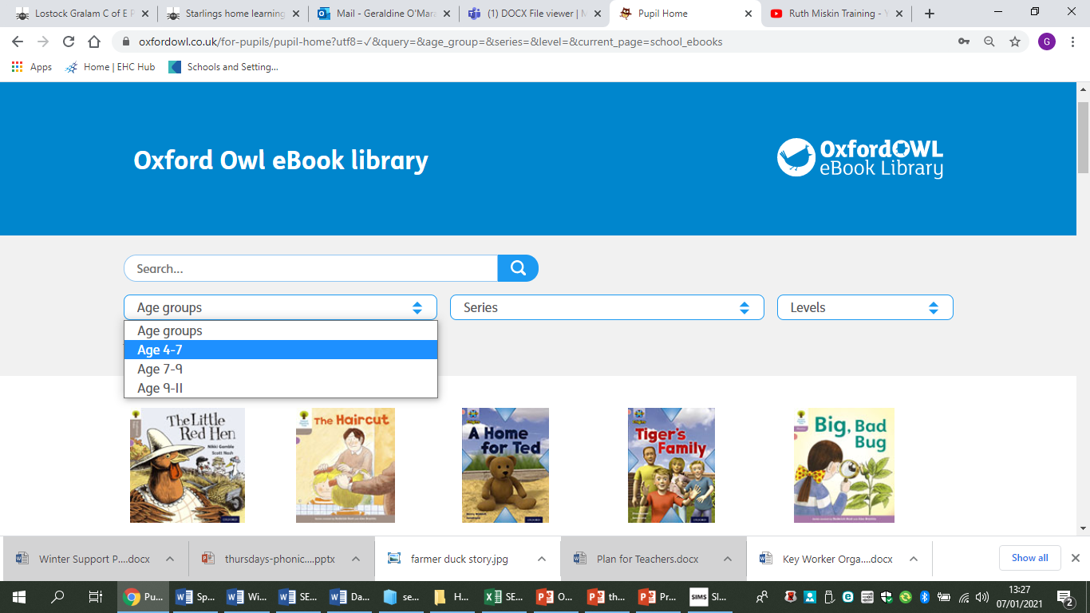

Slide 4
