Slide 1







Maths
Year Two Swallows
Friday 8th January 2021

Slide 2
4 A Day
70 + 14 = | 29 – 29 =
9 x 2 = | 60 ÷ 10 =

Slide 3
Answers
70 + 14 = 74 | 29 – 29 = 0
9 x 2 = 18 | 60 ÷ 10 = 6

Slide 4
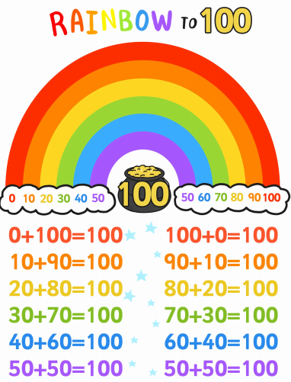
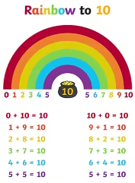
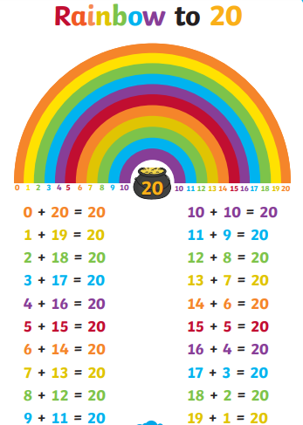
Number Bonds

Slide 5
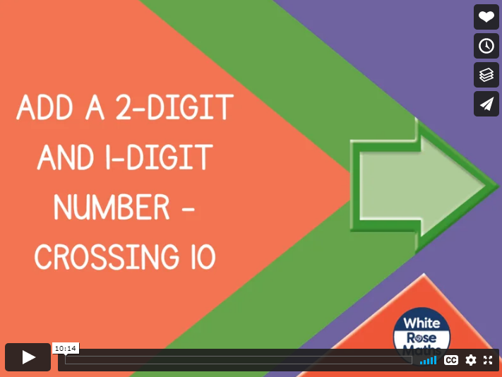
https://vimeo.com/465863014
Knkkkkkkkkkkkkkk kkVideo

Slide 6
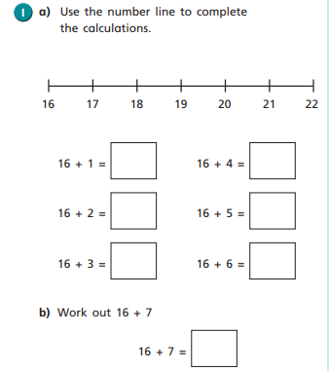
Your Turn

Slide 7
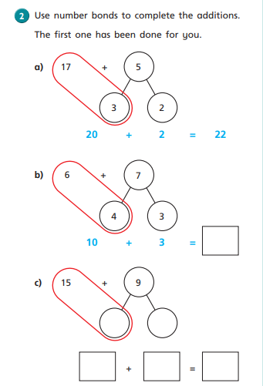
Your Turn

Slide 8
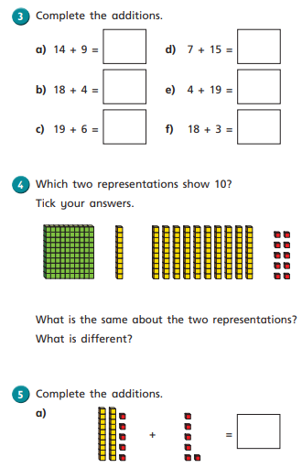
Your Turn

Slide 9
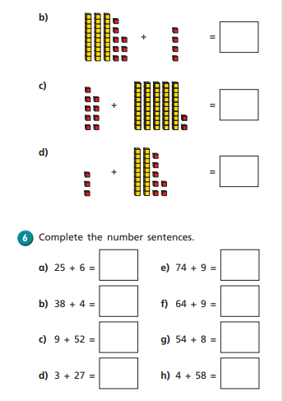
Your Turn

Slide 10
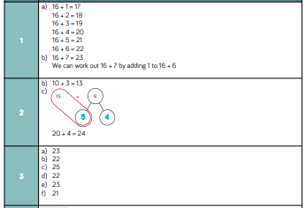
Answers

Slide 11
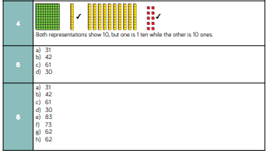
Answers

Slide 12
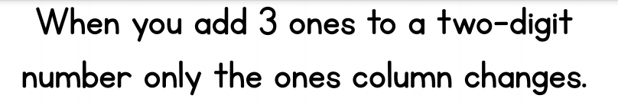
Challenge
True or False?

Slide 13
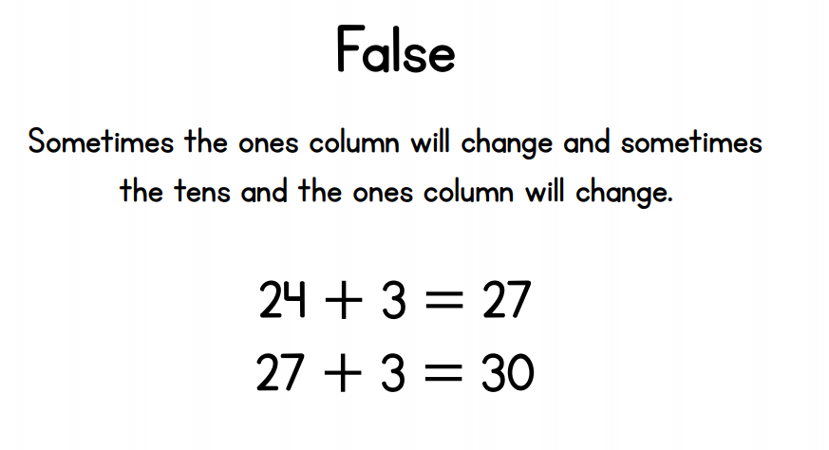
Challenge
True or False?

