Slide 1



English
Year 2 Swallows Class
Friday 8th January 2021

Slide 2
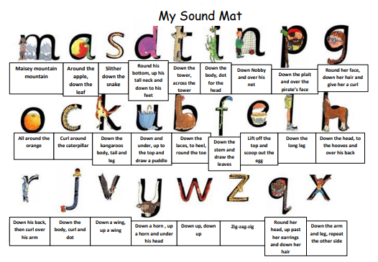

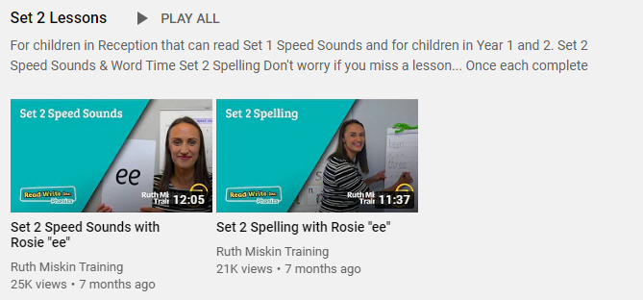
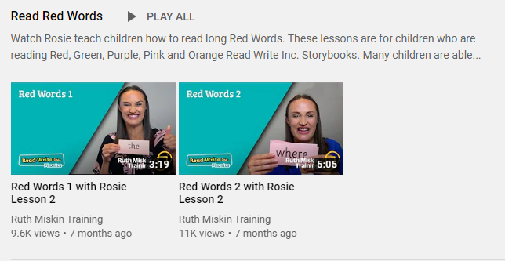
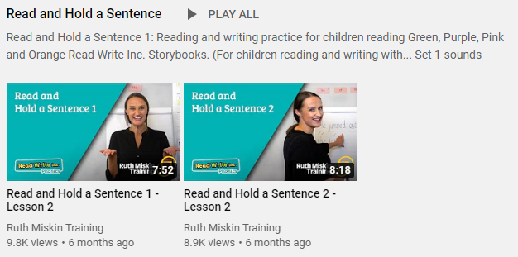
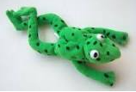
Read Write Inc
Set 2
If you are currently reading green books, please follow the link below to your Read Write Inc lesson today. Each day you will need to click on the video’s shown in the screen shots below. Please remember that although the screen shot says /ee/, the sound will change each day but will be found in the same place. https://www.youtube.com/channel/UCo7fbLgY2oA_cFCIg9GdxtQ
Video 1: Please watch ‘Set 2 Speed sound’ lesson.
Video 2: Please watch ‘Set 2 Spelling’ lesson.
Please complete all 4 video’s each day ☺
Video 3: Please watch ‘Red words 1’ lesson only.
Video 4: Please watch ‘Read and Hold a sentence 1’

Slide 3
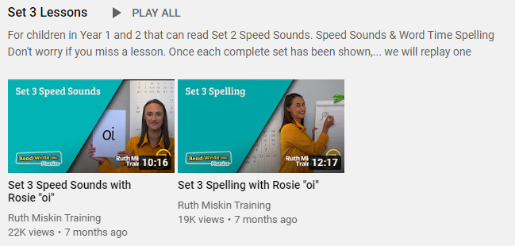
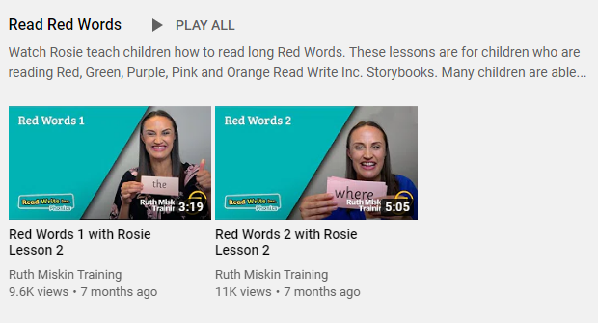
Set 3
If you are currently reading pink, orange, yellow, blue or grey books, please follow the links below to your Speed Sound lesson, red word focus lesson and hold a sentence activity for today. Each day you will need to click on the video’s shown in the screen shots below. Please remember that although the screen shot says /ee/, the sound will change each day but will be found in the same place. https://www.youtube.com/channel/UCo7fbLgY2oA_cFCIg9GdxtQ
Video 1: Please watch ‘Set 3 Speed sound’ lesson.
Video 2: Please watch ‘Set 3 Spelling’ lesson.
Video 3: Please watch ‘Red words 2’ lesson only.
Video 4: Please watch ‘Read and Hold a sentence 2’

Slide 4
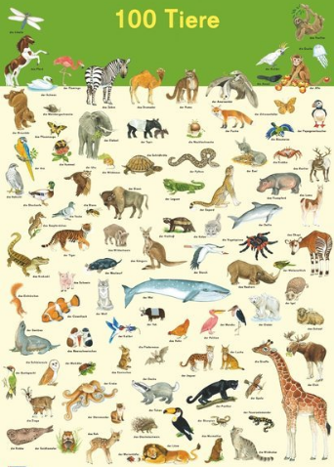
Writing
Can I describe my favourite animal?
Can I create a fact file?
Animals
What is your
favourite animal?
Can you remember what my favourite animal is?

Slide 5
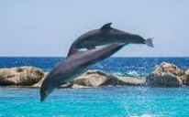
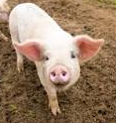
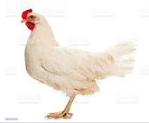
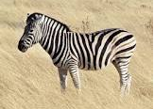
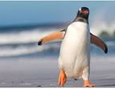

Task
Are you a big fan of pandas or pigs, dolphins or dogs?
Choose your favourite animal to create a fact file about. Do some research in any books you have at home or ask an adult to help you look online. Make some notes about your chosen creature and then write them into sentences.
Write a fact file (information text) about your animal.
Think about:
• What it looks like
• What it eats
• Where it lives – which country and what its habitat is like
• What does it do, how does it move

Slide 6

Research
https://www.sciencekids.co.nz/sciencefacts/animals.html
https://www.sciencekids.co.nz/sciencefacts/animals.html
https://animalfactguide.com/animal-facts/
What does your animal look like?
What does it eat?
Where does it live?
What does it do?

Slide 7

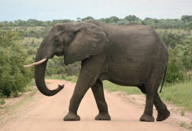
Elephants
Appearance
Elephants are the largest land mammals in the world. There are three types of elephant: African savannah elephants, African forest elephants and Asian elephants. Elephants have trunks, which they use for smelling, breathing, making sounds, squirting water and picking things up. The ears of an African elephant are much larger than those of an Asian Elephant. Both male and female African elephants grow tusks, but only male Asian elephants can.
Diet
Elephants are herbivores and eat grass, leaves, roots, flowers, fruits and bark, They need so much food that they can spend most of their day eating.
Habitat
Write about where your animal lives.
Fun Facts
Write about what your animal does.

Slide 8
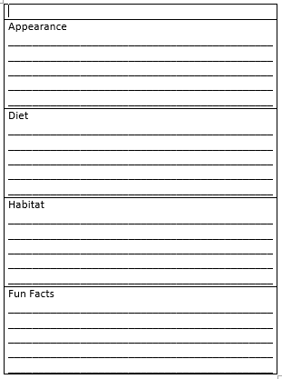
Animal
Appearance (what it looks like)
Diet (What it eats)
Habitat (Where it lives)
Fun Facts (What it does)
See Blog

Slide 9

Mastery Keys
Plan or say out loud what is going to be written about
• Use punctuation correctly – full stops, capital letters
• Write expanded noun phrases to describe and specify
• Use subordination (because) and coordination (and)

Slide 10




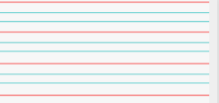
Can you re-read what you have written to check that it makes sense?
Headings Subheadings
Joined handwriting

Slide 11


I wonder what will happen in our story today?
Where did Alice and Jago keep the toads?
How many toads did they catch?
What did the chief toad ask Alice and Jago to stop doing?

Slide 12

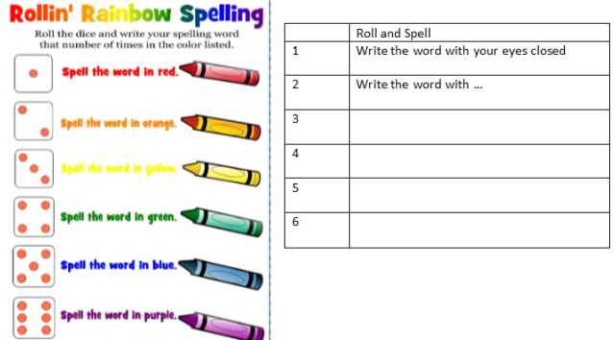
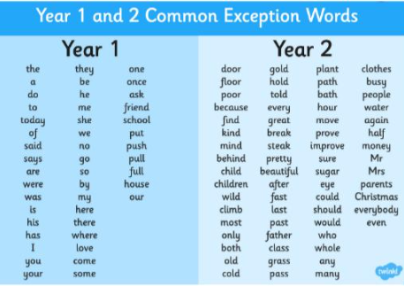
Spellings
Can you read and spell the words below?
fast last past father
quiz

