Slide 1
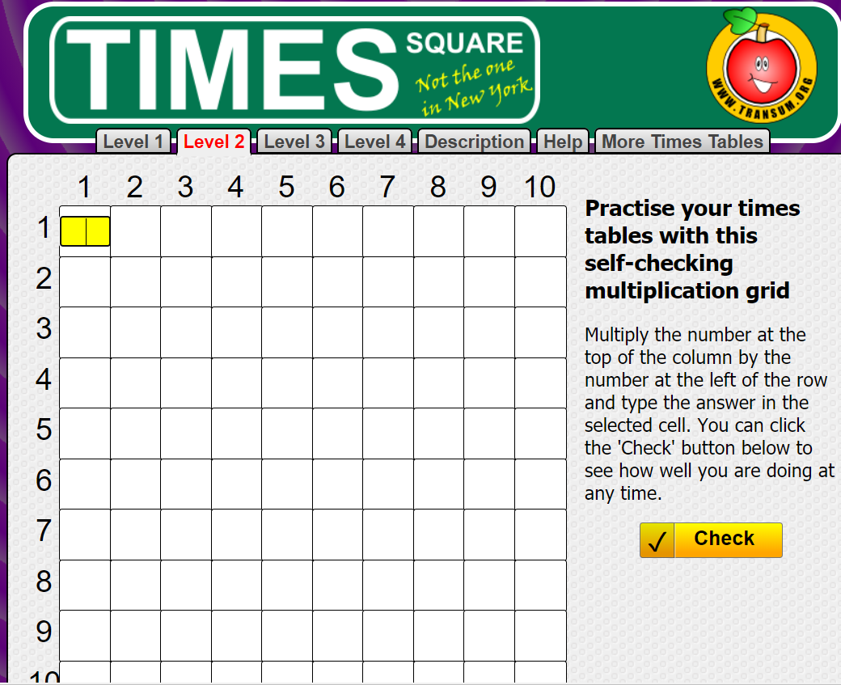

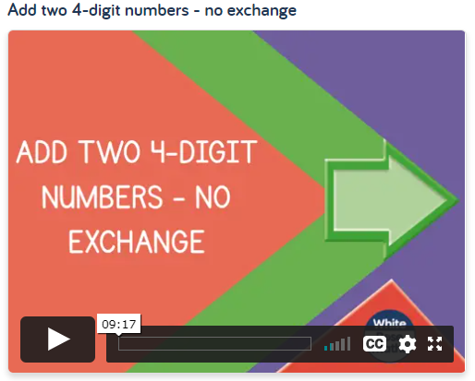
Friday 8th January
A times table challenge to warm up with today: Level 2
https://www.transum.org/Tables/Square.asp
Can I add two 4-digit numbers- no exchange?
https://whiterosemaths.com/homelearning/year-4/week-5/

Slide 2
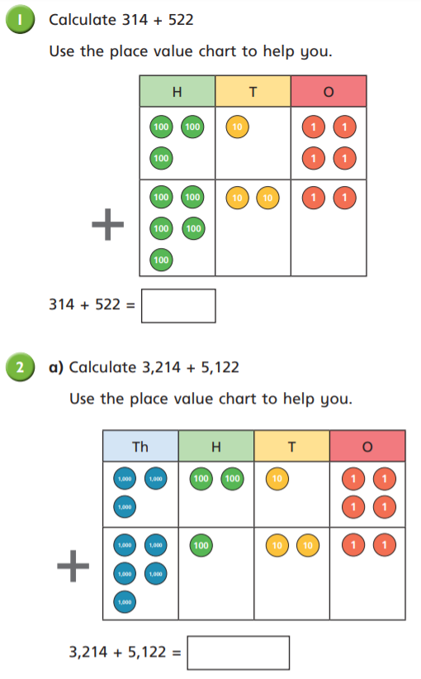
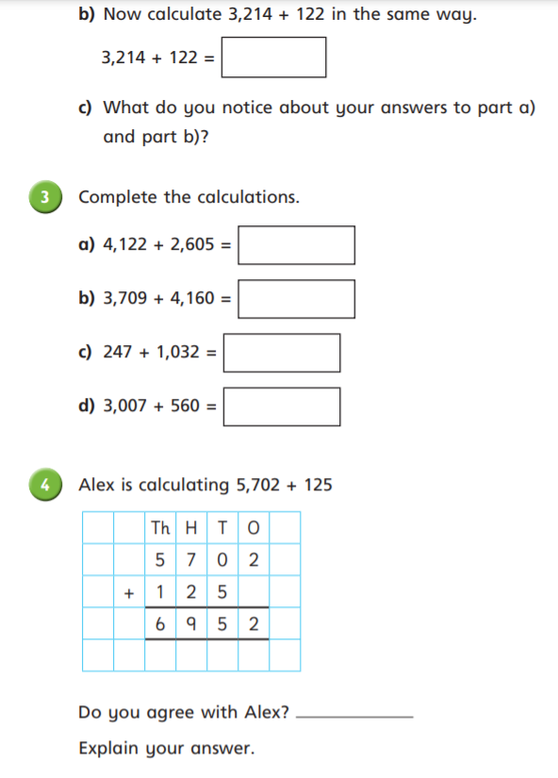

Slide 3
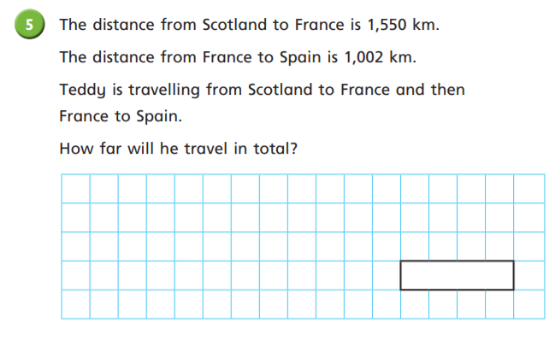
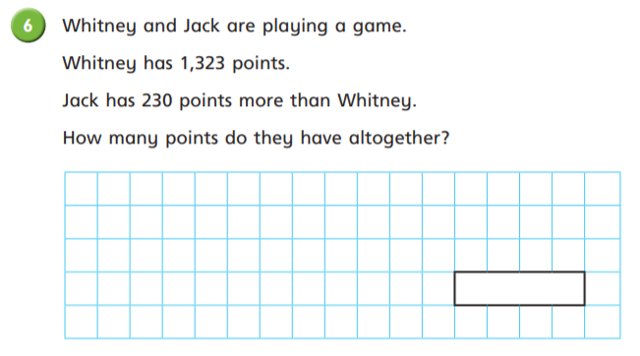

Slide 4
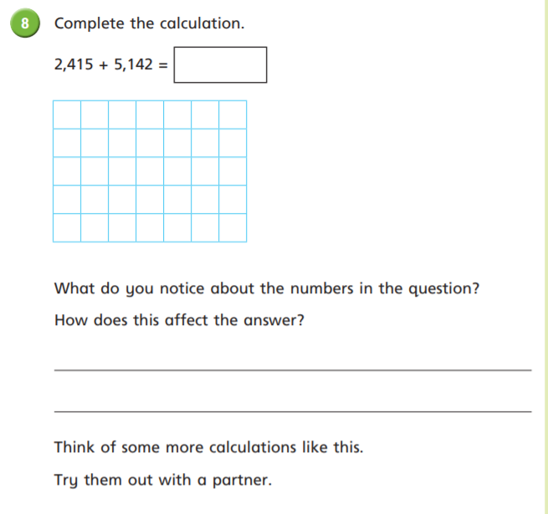
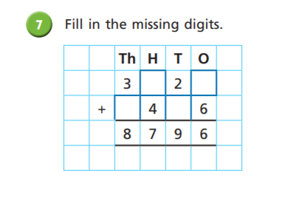
Challenge

Slide 5
