Slide 1






English
Friday 8th January 2021

Slide 2
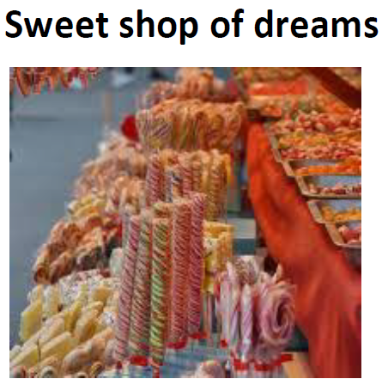
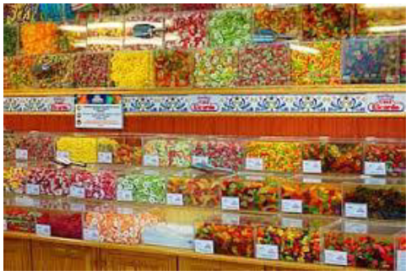
Imagine you have visited the most wonderful sweet and chocolate shop in the world.
How did you feel on the approach to the shop?
What sights did you see? What could you smell? What have you bought? How did you feel when you were in the shop? Did something happen while you were inside?

Slide 3


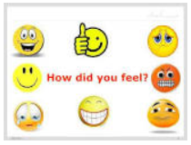
I could see…
I could smell…
Clouds of sweetness from all around.
Wafts of sharp citrus from the lemon sherbets.
The tang of liquorice.
A rainbow of colour from floor to ceiling.
Every shape I could imagine from large round lollipops to soft twisty marshmallows.
?
What happened while you were inside the shop?
I was allowed to taste some new luxurious chocolate.
I bought some delicious Mallow Pops for my children.
The shopkeeper accidentally dropped a whole pot of sherbet which wafted into the air in a giant cloud of sweetness.
I felt…
Mesmerised by the riot of colour facing me.
I sighed in happiness as the clouds of sweetness surrounded me.
Excited about the vast choice of delightful treats in front of me.

Slide 4
Dear Diary,
Earlier today I discovered the most amazing new sweet shop had opened in the village so I decided to investigate. When I arrived, there was the longest queue outside and I had to be very patient even though I was so keen to go in.
When it was finally my turn to enter, I stepped into a rainbow of colour from floor to ceiling whilst the sharp tang of citrus from the sherbet lemons hit my nose. Every where I looked, there were sweets of every shape I could imagine from large round lollipops to soft twisty marshmallows.
The shopkeeper was an ancient looking man who reminded me of a wise old wizard. He smiled the friendliest smile and asked if I wanted to sample any of the delicious looking goodies on display. Oh diary, I couldn’t believe my luck! It was difficult to decide which tempting treat to choose first. Eventually, I chose a piece of luxurious chocolate which melted in my mouth as I ate it.
Then a funny thing happened. As the shopkeeper reached up to collect four Mallow Pops for me to give to my children later, he accidentally knocked over a whole jar of sherbet which exploded in the air in a cloud of the tangiest sweetness. We both laughed and enjoyed the taste as it landed on out tongues.
What a great day diary! I’ll definitely be visiting my new favourite shop again.

