Slide 1


Friday 8th January
Writing

Slide 2
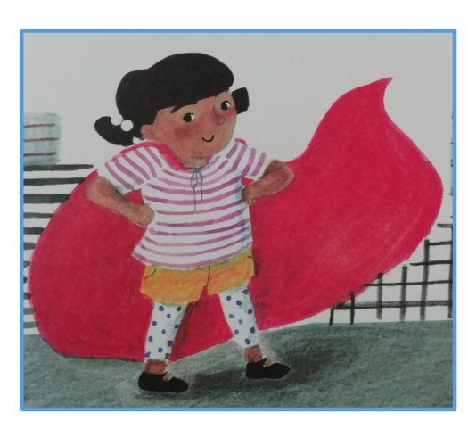
brave
smart
strong
fast
sneaky
loves ice-cream
can fly

Slide 3
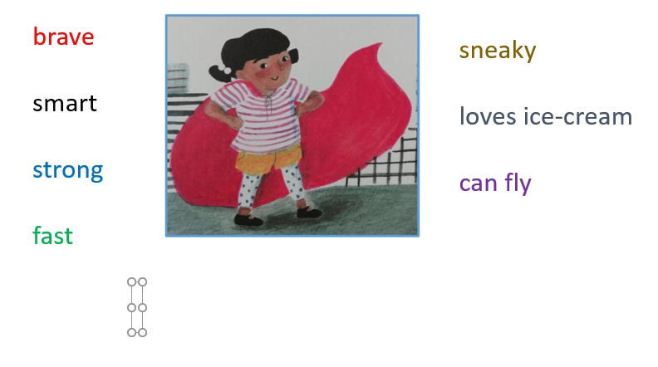

Slide 4
Now it is your turn to describe Juniper Jupiter.

