Slide 1
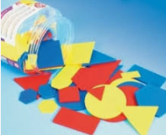

Friday 8th January
Maths

Slide 2
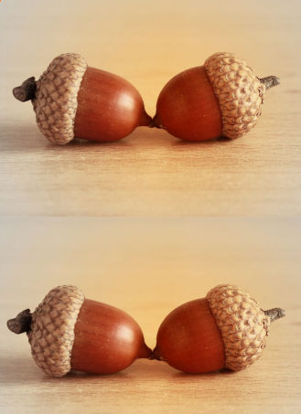

Slide 3


Slide 4
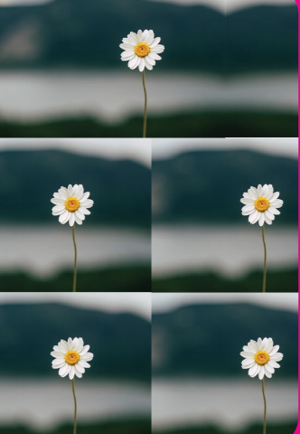

Slide 5
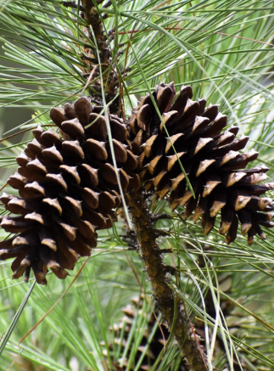

Slide 6
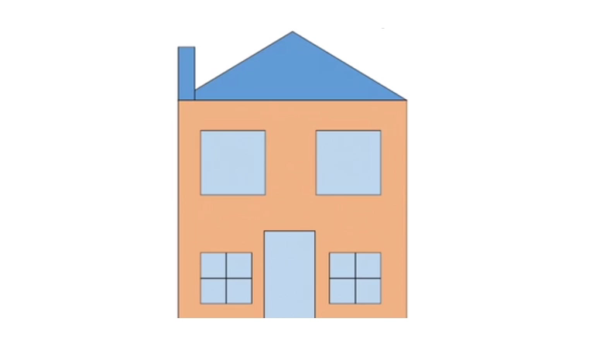

Slide 7
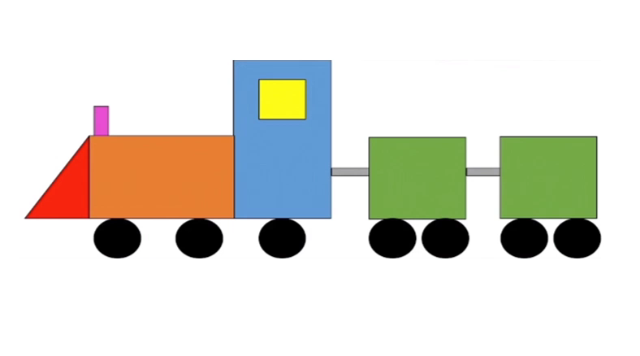

Slide 8
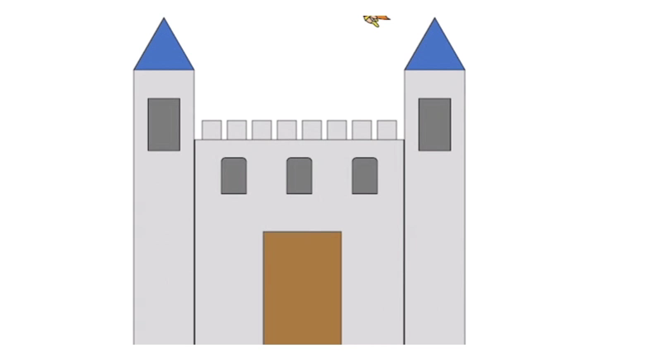

Slide 9
Now it’s your turn to draw your own shape picture.
Remember to talk about the different shapes you are using and describe them.

