Slide 1


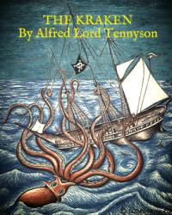


English
DATE
The Kraken
by Alfred Lord Tennyson

Slide 2

Practice reading the poem below. You can click here too to listen to me it reading it you!
The Kraken
Below the thunders of the upper deep,
Far, far beneath in the abysmal sea,
His ancient, dreamless, uninvaded sleep
The Kraken sleepeth: faintest sunlights flee
About his shadowy sides; above him swell
Huge sponges of millennial growth and height;
And far away into the sickly light,
From many a wondrous grot and secret cell
Unnumbered and enormous polypi
Winnow with giant arms the slumbering green.
There hath he lain for ages, and will lie
Battening upon huge sea worms in his sleep,
Until the latter fire shall heat the deep;
Then once by man and angels to be seen,
In roaring he shall rise and on the surface die.
by Alfred Lord Tennyson

Slide 3
Activity
Listen to and re-read the poem The Kraken.
Have a go at answering the following questions. I will share the answers with you during tomorrow’s lesson!
Where does the Kraken sleep?
How does he sleep if it is ‘uninvaded’?
Can you find examples of archaic (older) language?
How can you tell this sea monster has laid below the sea for a long time? Which words are used?
What happens to the Kraken on the surface of the water?
Name 5 adjectives used in the poem.
Which are your favourite descriptions from the poem? Why do you like them?

Slide 4
Rocco San Giovanni by George Fraser Gallie
As you listen to this war poem today read by Mrs Whittingham reflect on the landscape and how it changes because of the war

