Slide 1


Mathematics
Date: 07.01.21
Lesson 2
Factors

Slide 2
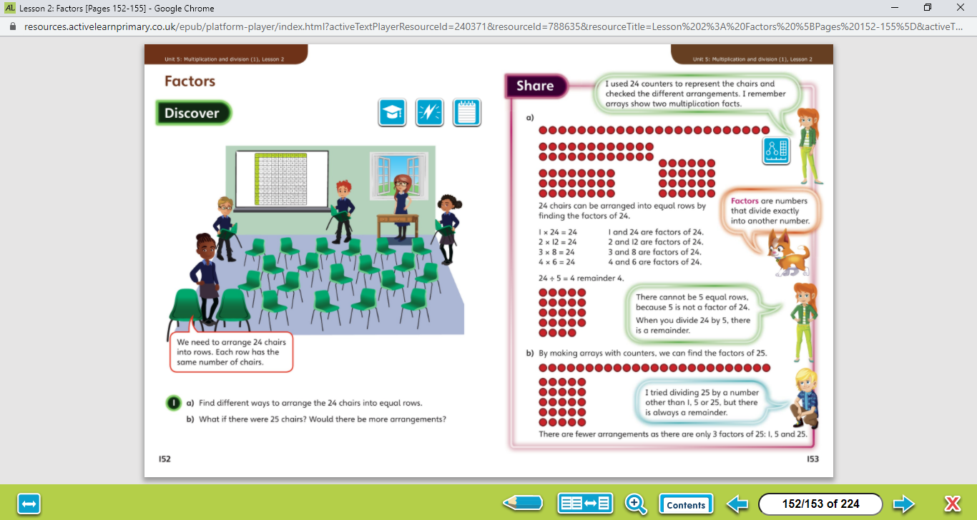

Let’s work together!
Look at the picture clue. What can you see?
Have a look at the questions.
Click on the sound button below to hear the questions read to you. We will also talk through the questions together like we do in school.
We will go through the possible methods and answers on the next slide.

Slide 3
Click on the sound button below to hear the answers and possible methods for question A.
Click on the sound button below to hear the answers and possible methods for question B.

Slide 4
Factors of 12:
1 x 12 = 12
2 x 6 = 12
3 x 4 = 12
So, the factors of 12 are 1, 12, 2, 6, 3 and 4
Let’s work together!
Click on the sound button below to hear the question read to you. We will work together to reach the answer.
What are the factors of 18?

Slide 5
Factors of 12:
1 x 12 = 12
2 x 6 = 12
3 x 4 = 12
So, the factors of 12 are 1, 12, 2, 6, 3 and 4
Let’s work together!
What are the factors of 18?
Click on the sound button below
1 x 18 = 18
2 x 9 = 18
3 x 6 = 18
So, the factors of 18 are 1, 18, 2, 9, 3 and 6

Slide 6
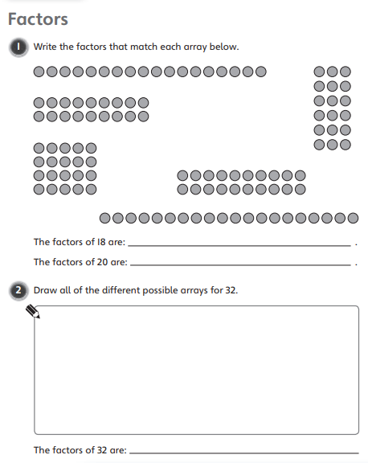
Your Turn…
Have a go at these questions independently. Click on the button below if you would like the questions read to you.
Click on the sound button below to hear the answers.

Slide 7
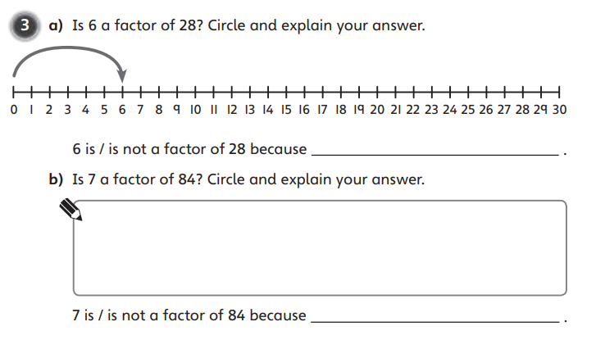
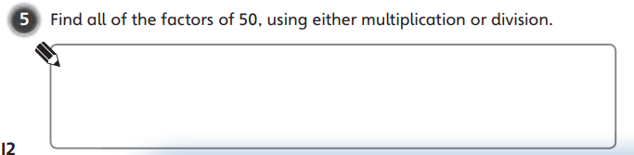
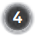
Have a go at these questions independently. Click on the sound button if you would like the questions read to you.
Your Turn…
Click on the sound button to hear the answers.

Slide 8
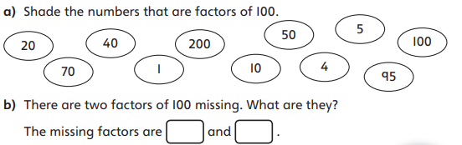
Challenge Time!
Only try this question if you are feeling confident ☺
Your Turn…
Click on the button below if you would like the question read to you.
Click on the button below to hear the answer.

