Slide 1
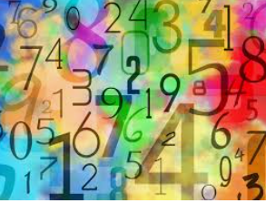

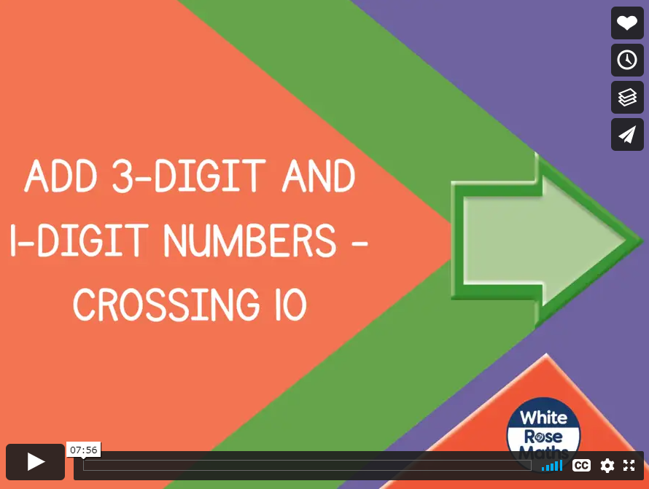
Friday 8th January 2021
Today, let’s add a three digit number plus a single digit number that makes us cross the tens boundary.
When the ones total more than 10, exchange ten ones for one ten to make it easier to add. We have done this in class with our place value counters. You know how to draw these calculations out on paper.
Click here to watch the video lesson
https://vimeo.com/459365558

Slide 2
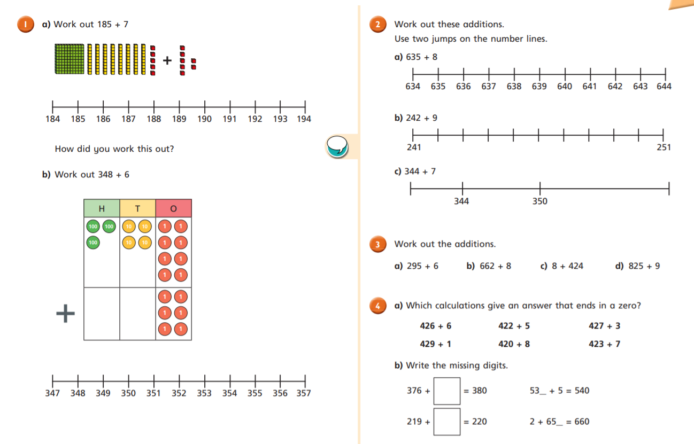

Slide 3
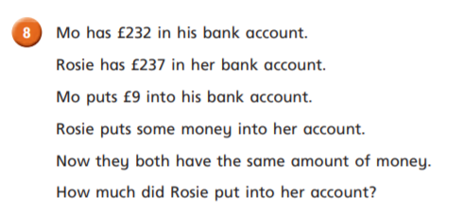
                Challenge Time

Slide 4
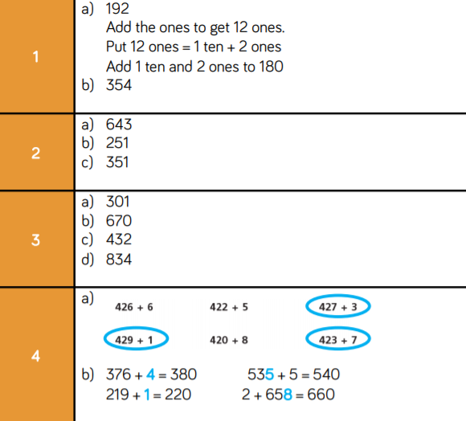

Here are the answers!

