Slide 1





Friday 8th January 2021
Writing

Slide 2
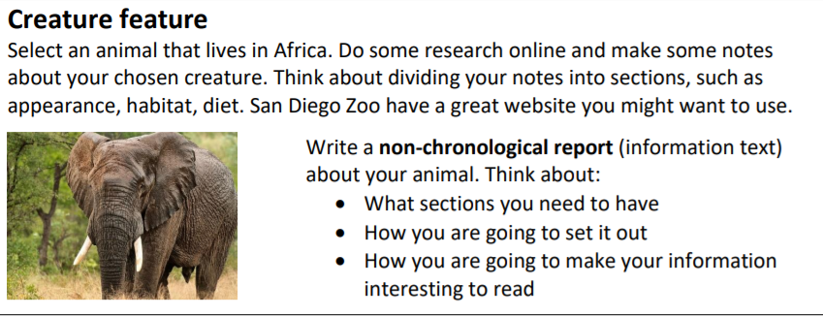
Non Chronological Report (Facts and information)
https://zoo.sandiegozoo.org/animals-plants

Slide 3
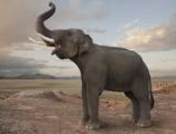
Vocabulary Mat
elephant mammal
trunk communicate
tusk protect
ears strength
eyes powerful
diet heavy
habitat elegant
appearance beautiful
special features tail

Slide 4
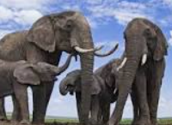
Elephants
What is an elephant’s appearance?:
These beautiful, graceful mammals have grey, wrinkled skin, long powerful trunks, white tusks, large, flappy ears and tiny eyes. Their legs are long and wide. When they plod through the plains of Africa, their immense weight, makes the ground vibrate which warns other animals of their presence. An elephant’s skin is tough and wrinkled due to long hours of sun exposure. Did you know that they flick mud and soil onto their backs using their trunks to protect their skin from getting sun burnt? Their very own sun cream! Elephants’ ears are cleverly designed to cool them down when they flap. Sadly, these elegant animals are hunted in certain parts of the world for their trunks which are made out of ivory. Ivory can be sold for a lot of money.
Habitat:

Slide 5
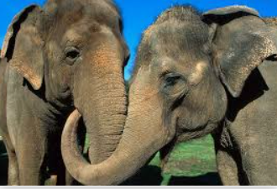
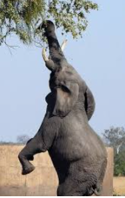
What Special Features do Elephants have?
An elephant’s trunk is extremely useful for many reasons. This long, powerful muscle can reach up high to pull leaves off the tallest of trees, it can rummage low down for food in the soil on the ground as well as being able to suck water up to drink. Pulling leaves and rummaging in the soil, are delicate movements however the trunk also has the ability to knock a tree down flat with it’s incredible strength! The trunk is a multi functional body part because it helps the elephant to eat, drink, act as a weapon and to communicate with others. It is also used to show love and affection to other members of the herd.
conjunctions in green adjectives in red prepositions of place in blue

