Slide 1

Starlings English Home Learning
Friday 8th January

Slide 2



Slide 3


Today you are learning to independently read Little Red Riding Hood and match sentences to pictures.
That means you will
Read sentences without a grown up’s help
Use your phonics skills to sound out words that are tricky
Understand what you have read by matching the sentence to the picture.

Slide 4
Before we get started, grown ups may need to help you with the different version of ‘a’ in this text font. It doesn’t look the same as the ‘a’ we see in RWI!
Now, let’s practise reading some common exception words that you will find in today’s text version of the Little Red Riding Hood story
have
little
was
come

Slide 5
Red words:
There
She
Little

Slide 6
Next, let’s look at some phonemes that we may find tricky
ck – you will find this in the word track
ear – you will find this in the word dear
ar – you will find this in the word farm
ee – you will find this in the word teeth

Slide 7
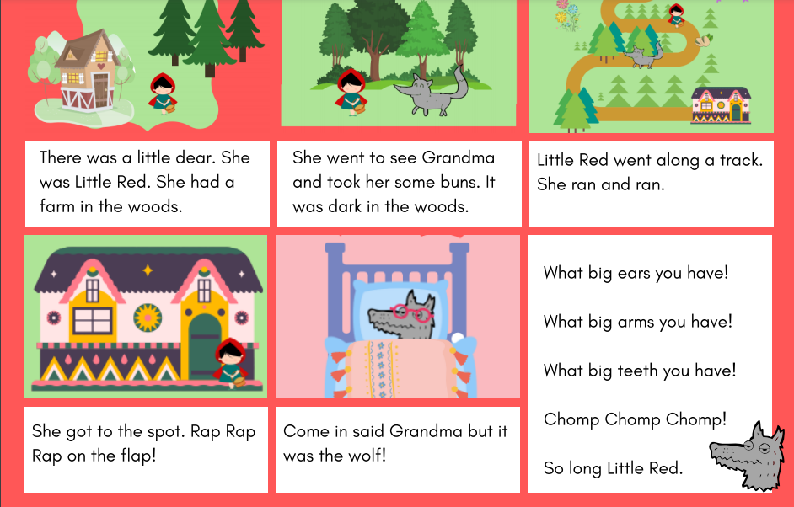

Slide 9
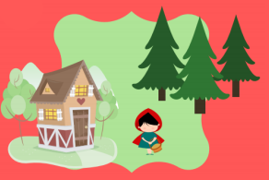
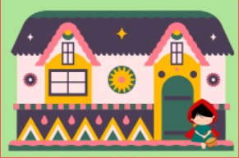
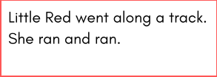
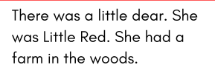
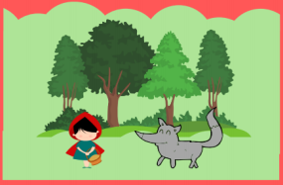
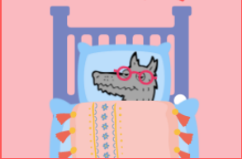
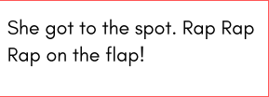
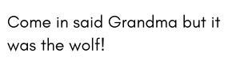
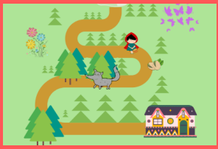
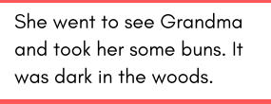

Slide 11
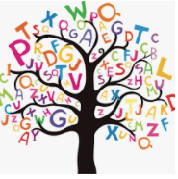
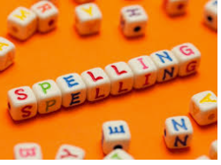


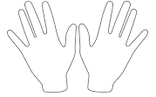
Words of the day!
tall call small
Can you write the word tall 5 times in your prettiest writing?
Can you write the word call 5 times with your eyes closed?
Can you write the word small 5 times using your other hand?

