Slide 1
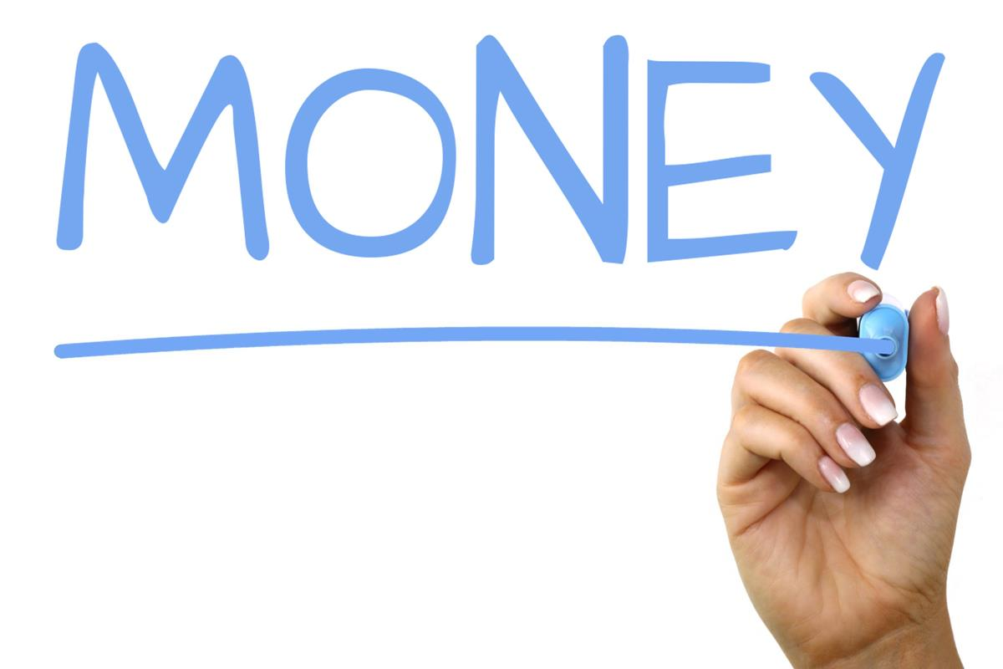
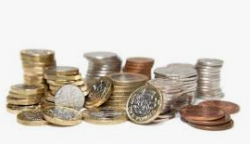


DAY THREE
Hello Starlings!
Today’s we are going to checking our understanding that a coin has a value which is independent of its size, shape, colour or mass.
You are going to play some games and complete some questions.

Slide 2
Can you play a guessing game where you have to guess what coin I’m describing (I am thinking of a coin. It’s silver, It’s about the same size as a penny. What coin is it?). See if you can play this game with someone in your house.
Can you complete the tasks on the next two pages to check your understanding?

Slide 3
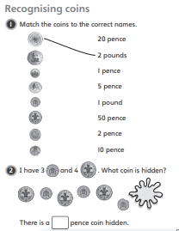
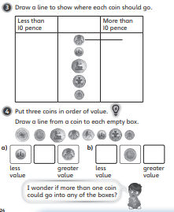

Slide 4

